Slide 1
Instructions for Detecting Sulfates using the Veris 3150
Product P1
Project 0-6362

Slide 2
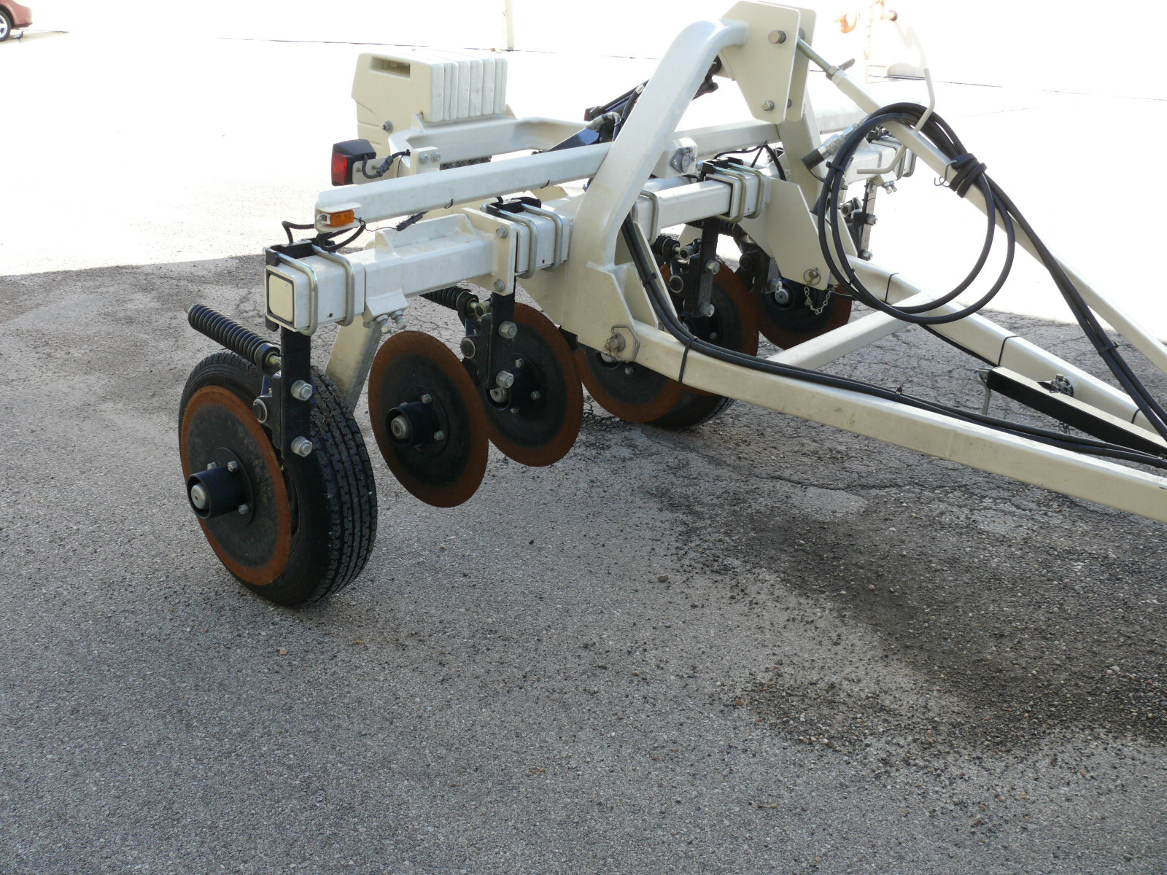
The following directions are for setting up the Veris 3150 Conductivity Device to collect data on a project with the data referenced to GPS coordinates.

Slide 3
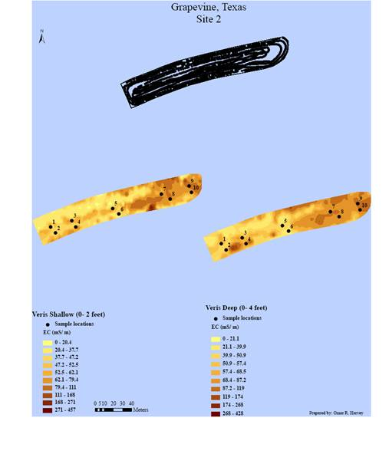
Conductivity Maps
The final product will be a map like the one shown here that gives the shallow (0-2 ft) and deep (0-4 ft) conductivity of a site.

Slide 4
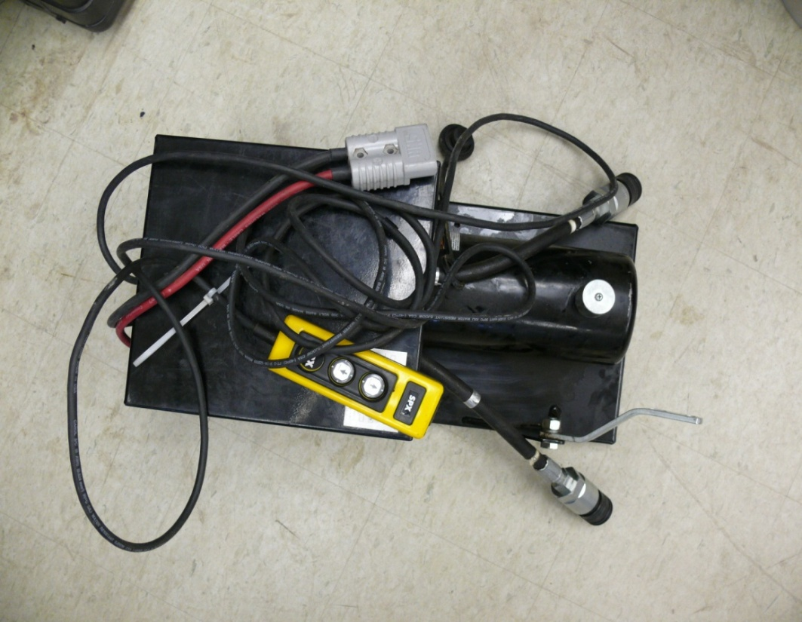
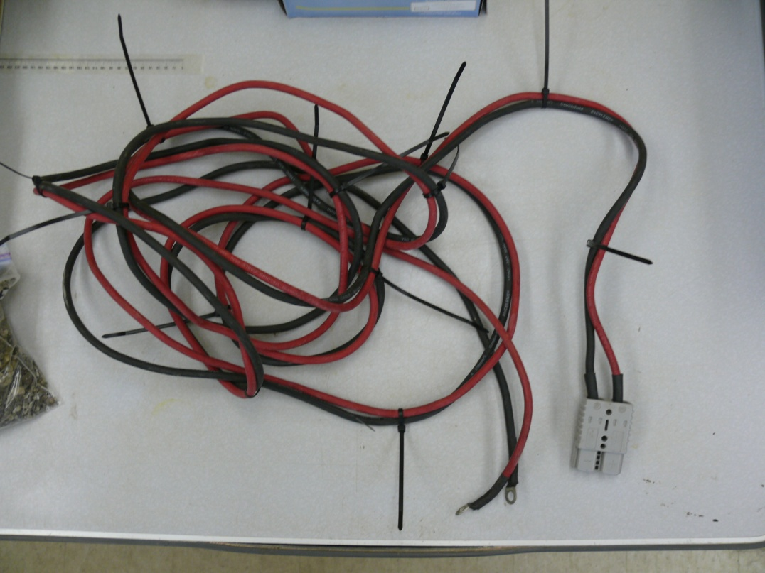
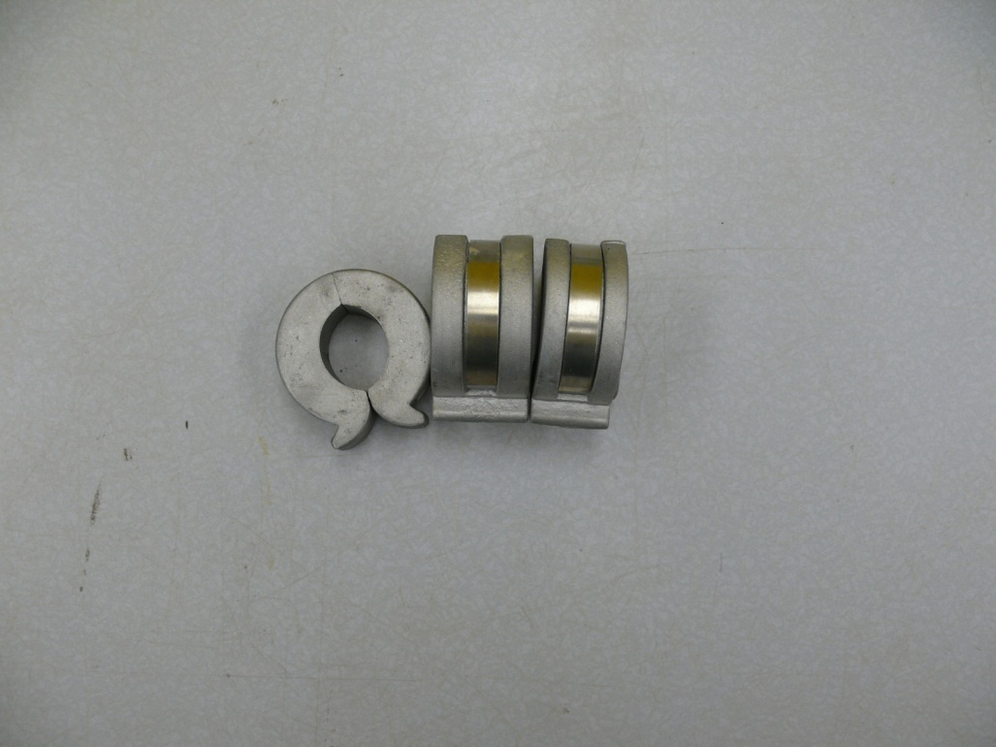
Hydraulic Power Unit
Equipment
The next three slides show the accessories
Attached to the Veris 3150 to collect the
Conductivity data.
20’ Power Cable for Hydraulic Power Unit
Hydraulic Cylinder Depth Collars

Slide 5
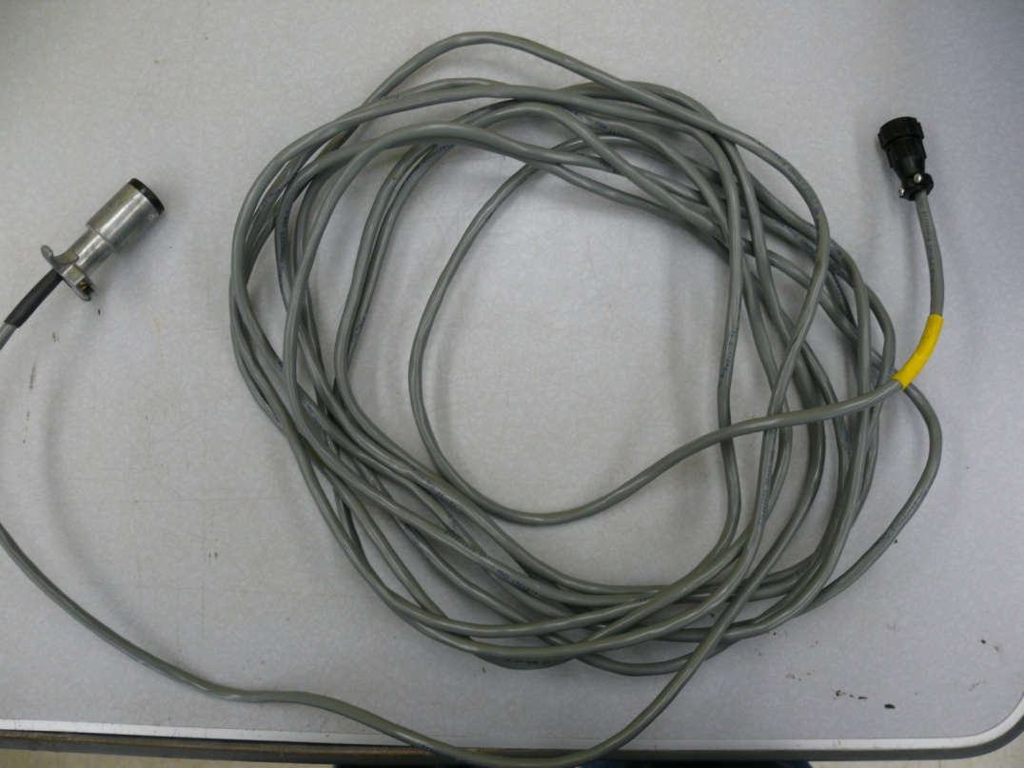
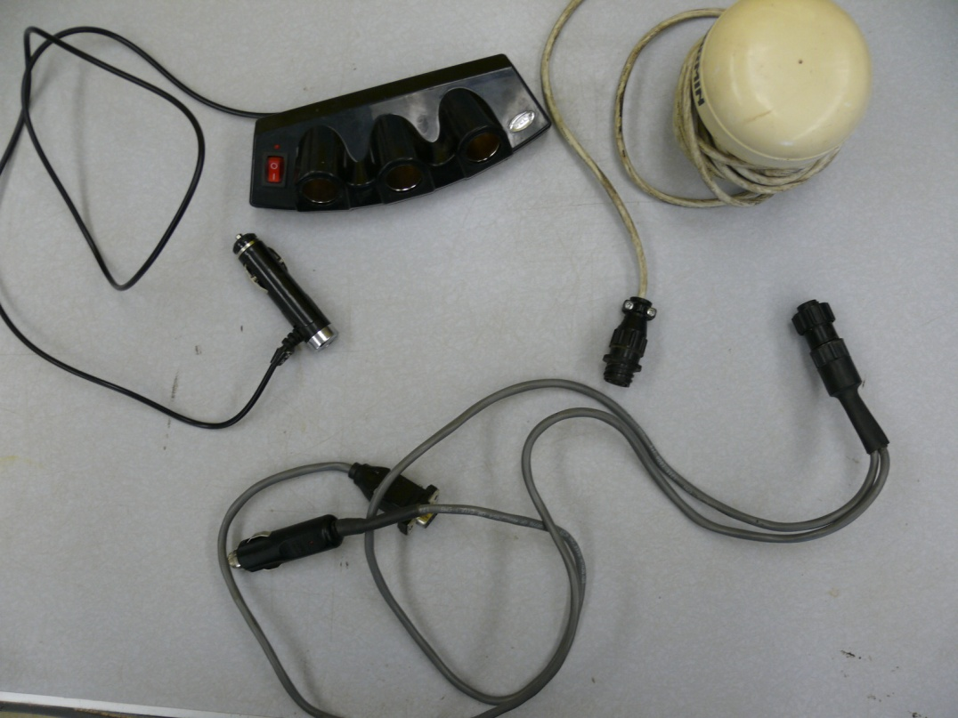
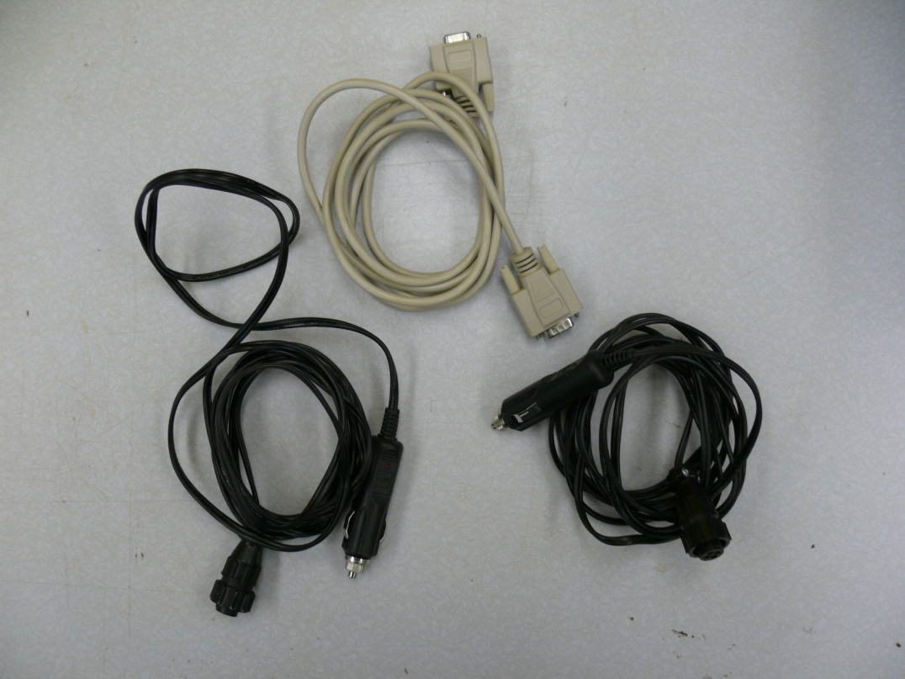
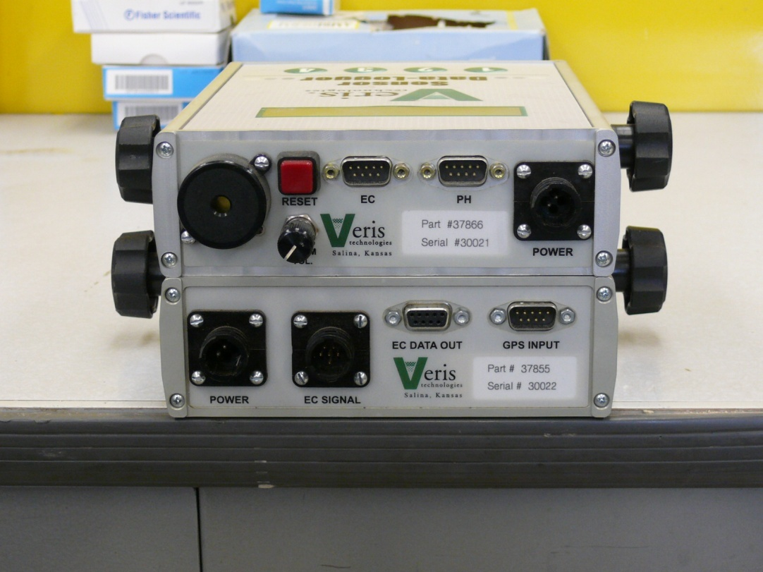
Electrical Conductivity (EC) Cable
GPS Antenna
3-way Power Splitter
GPS Connector Cable
Serial Cable
Data Logger Rear
Power Cords EC Surveyor and Data Logger
EC Surveyor Rear

Slide 6
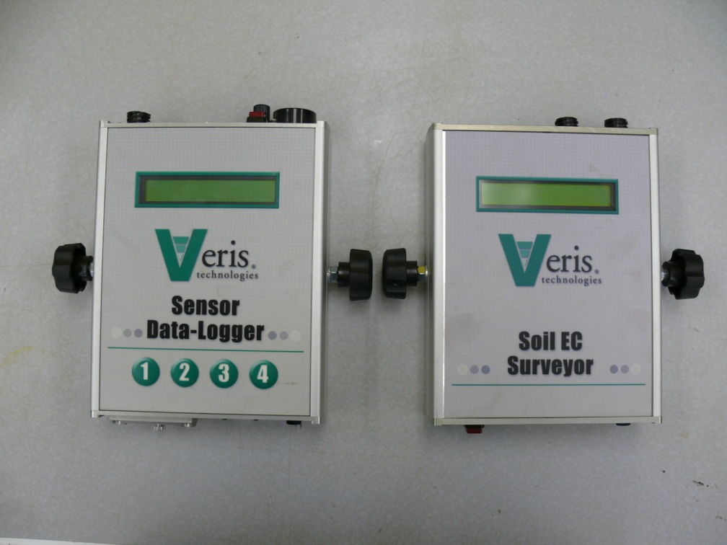
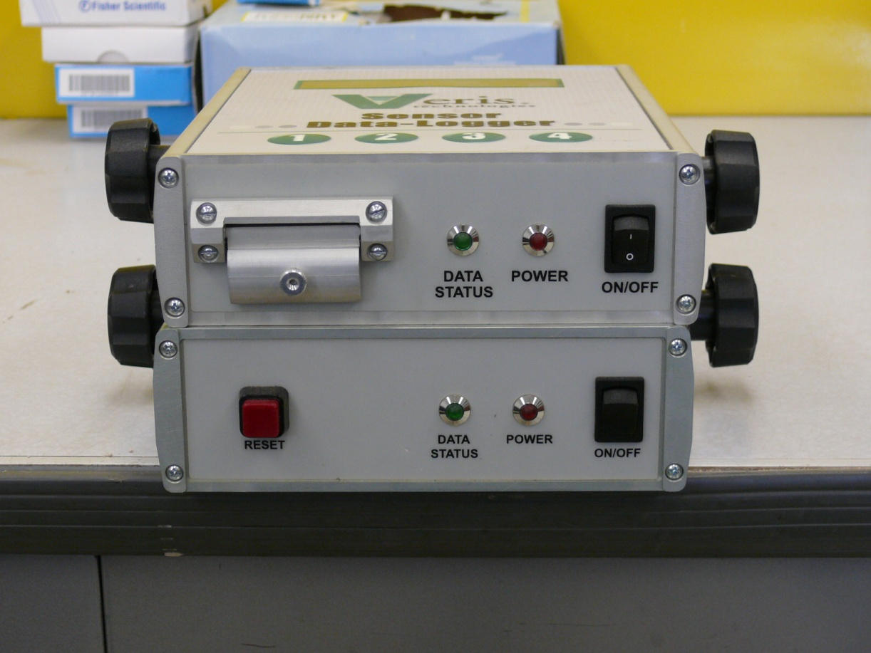
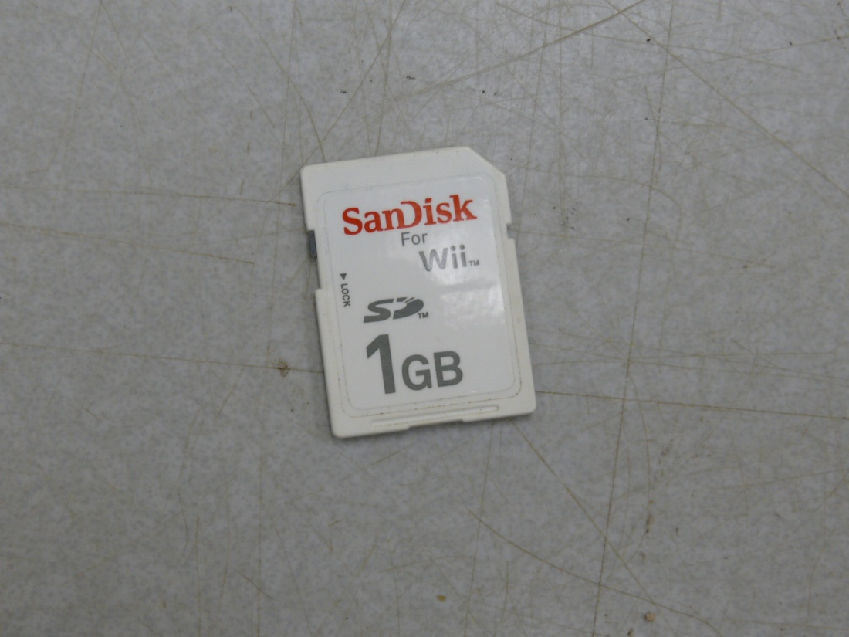
Data Logger Box
Data Logger Front
EC Surveyor Box
EC Surveyor Front
SD Data Storage Card

Slide 7
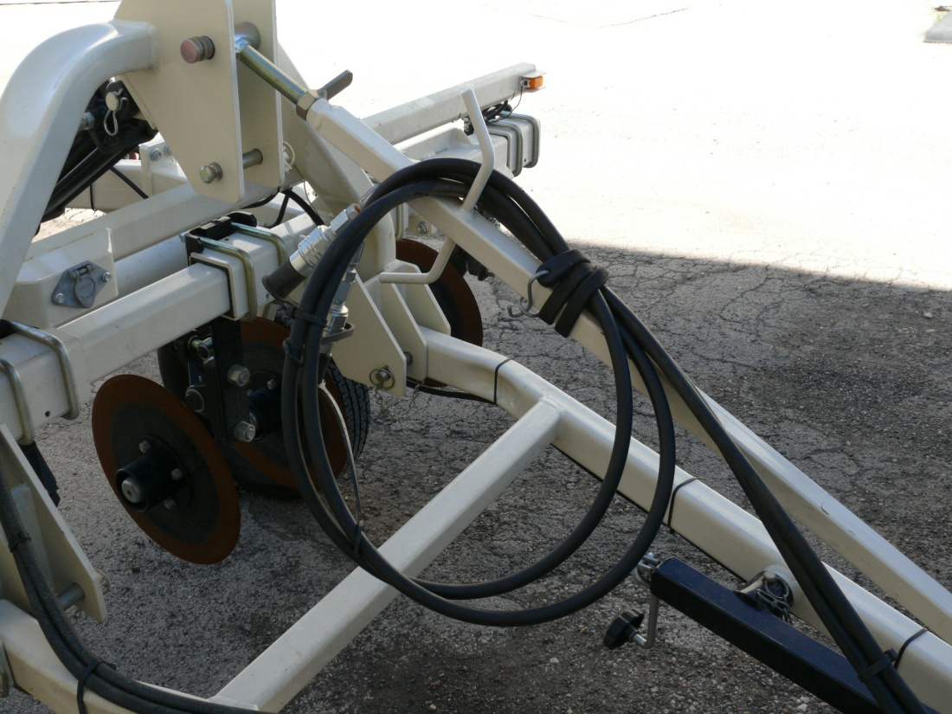
Readying the Veris for use
1
Make sure the tongue of the Veris 3150 is attached to a trailer hitch on whatever vehicle that will be used to tow the instrument (Fig 1) Alternatively—the Veris may be attached to a tractor
Remove the hydraulic lines from the storage/towing position (Fig 2) Alternatively—the hydraulic lines may be attached to the hydraulic system on a tractor
2

Slide 8
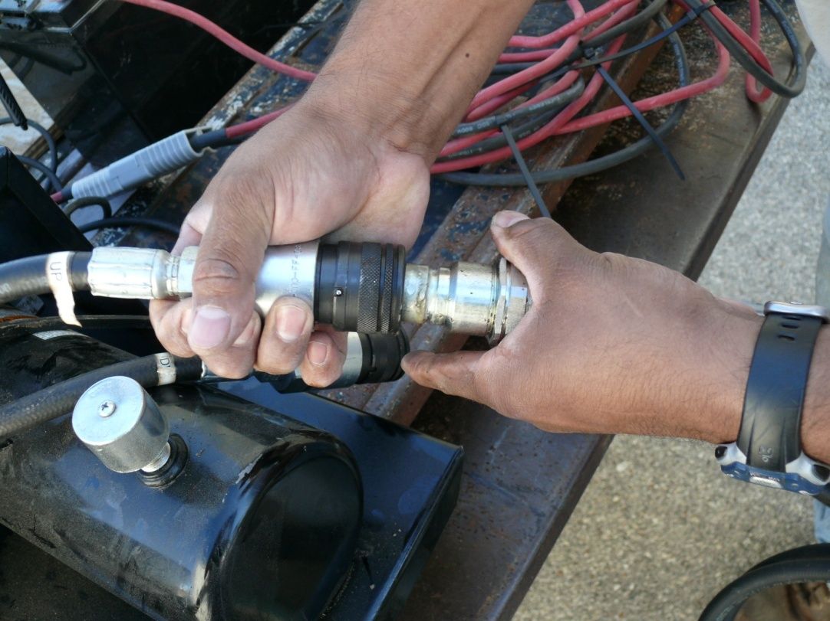
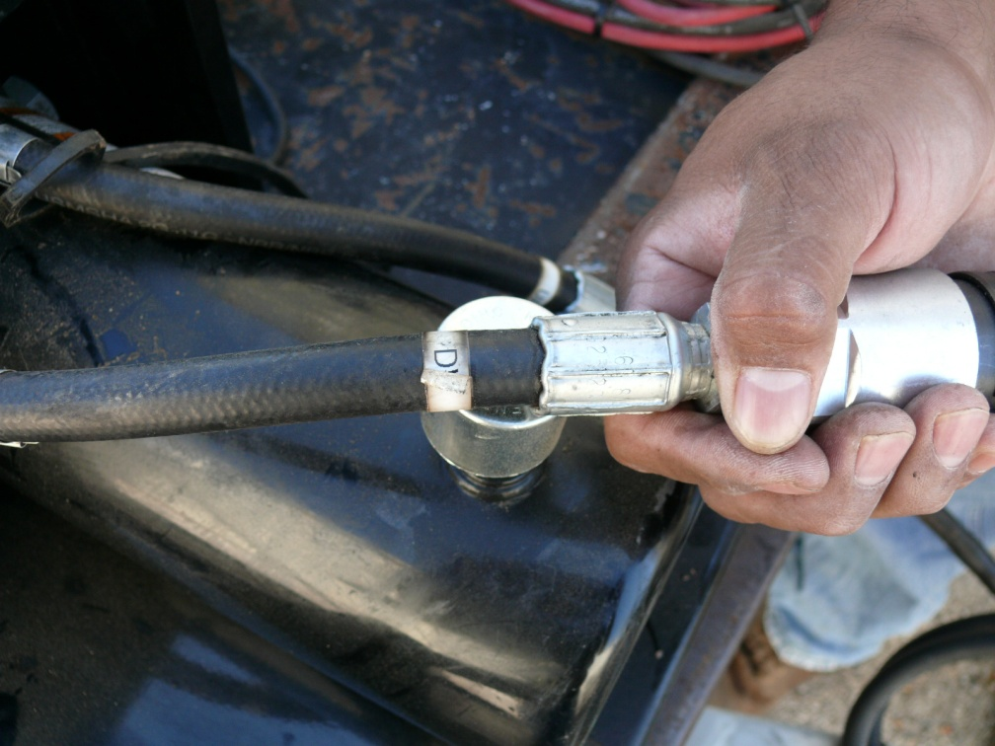
Connecting Hydraulic lines
1
Select the hydraulic quick connect labeled UP on the Hydraulic power unit (Fig 1) and attach the hydraulic quick connect labeled UP from the Veris (Fig 2).
The lines should connect by compressing the male end of the Veris connector to the female end of the hydraulic power unit (Fig 2).
Make the same connections with the lines labeled Down (Fig 3).
2
3

Slide 9
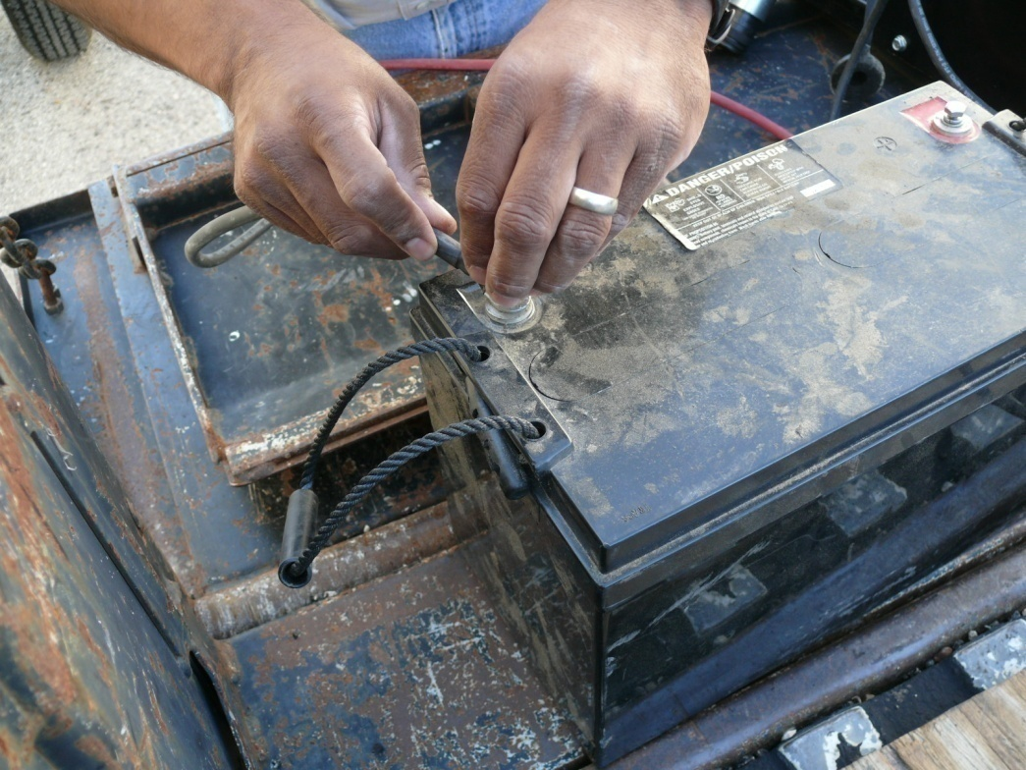
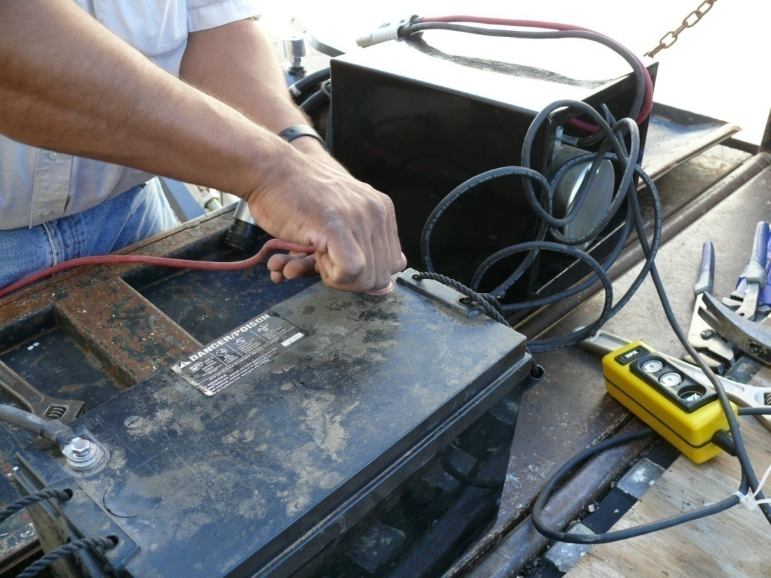
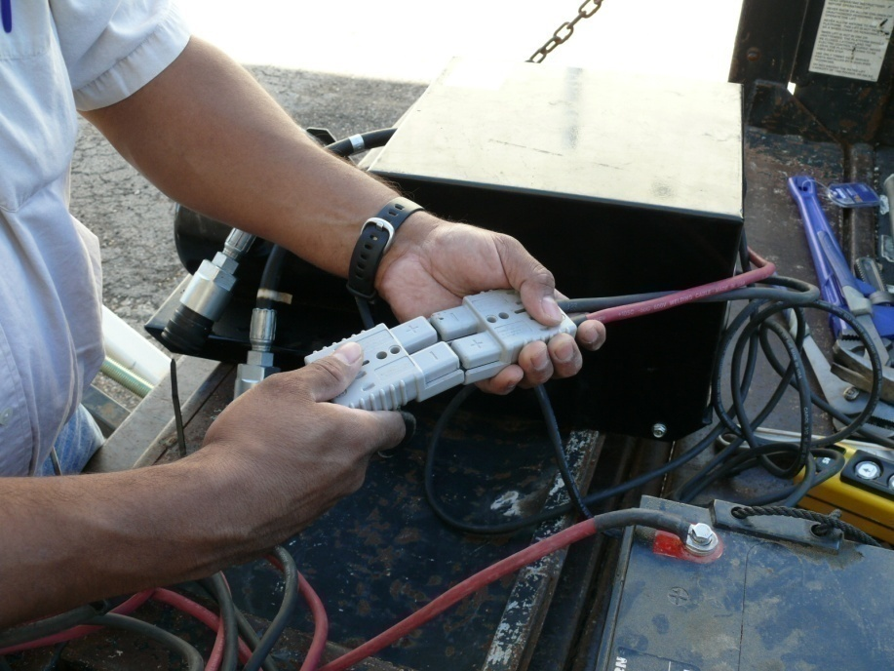
Attaching Hydraulic Pump to power supply
1
Select the 20 ft red and black cables with the gray connector (Fig 1) and attach the ground (black) and hot (red) cables to the (-) and (+) battery terminals respectively (Figs 2&3)
Align the positive and negative ends of the gray connector on the hydraulic pump to the gray connector attached to the battery and connect (Fig 4)
2
3
4

Slide 10
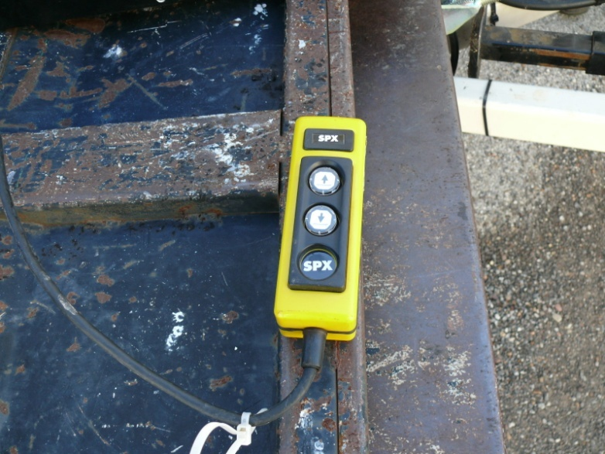
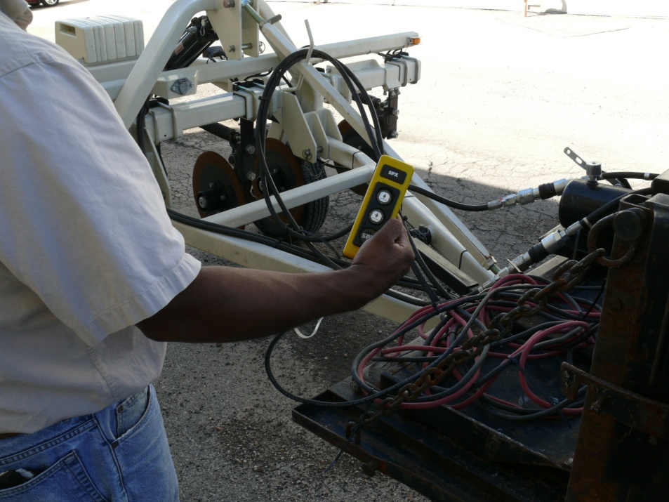
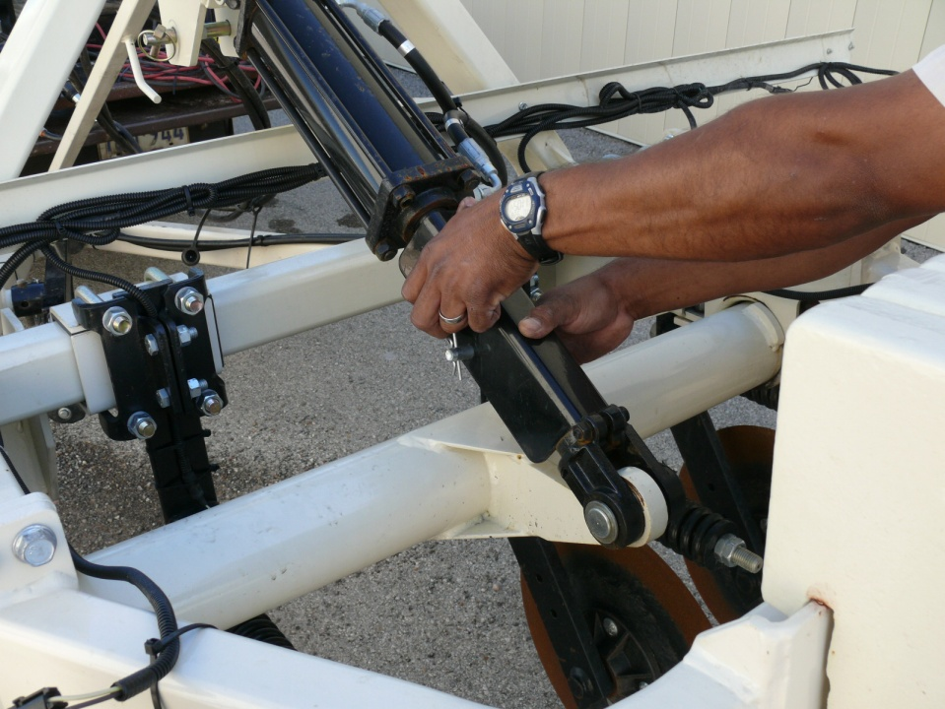
Readying Veris by removing Transport Lock
1
2
3
4
Use the yellow controller (Fig 1) that is connected to the hydraulic power unit (Fig 2) to raise the Coulters (Fig 3) slightly to release pressure on the transport lock (Fig 4) that is used during transport and storage

Slide 11
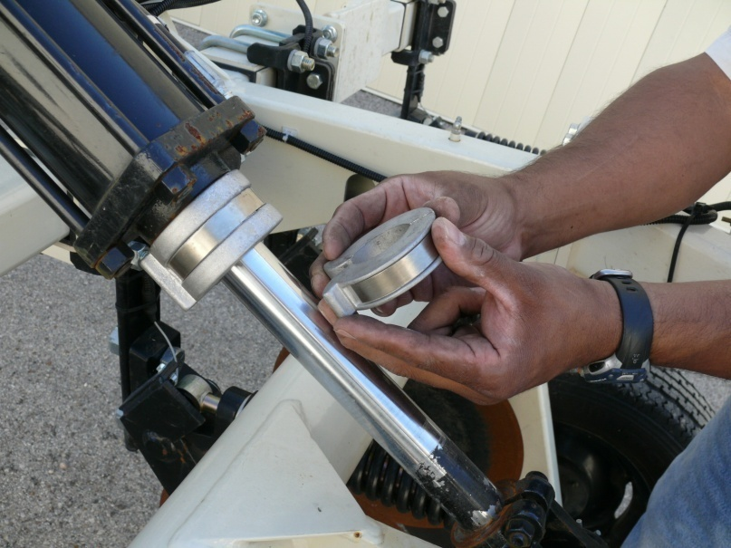
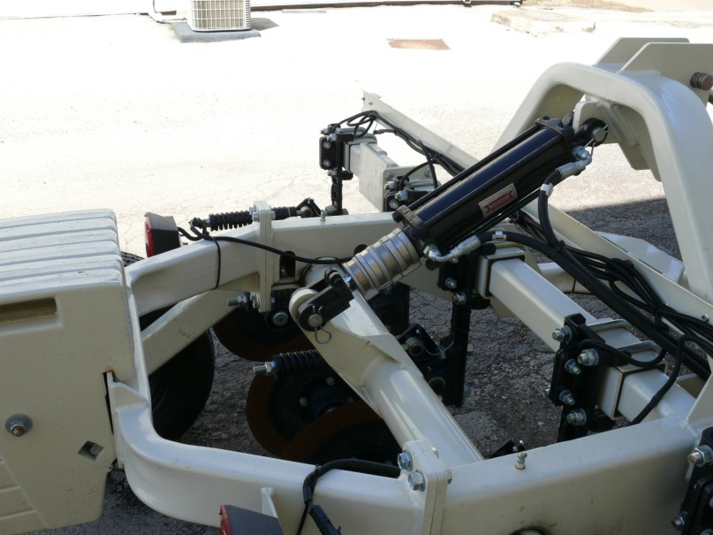
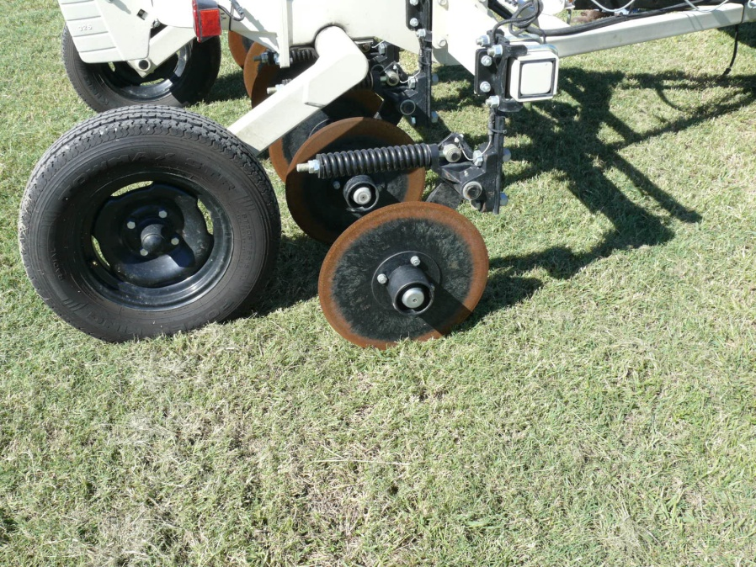
Adjusting Hydraulics for Coulter placement
1
2
3
4
Pull the pin on hydraulic cylinder transport lock and remove the transport lock (Fig 1) Place the depth collars on the hydraulic cylinder (Fig 2) and lower the hydraulic cylinder so that the depth collars almost touching both ends (Fig 3) of the cylinder. Note: There are 4 depth collars included, only use the number of collars needed for the desired penetration depth of the coulters (Fig 4) into the ground. (You need at least 1 inch of coulter penetration depth in the ground, maybe more in rough or very dry ground)

Slide 12
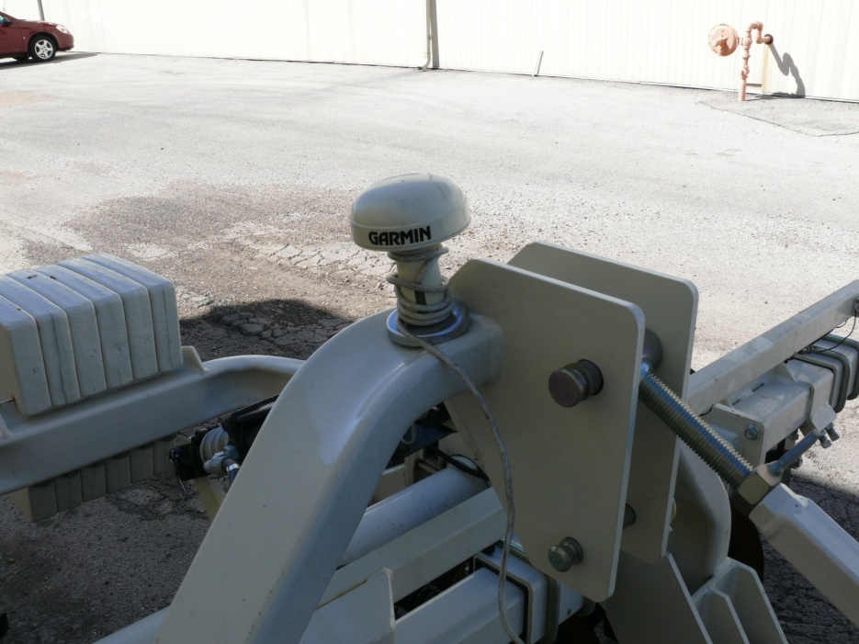
Attaching GPS
1
GPS Antenna
Take the Garmin GPS antenna (Fig 1) and unwrap the cable so that it extends far enough to reach the 3-way power splitter attachment to the power supply (Figs 1&3).
Then place the GPS antenna on the Veris 3150 directly over the coulters (Fig 2).
3-way Power Splitter
2
GPS Connector Cable
2
3

Slide 13
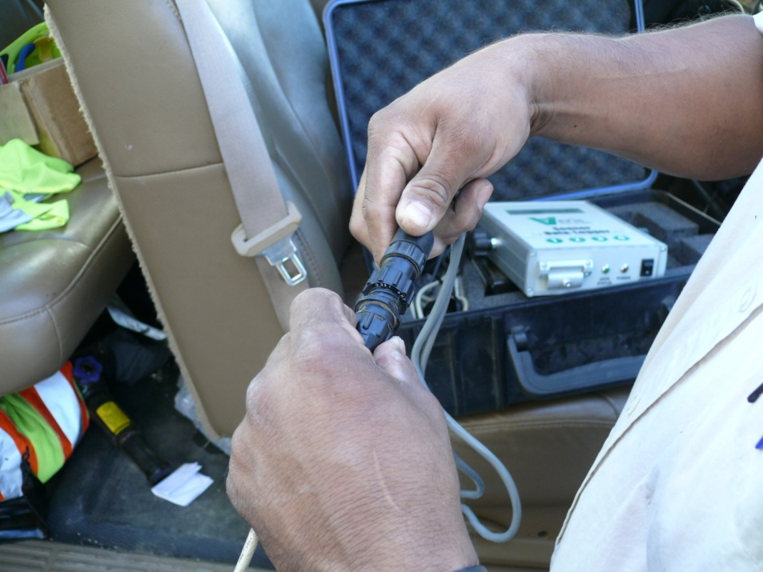
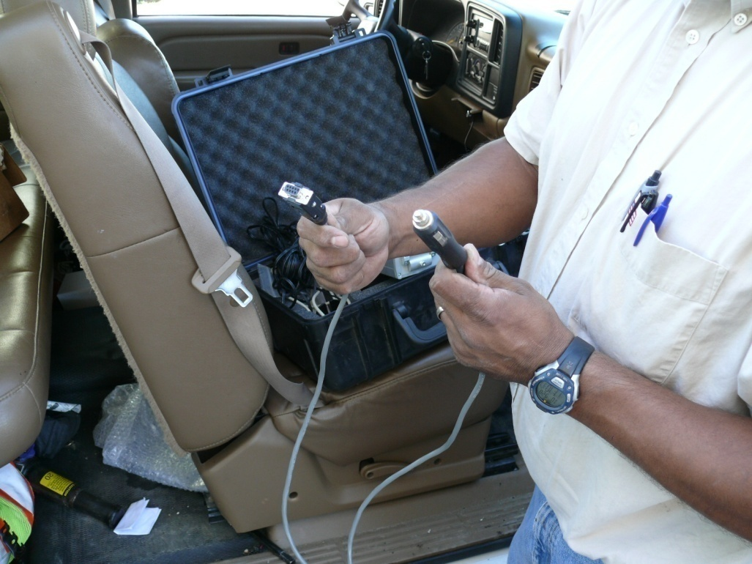
GPS Connections
1
Connect the GPS connector cable to the GPS antenna cable (Fig 1).
Connect one end of GPS connector cable (Fig 2) to 3-way power splitter and other end of GPS connector cable to the GPS input on the rear of the EC Surveyor box (Fig 3 arrow).
2
3
Data Logger Rear
EC Surveyor Rear

Slide 14
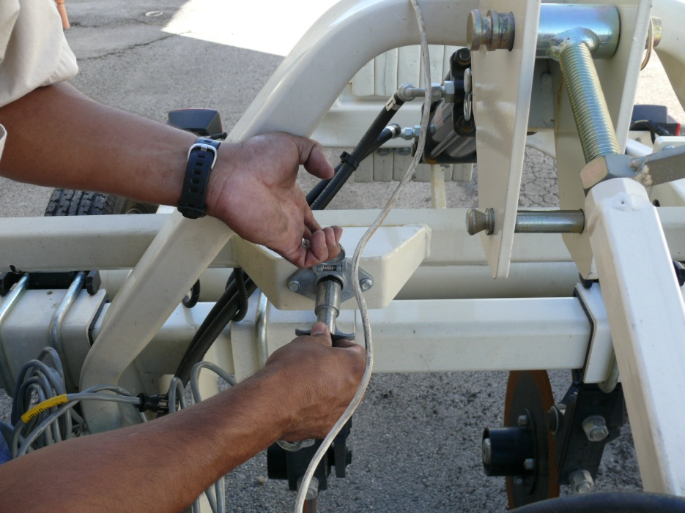
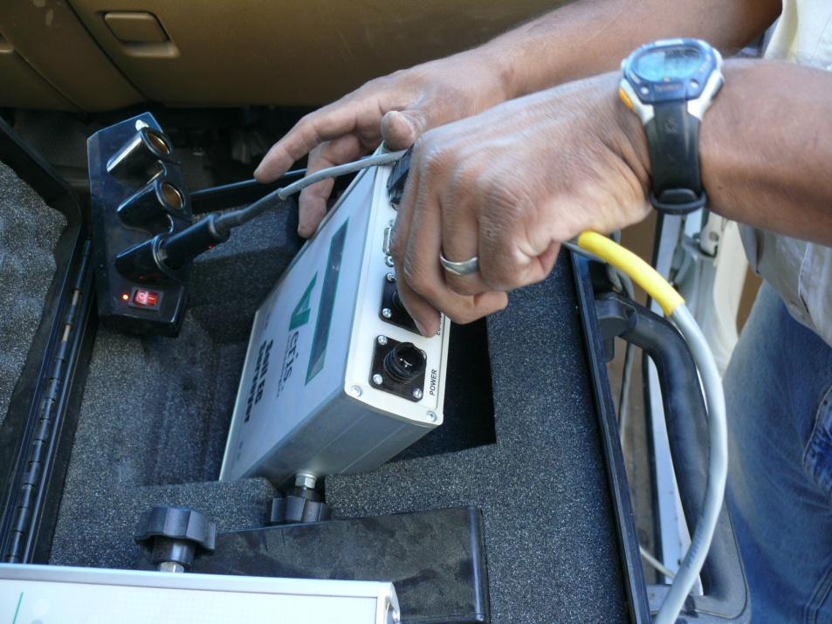
Establish Communication between EC Surveyor and Veris
1
3
2
Data Logger Rear
EC Surveyor Rear
4
Connect the metal plug on the EC Cable to the female outlet on the Veris (Figs 1&2) feed the cable along the same route as the GPS cable and connect the other end (yellow label on cable entitled EC Cable) of the EC cable to the EC signal port at the rear of the EC Surveyor box (Figs 3&4).

Slide 15
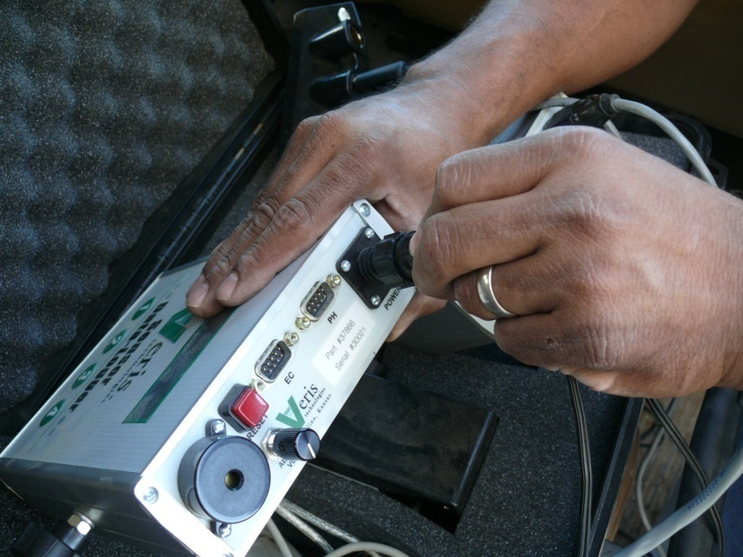
Power up EC Surveyor and Data Logger
2
Attach one black power cord to the rear of the EC Surveyor (Fig 2) and to the 3-way power splitter (Fig 1).
Attach the other black power cord to the rear of the Data Logger (Figs 2&3) and to the 3-way power splitter (Fig 1).
Data Logger Rear
1
EC Surveyor Rear
3

Slide 16
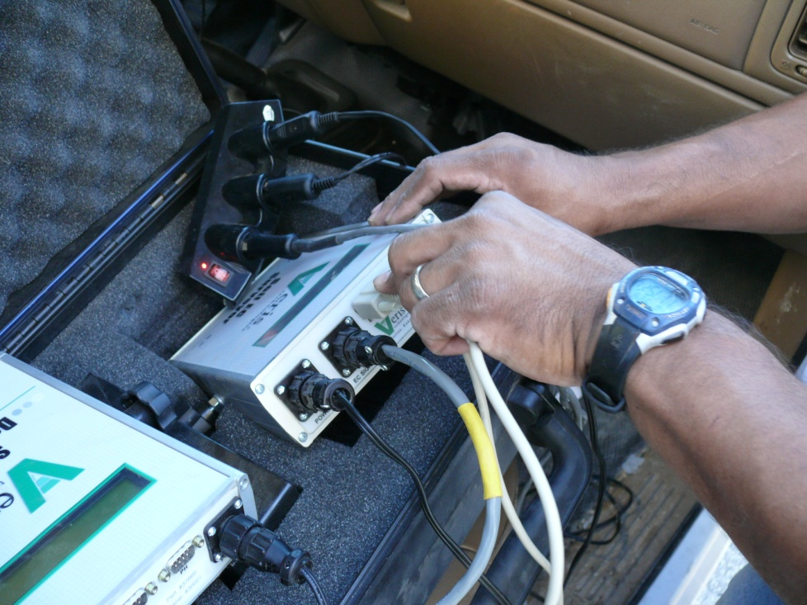
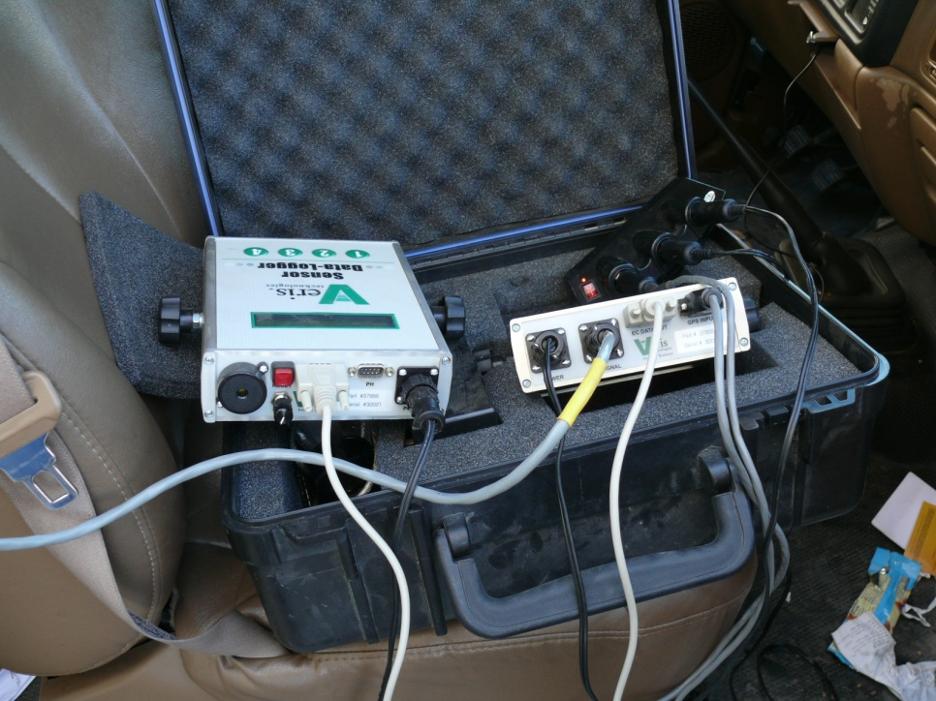
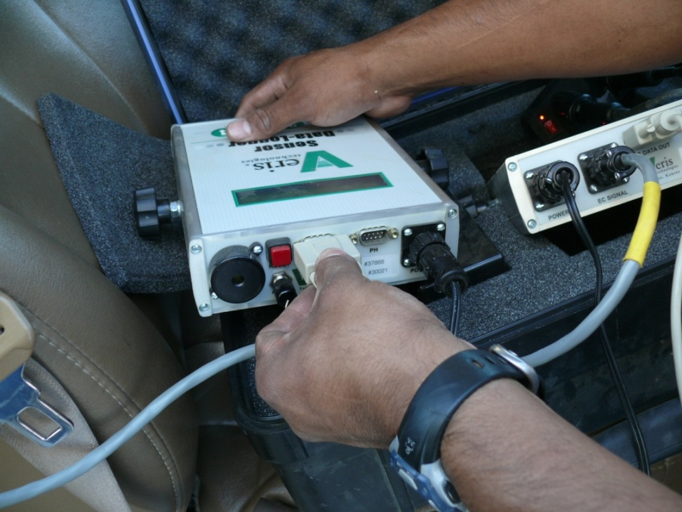
Connecting EC Surveyor to Data Logger
1
2
Take the serial cable (Fig 1) and attach it to the rear of the EC Surveyor (Fig 2).
Attach the other end of the Serial Cable to the rear of the Data Logger (Fig 3).
When all connections are made the rear of the Data Logger and EC Surveyor should look like Fig 4.
4
3

Slide 17
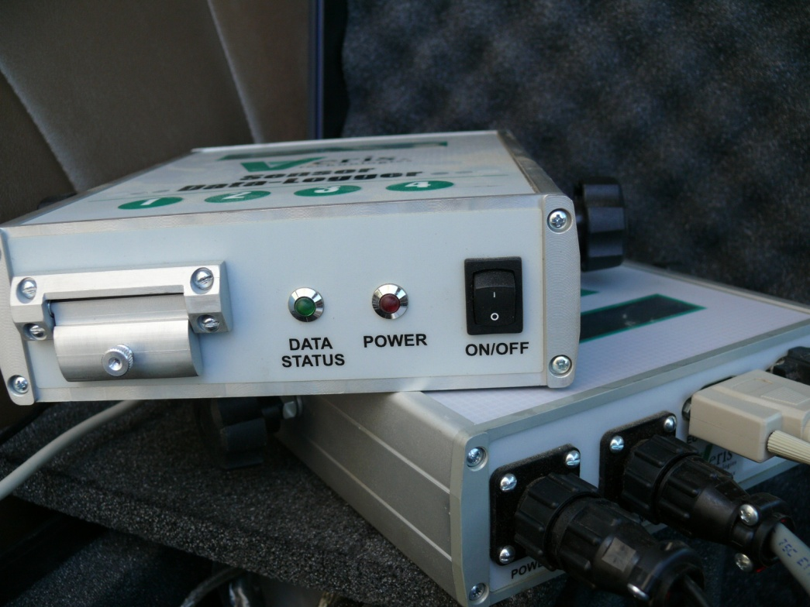
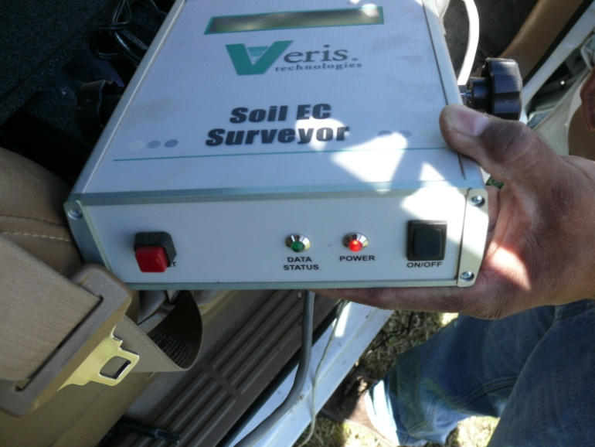
Power up the Veris
1
Make sure that the SD data storage card is inserted in the Data Logger (red arrow Fig 1). Note: if SD data storage card is absent, then no data will be recorded.
Turn power on to Data Logger and EC Surveyor (Figs 2&3). Note: red LED should illuminate when power is on.
2
3

Slide 18
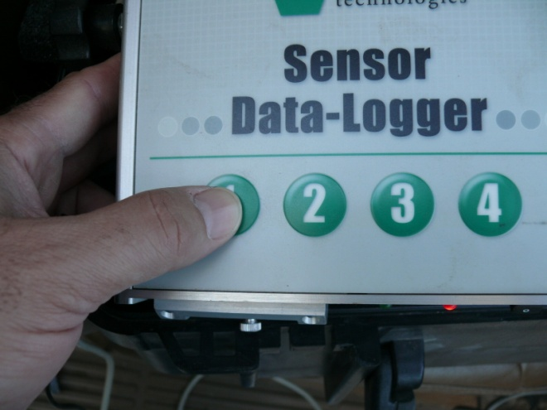
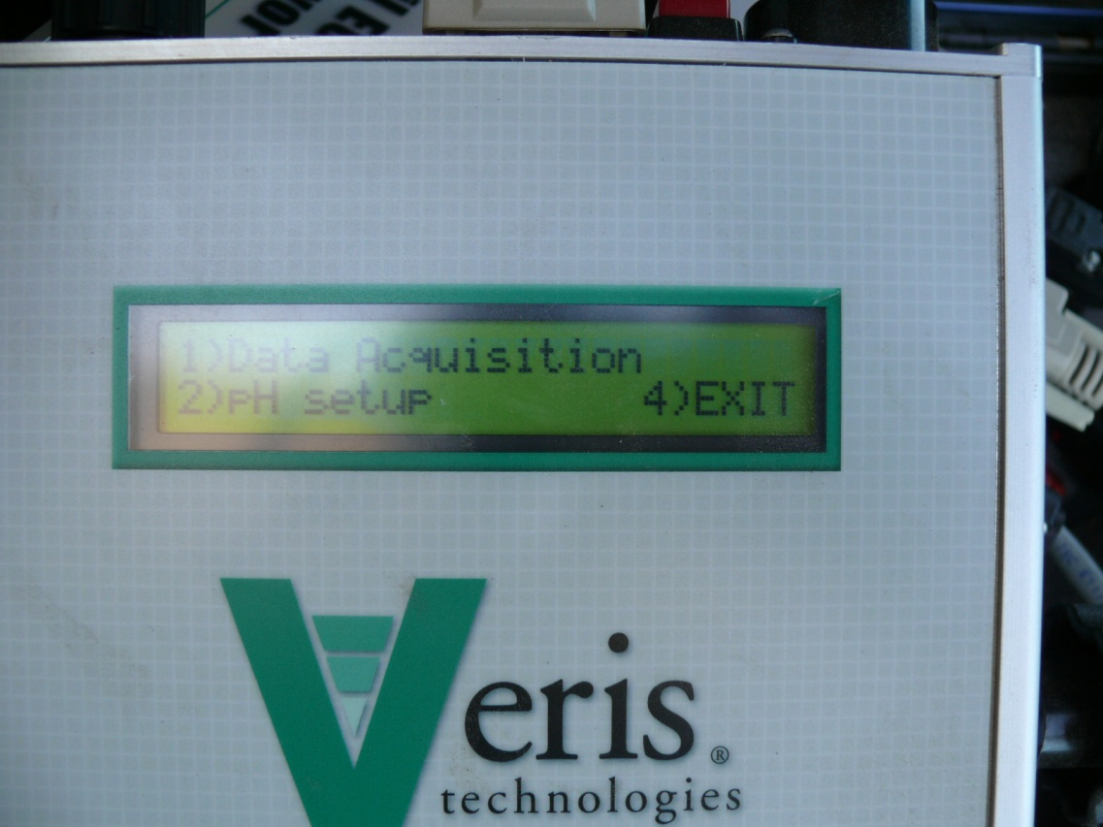
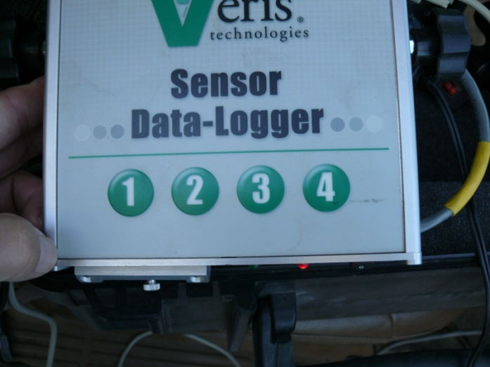
Data Collection Setup
1
When data Logger and EC Surveyor are turned on the following screen will appear on Data Logger (Fig 1).
Press any key labeled 1, 2, 3, 4 (Fig 2).
After any key is pressed the screen in Fig 3 appears. We want to Press 1 for Data Acquisition (Fig 4).
4
3
2

Slide 19
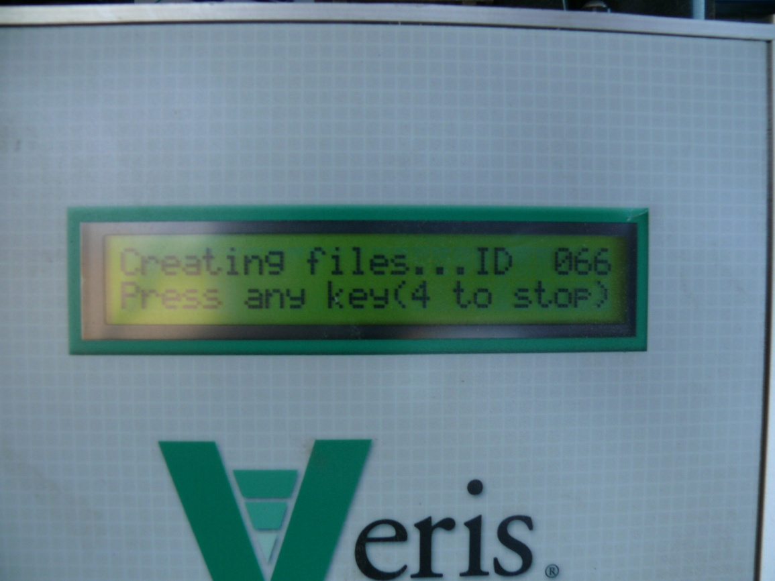
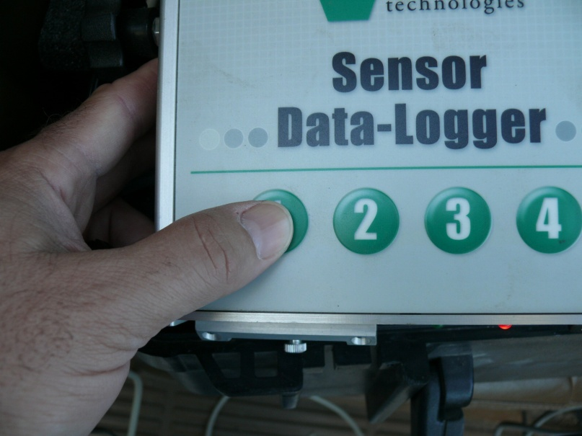
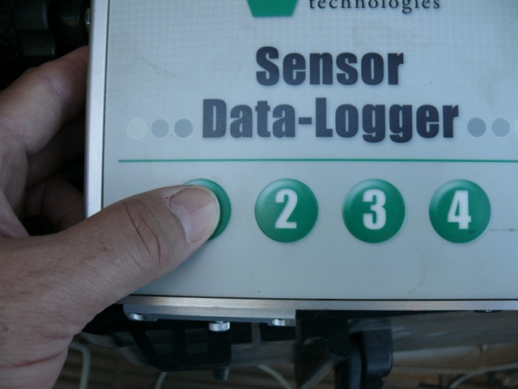
Data Collection Setup (Cont.)
1
3
2
4
The screen shown in Fig 1 will appear, we want to measure EC so Press “1” (Fig 2) and the screen shown in Fig 3 will appear. Imp.—Record the ID “066” that is the file name that will be given to the data you are about to collect. At this point you can push any button except “4” to begin data collection. I chose to press “1” again (Fig 4).

Slide 20
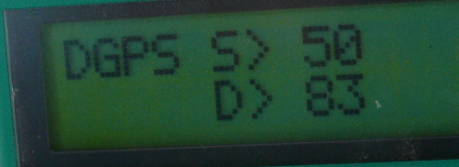
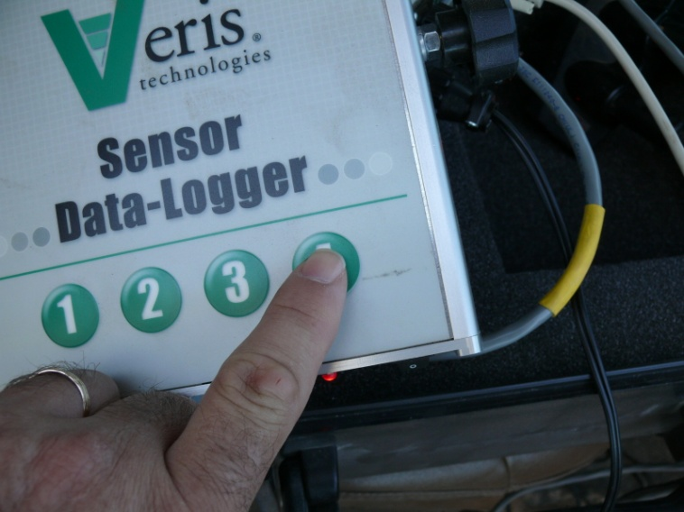
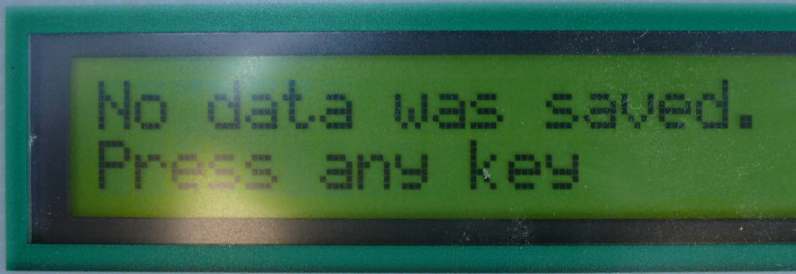
Data Collection
1
2
3
4
Fig 1 shows the signal from the Veris. The DGPS shows that we are recording GPS, (if there is not a DGPS listed, then no GPS signal is received and will not be recorded. The S stands for shallow conductivity and D stands for deep conductivity. When you are finished collecting data hit the “4” key to stop recording you will then get the message shown in Fig 3. If you get the message shown in Fig 4, then the data are not saved and you would need to do the test over.

Slide 21
Instrument Shutdown
1
After data are recorded and you press any key “1”, “2”, “3”, or “4” the message shown in Fig 1 will appear. You can then shut down power and break down the instrument if you are finished collecting data.

Slide 22
Data Retrieval
1
2
Once you have shut down the instrument, you need to take the SD card from the Data Logger (Figs 1&2) and connect it to your computer for processing.

Slide 23
Data Processing
Data processing can be done using Microsoft Excel with any spatial interpolation software. The steps described here are specific for the “Surfer 9” software (Golden Software Inc.).
Step 1: Preparing the data for processing (Pre-processing)
Three aspects:
Retrieving/importing data
Combining and labeling data
Removal/exclusion of anomalous data
Step 1a: Retrieving/importing data
Insert SD card into the SD drive on the computer (Fig. 1) and navigate to the data files (if necessary).
Files names are of the form “VSEC0” plus 3 numbers (e.g. VSEC0066). The 3 numbers represent the file ID (mentioned in slide 19). Data is stored in the “.dat” file format and can be opened directly in Microsoft Excel.
One or more data files can be viewed by “selecting” the files, “right click” the mouse and selecting “open” (Figure 2).

Slide 24
Step 1b: Combining and labeling data
We recommend that data be collected as single longitudinal transects (3 - 4 transects across a two lane road) along the area of interest.
During pre-processing, data from all transects should be combined into a single data file. To do this copy and paste data for all transects (end to end) into a single Excel sheet.
The new Excel sheet should also have 5 columns. Label the columns as: X-location, Y-location, EC_SH, EC_DP and ELEV_ft, respectively.
X- and Y- location are the GIS locations;
EC_SH and EC_DP are electrical conductivity readings to a depth of 2 and 4 feet, respectively;
ELEV_ft is the elevation in feet.

Slide 25
Step 1c: Removal/exclusion of anomalous data
Anomalous data may be in the form of zero or negative values. It is recommended that these values be removed.
To remove these values:
Select the row(s) (hold down on Ctrl key for multiple selections), right click the mouse and choose Delete
NB: After removing anomalous data, make sure to save the combined as an Excel (.xls or .xlsx) file, not .dat
CONGRATS YOUR DATA IS READY TO BE PROCESSED!!!

Slide 26
Step 2: Data processing/analysis
The objective of data processing is to obtain an insight into how soil EC vary spatially. Any spatial analysis software can be used for processing and data analysis.
Here, we describe data processing using the Surfer 9 software.
Two types of maps are typically required. A post map (which shows the location of data points across the study area) and a contour map (which shows areas of different electrical conductivity).

Slide 27
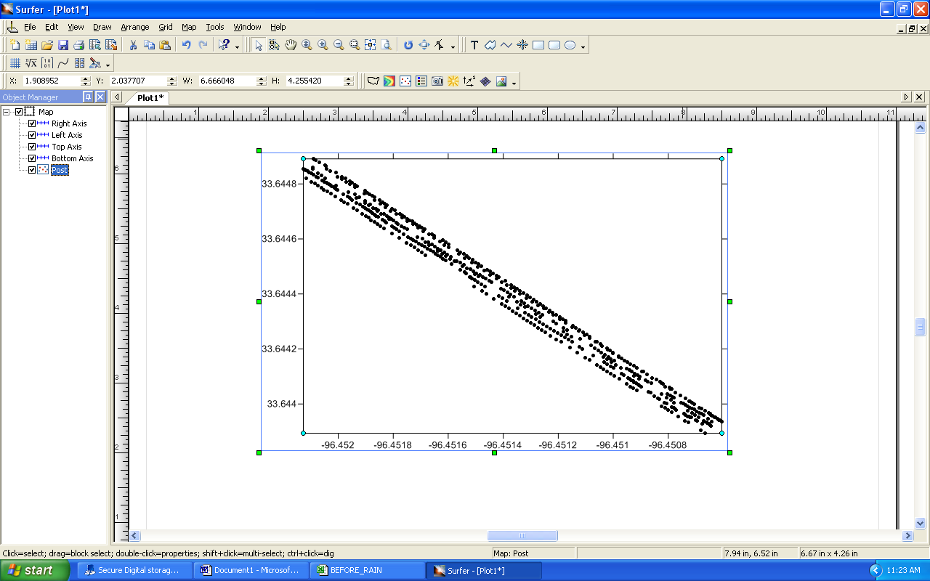
Creating a post map
Open Surfer 9
Click Map >> New >> Post Map
Select appropriate file – here the appropriate file refers to the saved Excel file from Slide 25.
Great your post map should show up as a series of points along different transects.

Slide 28
Creating a contour map
Click Grid >> Data
Select appropriate data (see Slide 25)
In the “Grid Data” window check to ensure the following matches:
X: X-location
Y: Y-location
Z: EC_SH (if interested in 0-2ft depth) or EC_DP (otherwise)
Gridding Method should be “Inverse Distance to a Power”
Changing the Output Grid File name is optional. The default is usually the name of the input excel file.
Click OK

Slide 29
Creating a contour map (cont’d)
Click Map >> Add >> Contour Layer
Select grid (from Slide 28)

Slide 30
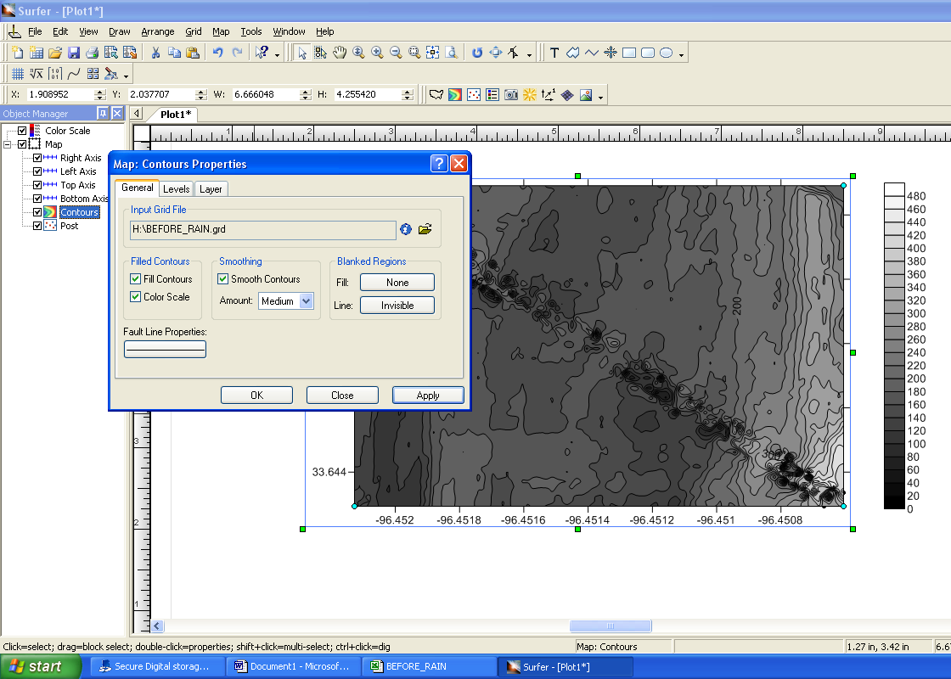
The final contour map should show filled contour areas of different shades and a color scale (see below).
If the map does not show these features, click on Contours (in the “Object Manager” window), then the General tab (in the “Map: Contours Properties” window). Make sure Fill Contours and Color Scale are selected.
Note: Map is only valid within the extent of the data.

