Slide 1
Technology Readiness Level (TRL) Scale
How do we determine when a research solution is ready to help us solve a transportation challenge?
Technology Readiness Level (TRL scale)
Using this assessment tool throughout the
life of a research project can help us in a lot of vital ways.

Slide 2
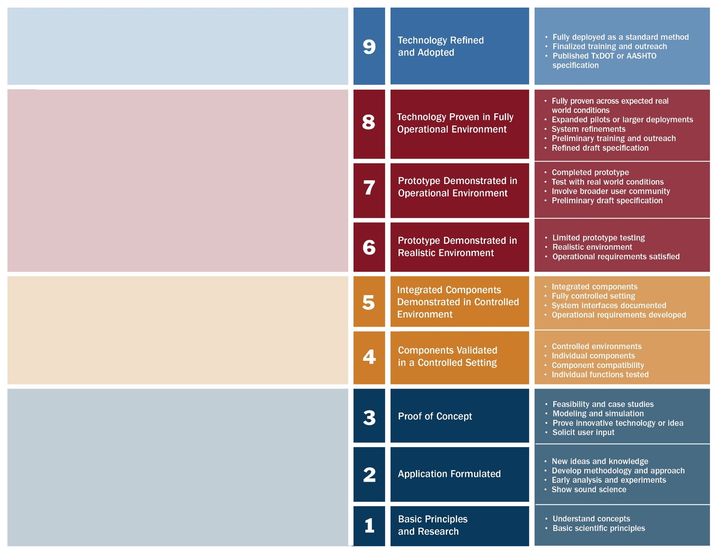
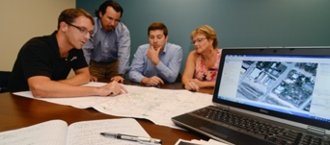
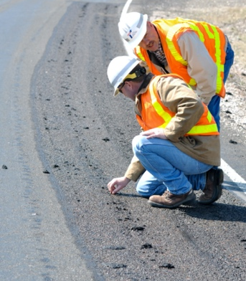
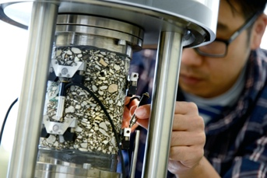
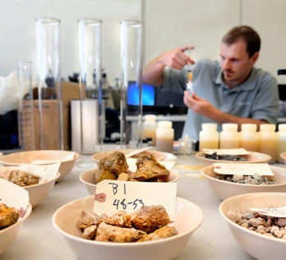
Technology Readiness Level (TRL) Scale
IMPLEMENTATION
DEVELOPMENT
APPLIED RESEARCH
BASIC RESEARCH

Slide 3
Technology Readiness Level (TRL) Scale
IMPLEMENTATION

Slide 4
Technology Readiness Level (TRL) Scale
DEVELOPMENT

Slide 5
Technology Readiness Level (TRL) Scale
APPLIED RESEARCH

Slide 6
Technology Readiness Level (TRL) Scale
BASIC RESEARCH

