Slide 1
North Region ROW Tool Implementation Workshop
August 2, 2010
Dallas District Office
Notes:
Welcome to the North Region ROW Tool Workshop. This workshop is funded under an implementation project sponsored by TxDOT’s Research & Technology Implementation Office (RTI). This is the second of four regional workshops being planned for this summer. One workshop is being planned in each TxDOT region.
Ron Hagquist of the Strategic Policy and Performance Measurement office is the project director overseeing this project.

Slide 2
Welcome and Introductions
Notes:
The first thing I like to do is be sure everyone is introduced. I will start the process, and then let everyone introduce themselves. I am ….

Slide 3
Workshop Objectives
Introduce two new ROW acquisition software tools (TAMSIM and EROW) to additional district ROW personnel in region
Share analysis of parcel acquisition possibilities for a Dallas District project
Obtain feedback on tools from district ROW personnel
Notes:
We have several objectives in mind for these workshops. First, it’s our desire to familiarize ROW personnel in the districts with the new tools that were developed. There are two of them, TAMSIM and EROW.
Second, as we have gathered actual project and parcel data from a district in each region, which we have been analyzing using these tools, we are using these workshops to share our analyses. Hopefully, these analyses will assist the ROW offices in these districts to better strategize acquisition activities.
Last, we need your input, comments, and suggestions. We will closeout the workshop with an opportunity for you to tell us what you think. And we welcome you to contact us later should additional thoughts come to mind.

Slide 4
Tool Capabilities
TAMSIM
  Determine Maximum Benefits on a Single Project
  Determine Parcel Priorities within a Project
  Determine Comparative Benefits from Various Parcel Selection Scenarios (Input Data Files for EROW)
EROW
  Determine Optimal Early Acquisition Budget Amount for Multiple Projects
  Determine Optimal Use of a Given Early Acquisition Budget
Notes:
We have handed out a document entitled Procedure for Use of TAMSIM and EROW Tools for ROW-Acquisition Planning. It describes three ways that TAMSIM may be used and two ways that EROW may be used. This is not to say there aren’t other possible uses for these tools, but these seemed the most apparent possibilities to us.
All three of the TAMSIM procedures are probably applicable to use in District ROW sections, as is the second EROW procedure. The first EROW procedure may also be of value at the district level, but the greatest value is probably for use in statewide budget decision making.
We will not demonstrate each one of these five procedures. That would be unnecessary to familiarize you with these tools. The basic inputs and steps in each TAMSIM procedure are very similar, and the steps in using EROW are also similar in each of the two procedures. What we will do is demonstrate the first TAMSIM procedure, which determines the maximum possible benefits from fully utilizing early acquisition on a single project, and the first EROW procedure, which will show how EROW can be used to determine an optimal budget for early acquisition when a number of projects are being considered.

Slide 5
Introduction to Simulation
Notes:
This brings us to the point of introducing you to the first of the two tools we will talk about this afternoon, TAMSIM. The acronym represents that the tool was developed at Texas A&M and it is a simulation program.
As you see on the agenda, we will first introduce you to what “simulation” is, i.e., what a simulation tool does. After you have been refreshed on what a simulation tool basically does, we will walk you through TAMSIM, showing you each screen and giving a brief description. Then you will be ready to try your hand at it, using actual project and parcel information from the Dallas District’s SH 78 project. Let me turn it over now to Dr. Rich Feldman to introduce you to simulation and the TAMSIM tool.

Slide 6
Simulation
Simulation is a statistical experiment where a computer model is designed to reproduce probabilistic events that are inherent in the system under consideration.
Notes:
Simulation means different things to different people. To an airline pilot, simulation implies a flight simulator where there is a mock cockpit that never leaves the ground. To a chemical engineer, simulation usually refers to a computer program that is essentially a large differential equation solver to predict the flow of fluid through a bunch of pipes within a chemical plant. But to an industrial engineer or a civil engineer, a simulation usually refers to a computer model of a system that incorporates randomness into the system description. The reason is that for control purposes or scheduling purposes, it is statistical variation that creates difficulties.

Slide 7
An Example
ROW project involving four parcels
Purchase time for parcels is random
Goal is to estimate average time at which construction can begin, i.e., when all parcels have been purchased
Notes:
To illustrate, let us consider a specific example of a small project involving four parcels.

Slide 8
Probability Law for the Duration of a Parcel Purchase
Twenty-five percent of the time parcel purchase takes five months
Fifty percent of the time parcel purchase takes ten months
Twenty-five percent of the time parcel purchase takes twenty months
Notes:
Our project is going to have some statistical variation to it and this is described on the slide.

Slide 9
Mathematical Description
Let T be a random variable denoting the time duration for parcel acquisition
  Pr{T=5 mo} = 25%
  Pr{T=10 mo} = 50%
  Pr{T=20 mo} = 25%
Notes:
A mathematical statement of the previous slide is shown here. Notice that the mathematics simply offers a way to write everything in short-hand.

Slide 10
Mathematical Description
Let T be a random variable denoting the time duration for parcel acquisition
  Pr{T=5 mo} = 25%
  Pr{T=10 mo} = 50%
  Pr{T=20 mo} = 25%
Average duration is 11.25 months
Not equally likely, and not symmetric
Notes:
Just as a matter of interest, I would like to point out two features to this probability law. First the average value of the purchase time for a parcel is 11.25 months, and second, the probability law is not symmetric. (Keep these facts in the back of your mind because we will return to them.)
A key to a simulation is some method for reproducing the randomness that is appropriate for the various system variables. Thus we need some mechanism to generate a 5 month duration for purchase time, a 10-month duration, and a 20-month duration. For purposes of illustration, we shall use two coins, so everyone please get out two coins and we will let you do the random number generation according to the next slide.

Slide 11
Preparation for Simulation
Let T be a random variable denoting the time duration for parcel acquisition
Let two coin flips determine simulated time durations that occur
  Pr{T=5 mo} = Tail-Tail
  Pr{T=10 mo} = Head-Tail or Tail-Head
  Pr{T=20 mo} = Head-Head
Notes:
If everyone has two coins ready, we shall proceed with the example. To record the results, let me open a spreadsheet and then we will get started.
Instructor Notes:
With the spreadsheet, fill in the appropriate cell with TT, HT, TH, or HH (note cap letters). In the F8 cell, type =MAX(F3:F6) and that will be the time duration for the project.
Explain that since this is only one data value, we must do it again. Copy Cells E1:F8 to Cells H1:I8. Have them re-flip their coins. After several replications, calculate average of time duration.
A simulation software tools performs a thousand or more replications of a modeled process in brief seconds.

Slide 12
A Word about Statistics
Data
  $9,000, $12,000, $12,200, $12,500, $50,000
Mean $19,140
Median $12,200
Notes:
Before we go on, I need to put out a caution about skewed data since most of our intuition is based on the familiar bell-shaped curve of the normal distribution. ROW acquisition data are definitely skewed. So a key point to consider is that the median value of a ROW data set may be a better description of the body of data than the mean value. This is why TAMSIM provides the user both mean and median values as output.

Slide 13
TAMSIM Simulation Tool Walkthrough
Notes:
Let’s walk through TAMSIM now.
(Instructor Option: If the participants have computers available to them, depending on the audience and time available, you may decide to have them load TAMSIM from the workshop CD at this time. Have them save the entire TAMSIM file folder to their desktop, and then open TAMSIM by clicking on the TAMSIM.exe file. Then, go straight in to the practical exercise slides and activities. Alternatively, the instructor opens TAMSIM and participants observe the electronic projector screen as the instructor walks through TAMSIM screens and describes inputs and software output.)

Slide 14
Dallas County SH 78 Practical Exercise Using TAMSIM
Notes:
We will now do a practical exercise using actual data from the Dallas County SH 78 project.

Slide 15
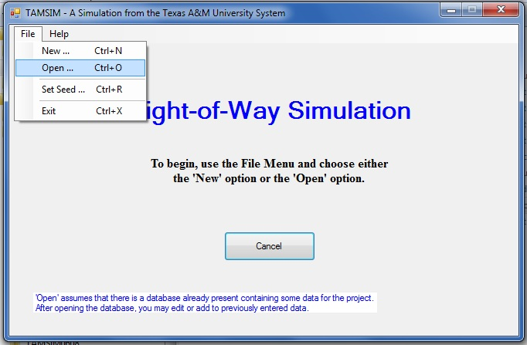
TAMSIM Exercise
Notes:
We have already entered a portion of the SH 78 project and parcel data to facilitate our workshop purposes today. This file has been saved and is in the TAMSIM file folder on your CD.
To open this file and continue entering data, click on the file tab at the top and then click on Open …

Slide 16
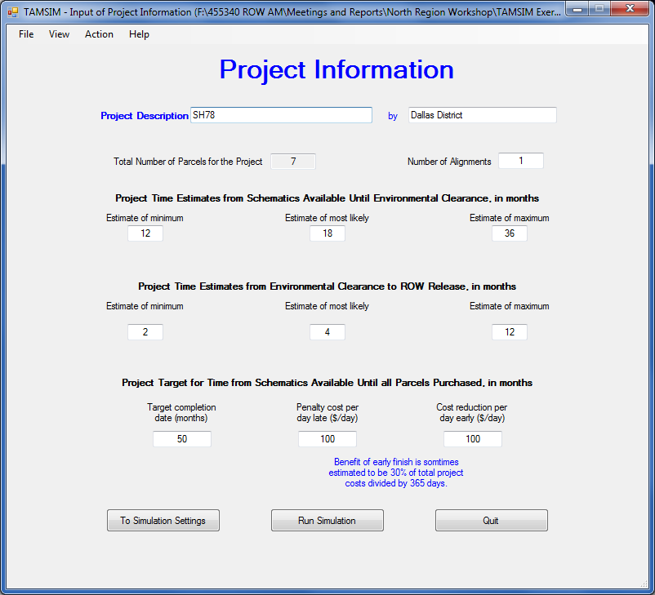
TAMSIM Exercise
Notes:
You now see the project information already entered. We have entered information for 7 of the 10 parcels on this project. (Go over the other entries on this screen with participants. The primary function provided by this screen is to set up the project time line to be simulated by the tool.)
We are now ready to move on, so click on To Simulation Settings at the bottom left.

Slide 17
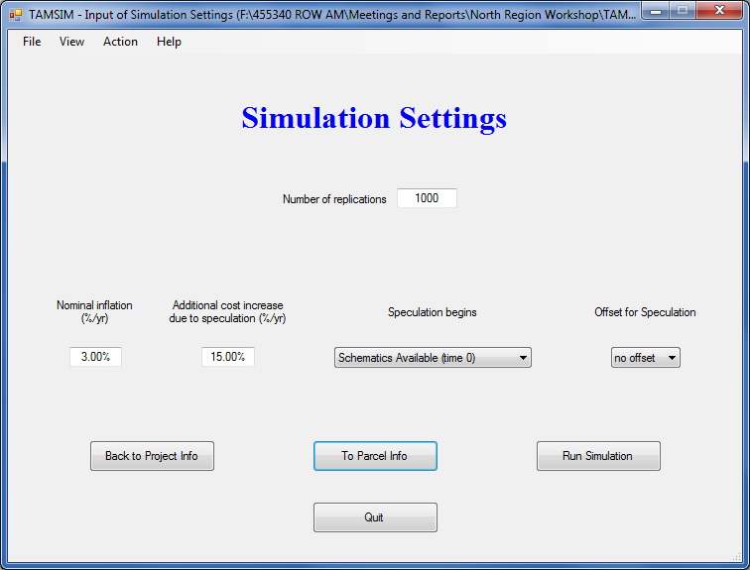
TAMSIM Exercise
Notes:
This takes us to the Simulation Settings screen. Explain that a minimum of 1000 replications should be selected. Explain data entry definitions already made on this screen. These data were provided by Dallas District ROW personnel.
We are now ready to move on, so click on To Parcel Info at the bottom center.

Slide 18
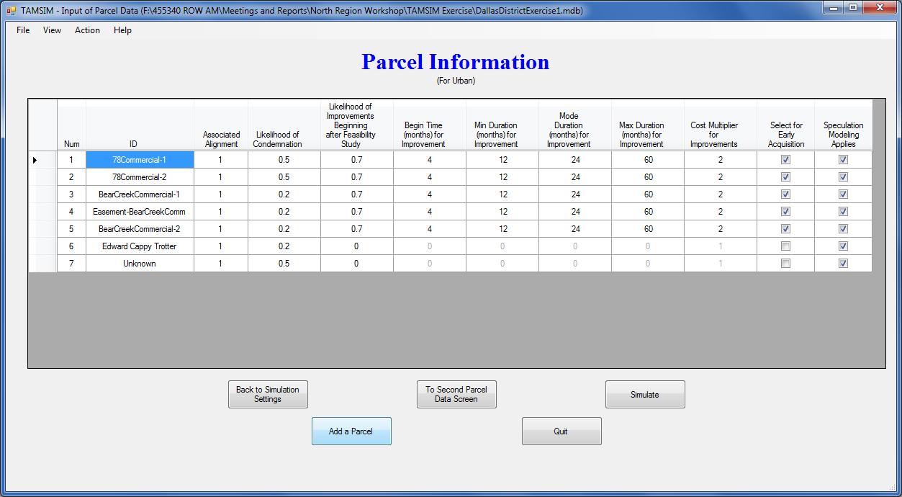
TAMSIM Exercise
Notes:
This is where we pick up where we left off when entering the first seven parcel information sets.
Click on the Add a Parcel button at the bottom.

Slide 19
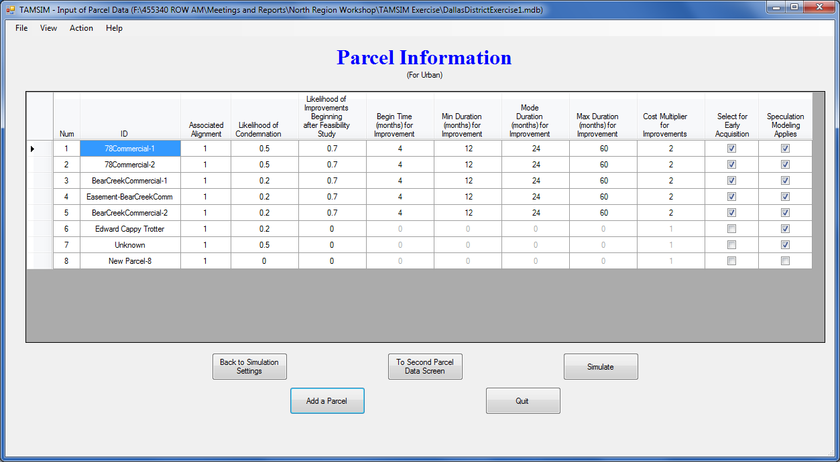
TAMSIM Exercise
Notes:
Notice that a new row for parcel information has been added to the table on the screen. Since the Dallas District anticipates speculator activity with this parcel, click on the Speculation Model Applies column box for this parcel.

Slide 20
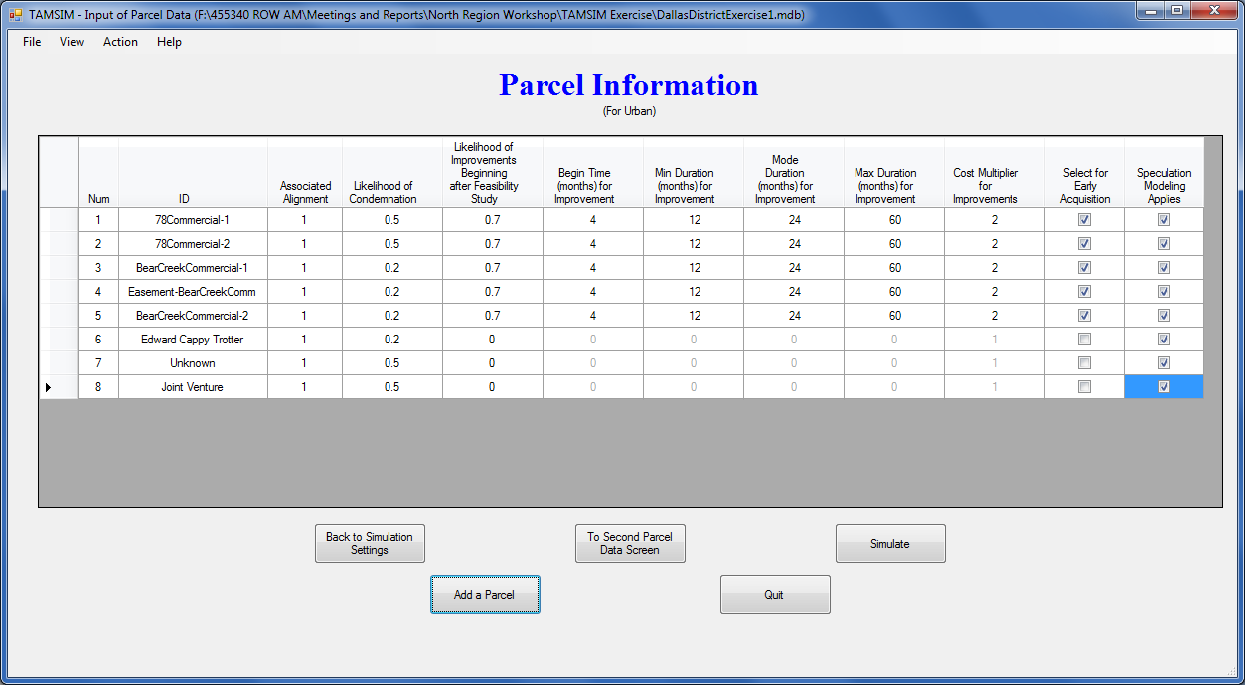
TAMSIM Exercise
Notes:
Go the Add a Parcel button again to move on to adding the next parcel.

Slide 21
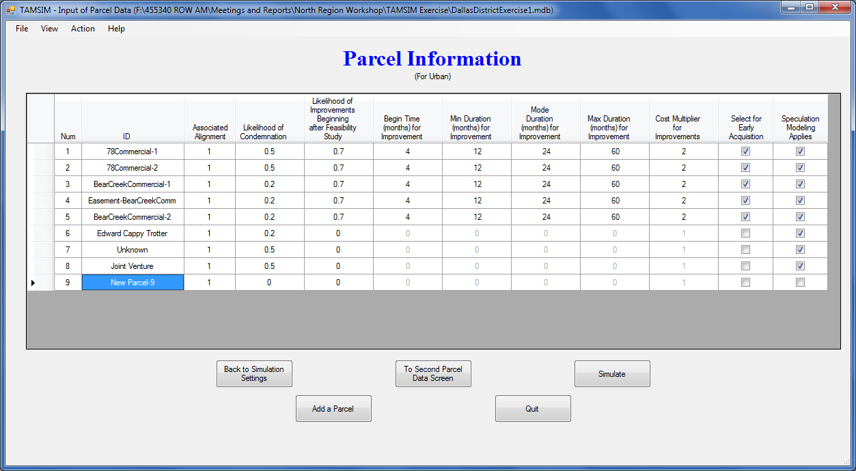
TAMSIM Exercise
Notes:
The Dallas District believes there is some likelihood of condemnation and also improvements to be constructed on this parcel, so we fill in the appropriate information in the area indicated.

Slide 22
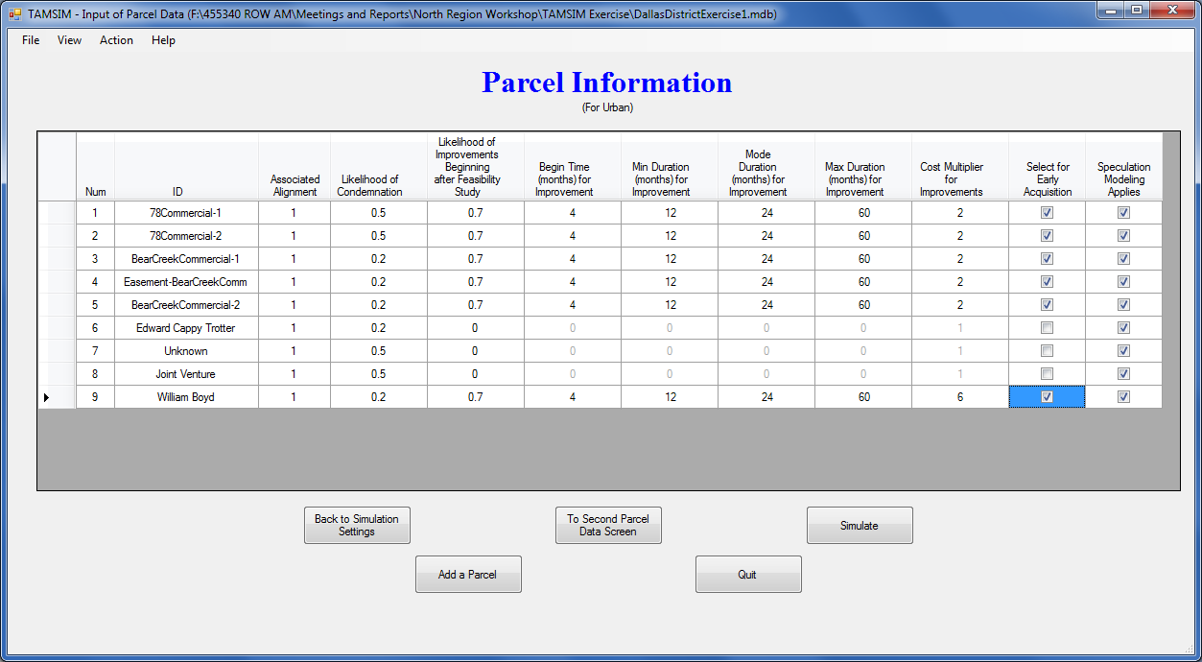
TAMSIM Exercise
Notes:
We also check the Select for Early Acquisition box to tell the tool to simulate with this parcel being purchased early.
Then we go on to adding information for the last parcel of the 10 parcels on this project. Click Add a Parcel again.

Slide 23
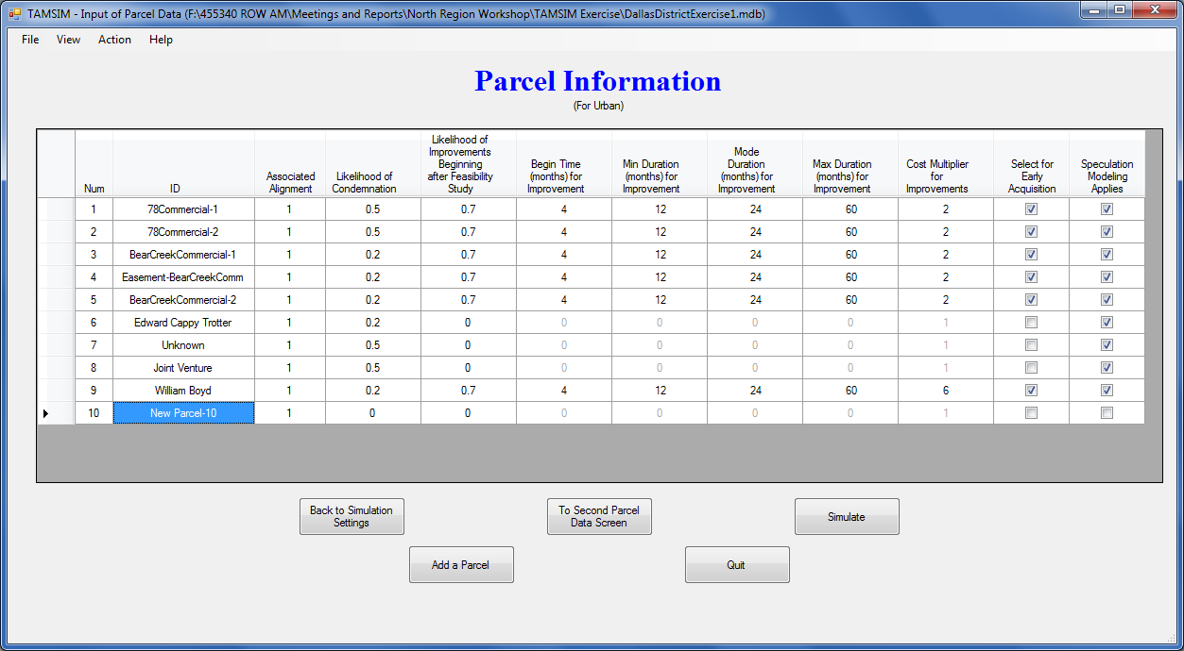
TAMSIM Exercise
Notes:
… and again add the appropriate information describing this parcel.

Slide 24
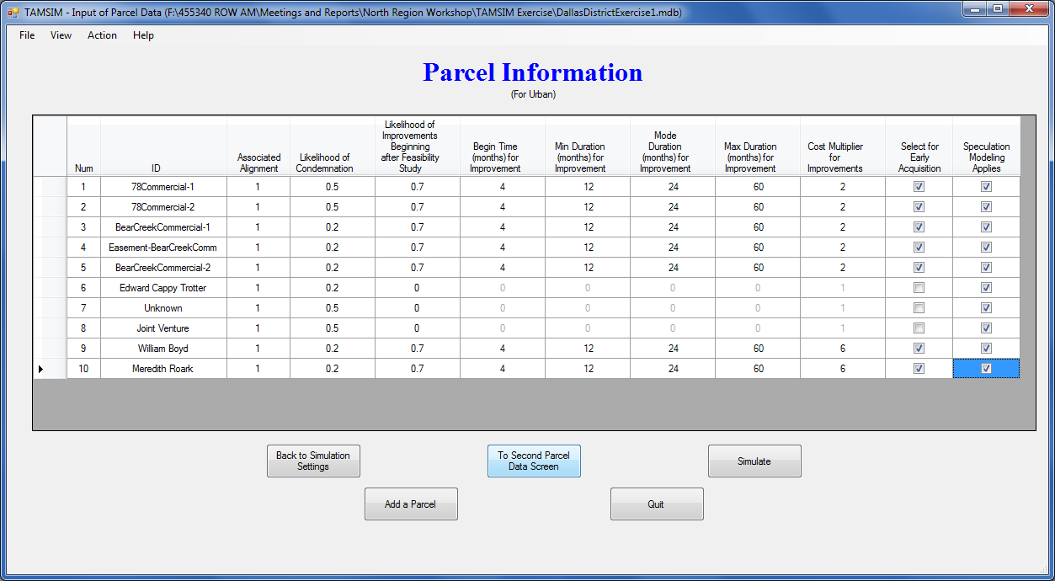
TAMSIM Exercise
Notes:
Once this information is added, click on the To Second Parcel Data Screen button at the bottom center.

Slide 25
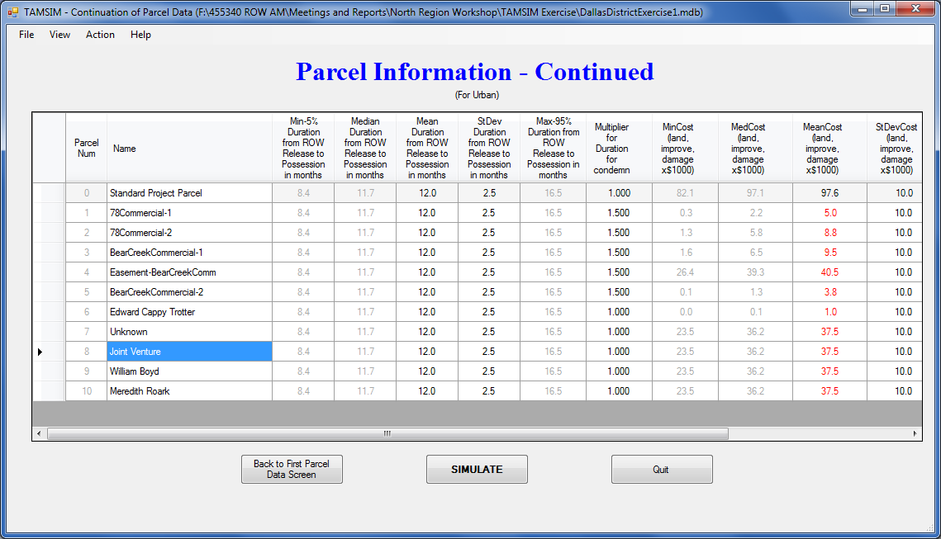
TAMSIM Exercise
Notes:
Notice that the names of newly added parcels are carried forward to this screen. Default data had been automatically displayed in the remaining columns of the newly added parcel rows of information.
Use the scroll bar at the bottom to view additional information on the right side of the table.

Slide 26
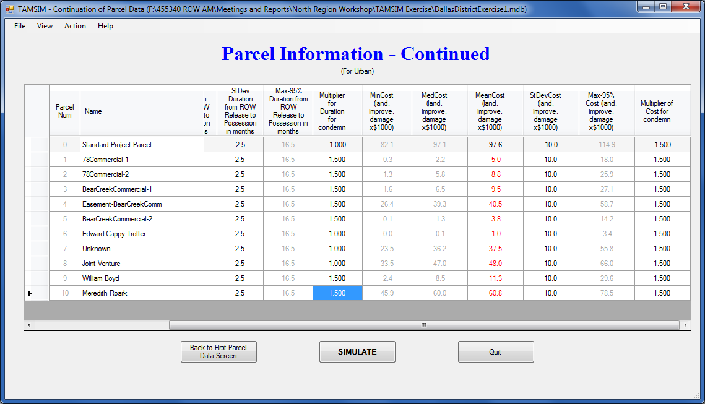
TAMSIM Exercise
Notes:
Enter cost estimates for each of the newly added parcels, and make adjustments to the cost standard deviation and other columns, as appropriate.
You are now ready to run the simulation. Click on the SIMULATE button and the bottom.

Slide 27
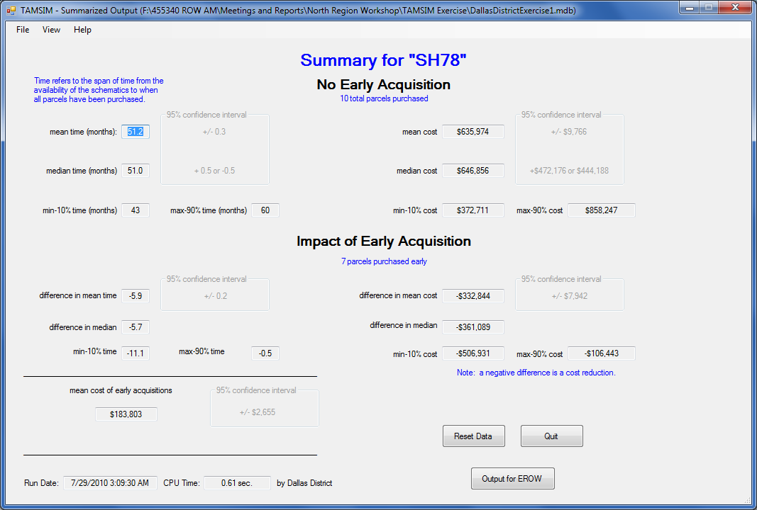
TAMSIM Exercise
Notes:
This is the tool output summary screen. The top portion of the screen displays cost and time duration information if no parcels are acquired early. The middle portion of the screen displays cost and time durations differences likely to occur if the parcels we designated are purchased early. As you may recall, we instructed the tool to simulate the early purchase of 7 parcels. The negative numbers indicate savings in time durations and costs.
The mean cost associated with purchasing these 7 parcels early is indicated toward the bottom left of the screen. This is the amount of early acquisition budget that would be utilized in this scenario.
If these data are being prepared for use in the EROW optimization tool for budget planning, click the Output to EROW button on the bottom right.

Slide 28
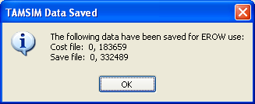
TAMSIM Exercise
Then click Reset Data to go on to create the next scenario and run again.
Notes:
The window that appears shows the data about to be saved for use with EROW. The two zeros indicate the early acquisition cost and savings if no parcels are acquired early, i.e., none, and the second two numbers indicate the cost and savings estimated for the scenario just simulated, this is, purchasing 7 parcels early.
If additional scenarios are to be analyzed and saved, click on the Reset Data button and repeat the process.

Slide 29
BREAK

Slide 30
Introduction to Optimization
Notes:
This brings us to the second tool to be introduced, EROW. EROW is an optimization program to assist in budget decision making once individual projects have been analyzed using TAMSIM. It has potential application at the district level, but its primary use will likely be at the statewide level in the ROW division. EROW runs on the output files generated by TAMSIM.

Slide 31
Introduction to Optimization
Optimization is derived from the Latin word “optimus,” meaning the best.
Organizations are striving to streamline their business processes to maximize utility of resources.
O
What is the best (optimal) way of using resources (e.g., workforce, machinery, capital, etc.) to produce maximum output?
Business Processes
INPUTS
OUTPUTS
Notes:
Optimization is another business science tool for assisting in business decision making.
Its name is derived for a Latin word meaning best.
Businesses use optimization tools to help make best possible use of their resources. In our case, we are trying to make best possible use of taxpayer money when we go about purchasing needed ROW.

Slide 32
Example
We have 5 projects to choose from.
The total budget available is $40. Which ones would you choose?
Project | 1 | 2 | 3 | 4 | 5
Cost, $ | 10 | 24 | 14 | 5 | 7
Net profit, $ | 20 | 60 | 25 | 9 | 15
Notes:
Let me go through a simple example with you to demonstrate optimization.
Let’s say we have five projects on which we can spend a budget of $40. Project costs are all different, and the benefits to be obtained from each project also differ.
Which projects would you pick to spend up to the maximum of $40, hoping to do the best with your money?

Slide 33
Analysis of Possibilities
Projects Selected | Total Cost of Projects Selected | Total Profits from Projects Selected | Benefit/Cost Ratio
2,3
1,2,4
1,3,4,5
2,4,5
Notes:
OK. Let’s see how some of these combinations come out. All of these might be possibilities to be the best.

Slide 34
Analysis of Possibilities
Projects Selected | Total Cost of Projects Selected | Total Profits from Projects Selected | Benefit/Cost Ratio
2,3 | $38 | $85 | 2.24
1,2,4
1,3,4,5
2,4,5
Notes:
If we select project 2 and 3, the cost for those two comes to $38. The combined profits from the two is $85. And the B/C Ratio calculates to be 2.24 if I operated by calculator correctly the other day.

Slide 35
Analysis of Possibilities
Projects Selected | Total Cost of Projects Selected | Total Profits from Projects Selected | Benefit/Cost Ratio
2,3 | $38 | $85 | 2.24
1,2,4 | $39 | $89 | 2.28
1,3,4,5
2,4,5
Notes:
Similarly, if projects 1, 2, and 4 are selected …
Both the total profits and the B/C Ratio are higher, so this should be a better choice than the first scenario.

Slide 36
Analysis of Possibilities
Projects Selected | Total Cost of Projects Selected | Total Profits from Projects Selected | Benefit/Cost Ratio
2,3 | $38 | $85 | 2.24
1,2,4 | $39 | $89 | 2.28
1,3,4,5 | $36 | $69 | 1.92
2,4,5
Notes:
Similarly, if projects 1, 3, 4, and 5 are selected …

Slide 37
Analysis of Possibilities
Projects Selected | Total Cost of Projects Selected | Total Profits from Projects Selected | Benefit/Cost Ratio
2,3 | $38 | $85 | 2.24
1,2,4 | $39 | $89 | 2.28
1,3,4,5 | $36 | $69 | 1.92
2,4,5 | $36 | $84 | 2.33
Notes:
And last, looking at selecting projects 2, 4, and 5 we get these numbers.
Reviewing all of the results, a case could be made that I’m better off in the scenario of selecting projects 1, 2, and 4 since I maximize profits there.
But a better case can be made, perhaps, selecting projects 2, 4, and 5 since the Benefit to Cost Ratio is greatest in that scenario.
Now, imagine doing an analysis like this but with 100 TxDOT ROW projects averaging 15 parcels on each, which would amount to 1,500 selection choices to choose between instead of 5! Doing it manually would be so time consuming to make it virtually impossible. This is where an optimization program becomes so valuable.

Slide 38
Optimization
Optimization falls in the category of decision support tools.
Involves building a mathematical model of business processes and solve the model to find the best (optimal) input mix to achieve the stated objective.
The solution is obtained by systematically choosing values of decision variables within their allowable range.
Notes:
Like simulation, optimization falls into the category of decision support tools. They provide helpful information to decision makers. They do not replace the need for thoughtful decision makers to make final decisions. Not every consideration can be included in a simulation or optimization tool.
Like simulation, optimization involves building a mathematical model of a business process, and then running the model systematically until a best solution is determined.

Slide 39
Optimization
There are different optimization methods/algorithms:
    nonlinear programming,
    linear programming,
    mixed integer programming,
    dynamic programming, etc.
Notes:
We won’t go deeply into this at all, but there are a number of optimization methods that may be chosen, depending on the type of problem to be solved. The last one, dynamic programming, was the method selected and used in EROW.

Slide 40
Dynamic Programming
A method of solving optimization problems that exhibit a special structure.
The problem is divided into a sequence of overlapping sub problems and the solution from one is used to solve the next one.
When compared with total enumeration of all solutions, dynamic programming can significantly reduce the computational time of finding the optimal solution.
Notes:
Dynamic programming, said simply, means that the problem to be solved is broken into a number of sub problems. Then, as one sub problem is solved, the results from it effect the solution of the next sub problem. And this continues until a complete solution is determined. The main advantage with dynamic programming is that it greatly speeds the solution process compared to comparing outcomes from every possible combination of scenarios.
Considering the number of ROW-related projects in Texas, and sometimes even within a given district, and the number of ROW parcel acquisition scenarios possible on each project, dynamic programming appeared to be the best fit, and so was chosen for use.

Slide 41
EROW Optimization Tool Walkthrough
Notes:
Let’s look at EROW now. It is a simpler tool to use, at least it has fewer inputs and basically only three screens.

Slide 42
EROW Practical Exercise
Notes:
As mentioned earlier, EROW input is created by TAMSIM during simulation runs for possible parcel-purchase scenarios.

Slide 43
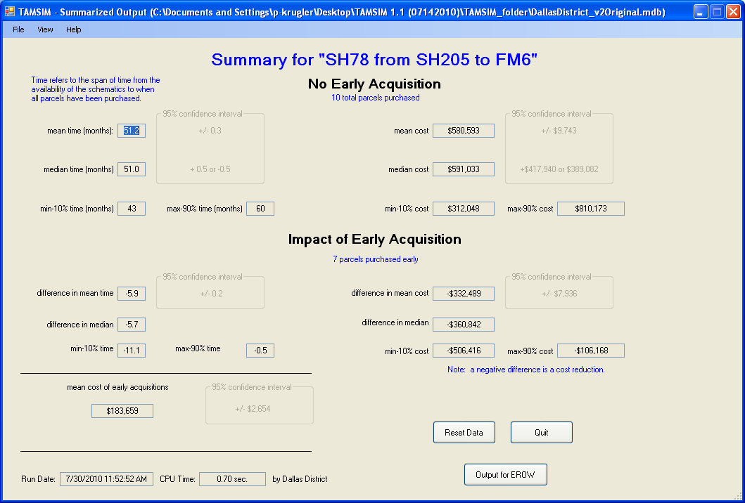
TAMSIM Output for EROW
Will be saved in savings.txt file
Will be saved in costs.txt file
Notes:
In order to use the EROW optimization tool we need to have two types of output values from TAMSIM. In this summary screen of TAMSIM output the first input value needed for EROW is the “mean cost of early acquisition,” which is circled in red. The second input value needed by EROW to perform an optimization is the “difference in mean cost,” or savings, as circled in green. Notice that TAMSIM shows a negative number, -$332,489, for the mean cost reduction. As mentioned earlier, this means that there is an estimated savings of $332,489 associated with the early acquisition of 7 parcels. These two values will be saved in separate files, as EROW downloads them separately. The text files where they are saved are named costs.txt and savings.txt.

Slide 44
Standard TAMSIM Runs for EROW Optimization
A series of TAMSIM runs to determine individual parcel costs and savings should each parcel alone be purchased early.
A series of TAMSIM runs to determine costs and savings of groupings of parcels. Parcel groupings are created based on individual parcel rates of return, from highest to lowest.
Notes:
There is a normal procedure for running a series of TAMSIM scenarios to be fed to EROW. The first step is to run TAMSIM one time with each individual parcel being the only parcel acquired early, saving the output for EROW each time.
The next step is to analyze these data and determine cost/benefit ratios for each parcel when it is purchased early. All of the parcels are then prioritized by benefit cost ratio. Once this is done, create groups of parcels for early acquisition, beginning with the two with greatest benefit cost ratio, and run this additional TAMSIM scenario. After that scenario is run and the data saved as output for EROW, add the parcel with the third highest benefit cost ratio and determine costs and savings from that scenario, and save the output for later consideration by EROW. Continue this process to the extent desired by the user.

Slide 45
TAMSIM Runs and Output for SH78
Speculation Begins: Schematics Available (Time 0)
Additional Cost Increase Due to Speculation (%/yr): 15.00%
Project Identification Number (ROW CSJ Number) | Scenario No. | Selected Input Conditions |  | OUTPUT: Mean Project Cost |  |  | OUTPUT: Duration
 |  | Number of Parcels for Early Acquisition | Early Acquisition Parcel ID | Mean Cost without early acquisition | Difference in Mean Cost due to early acquisition | Mean Cost of Early Acquisition | Mean Time w/o early acquisition | Difference in Mean Time | Saving/Cost Ratio
Dallas SH78 from SH205 to FM6 | D01 | 1 | 1 | $787,793 | $9,182 | $6,777 | 50.5 | 0.7 | 1.35
 | D02 | 1 | 2 | $787,793 | $15,768 | $12,888 | 50.5 | 0.7 | 1.22
 | D03 | 1 | 3 | $787,793 | $14,119 | $11,999 | 50.5 | 0.3 | 1.18
 | D04 | 1 | 4 | $787,793 | $56,950 | $51,332 | 50.5 | 0.3 | 1.11
 | D05 | 1 | 5 | $787,793 | $5,696 | $4,497 | 50.5 | 0.3 | 1.27
 | D06 | 1 | 6 | $787,793 | $708 | $999 | 50.5 | 0.0 | 0.71
 | D07 | 1 | 7 | $787,793 | $39,405 | $66,346 | 50.5 | 0.0 | 0.59
 | D08 | 1 | 8 | $787,793 | $38,173 | $64,470 | 50.5 | 0.0 | 0.59
 | D09 | 1 | 9 | $787,793 | $44,653 | $16,781 | 50.5 | 0.3 | 2.66
 | D10 | 1 | 10 | $787,793 | $241,934 | $91,813 | 50.5 | 0.3 | 2.64
 | D11 | 2 | 9, 10 | $787,793 | $286,675 | $108,593 | 50.5 | 0.6 | 2.64
 | D12 | 3 | 9, 10,1 | $787,793 | $296,380 | $115,371 | 50.5 | 1.5 | 2.57
 | D13 | 4 | 9, 10,1,5 | $787,793 | $302,611 | $119,868 | 50.5 | 1.9 | 2.52
 | D14 | 5 | 9, 10,1,5,2 | $787,793 | $320,446 | $132,756 | 50.5 | 3.5 | 2.41
 | D15 | 6 | 9, 10,1,5,2,3 | $787,793 | $336,302 | $144,756 | 50.5 | 4.4 | 2.32
 | D16 | 7 | 9, 10,1,5,2,3,4 | $787,793 | $395,963 | $196,087 | 50.5 | 5.7 | 2.02
Notes:
Here are scenarios for the Dallas SH 78 project. The first 10 scenarios are for individual parcel early acquisitions. Notice that the last six rows are TAMSIM runs on groupings of parcels created based on the savings/cost ratios obtained from the individual parcel runs.
All of these scenarios may be fed into EROW for optimization analyses.
Further, this same technique may be used on multiple projects, from multiple districts, with all of the data fed to EROW to optimize budgets and parcel selections across all of the considered projects.

Slide 46
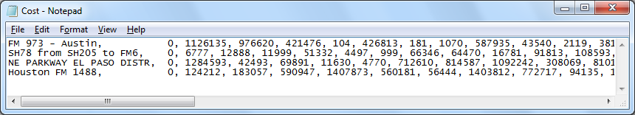
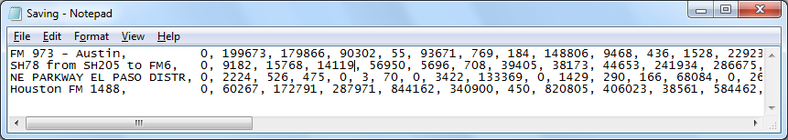
EROW Input Files
Project name
Scenario 1, Scenario 2, Scenario 3, Scenario 4, …
First scenario is always no parcels acquired early.
Notes:
This slide shows the two input files we will use for the EROW demonstration. These are results from TAMSIM simulations we ran on four projects, one each from the Austin, Dallas, Houston, and El Paso Districts. The first column identifies the project being considered. (We will look a little closer at the results from all these districts later in the data analysis slides.)
As discussed earlier, when we run TAMSIM for a given scenario it creates one cost and savings pair of numbers. EROW accepts numbers saved in simple text file format as inputs. They appear as shown on this slide. Each row represents each project and each column represents each scenario. You have to match the location of each cost and saving pair from the same scenario. For example the blue rectangles show the cost and the saving from TAMSIM output for a single scenario on the Houston project.
Note that in both files the first column is composed of zeros. This is done so that the first scenario is the situation where no parcels are to be selected for early acquisition.
For our EROW demonstration purposes, then, we have four projects, each with numerous scenarios to be considered by EROW in determining optimal problem solutions.

Slide 47
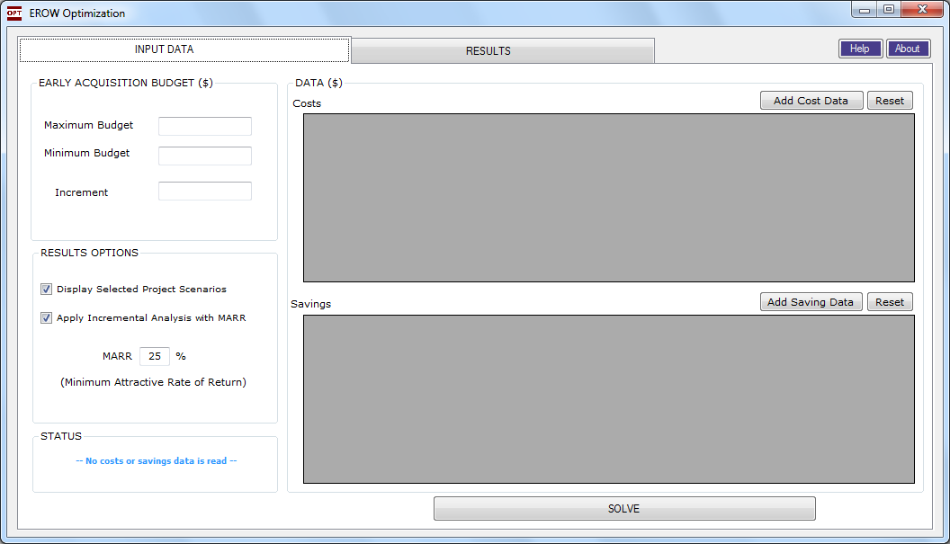
EROW Input Screen
Notes:
The first step in running the EROW program is to select the costs and savings text files desired for the optimization analysis to be performed. For that, we need to click the Add Cost Data button on the right side of the screen. This allows us to browse and find the appropriate saved cost file for this EROW analysis.

Slide 48
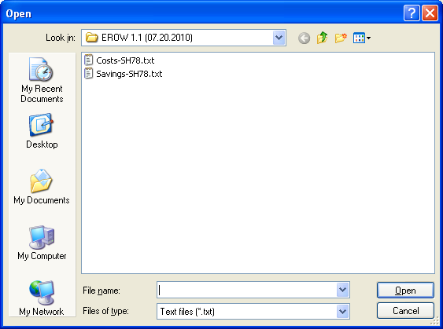
EROW Input Screen
Notes:
Clicking on the Add Cost Data button causes any txt files saved in the EROW folder to be displayed. Select the desired costs.txt file and click Open to move the desired data into EROW.

Slide 49
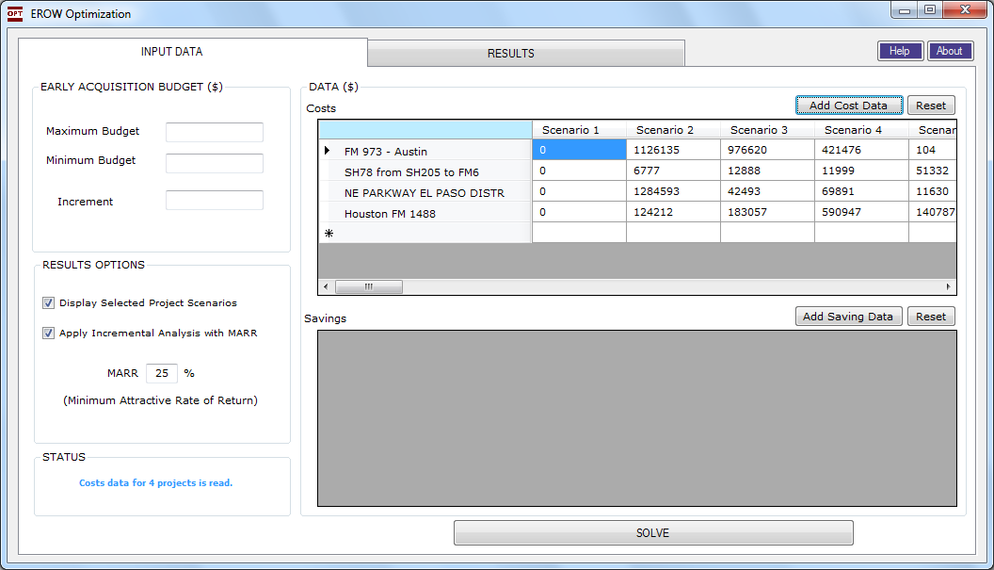
EROW Input Screen
Notes:
Now that the desired cost data have been entered and are being displayed, go to the bottom portion of the screen and click on Add Savings Data.

Slide 50
EROW Input Screen
Notes:
This again displays any saved txt files. Select the appropriate file and again click Open.

Slide 51
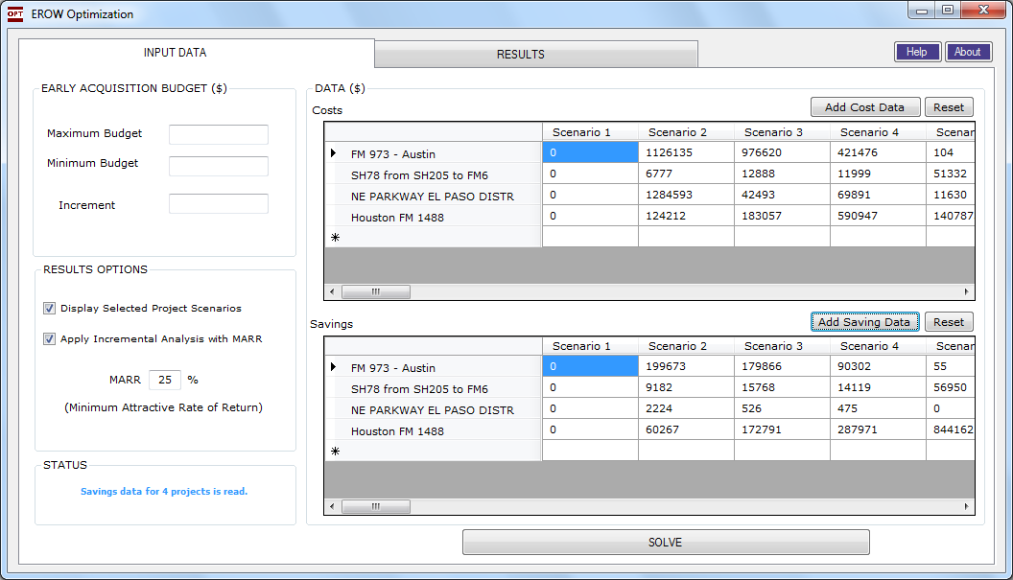
EROW Input Screen
Notes:
After selecting and adding desired costs and savings data, type in the maximum budget, minimum budget, and an increment value in the upper left side of the screen. Increment is the value the EROW program increases automatically beginning from the minimum budget as it searches for the best possible combination of parcel purchase scenarios from the projects.

Slide 52
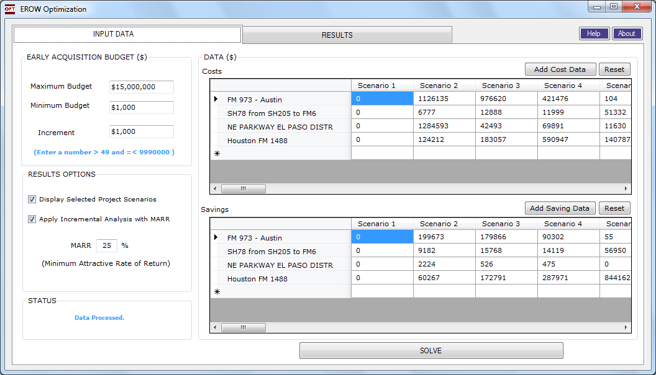
EROW Input Screen
Notes:
Here are some reasonable budget numbers to set up this analysis.

Slide 53
EROW Input Screen
Notes:
The check box options in the RESULTS OPTIONS menu control the results information to be displayed. Uncheck the top box if you do not wish to see the project scenarios selected by EROW for each early acquisition budget increment.
The second option allows the user to have an incremental analysis performed during the optimization. When this box is checked, the additional funding provided under the next highest budget increment is compared to the resulting savings amount from this additional expenditure. The rate of return from the additional expenditure is compared to the Minimum Attractive Rate of Return (MARR) entered by the user. If the rate of return of this additional expenditure does not equal or exceed the MARR, this budget increment is not considered a potential budget solution.
An MARR of 25% is the default value since this is the generally accepted rate of return expected from investments in adding highway capacity.
When you are ready, hit the SOLVE button to run the program and view the results.

Slide 54
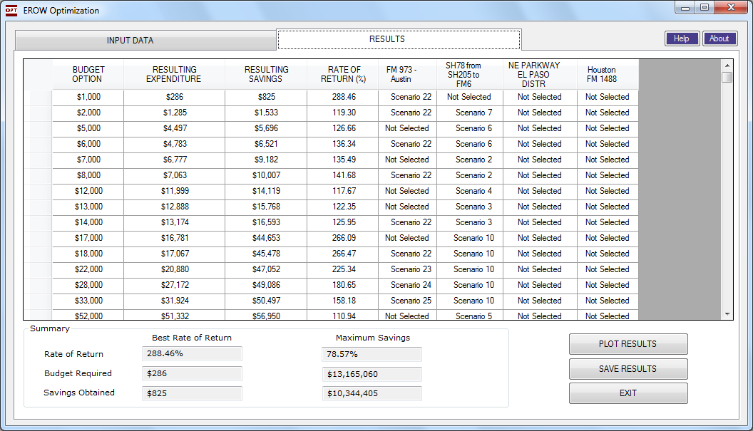
EROW Output Screen
Notes:
Let’s look across the top of the Results display table. In the first column we see the potential early acquisition budgets being considered, separated by the incremental amount we selected on the Input Data screen. Notice that budget increments of $3,000 and $4,000 are not displayed. This is because the additional expenditure possible under these budget increments did not meet the prescribed MARR.
Next to each potential budget is the amount of the budget that would be spent and the resulting savings and rate of return under the optimal solution found by the tool. The last four columns on the right display where the budget would be spent for the given budget amount. For the $1,000 budget option, the parcel or parcels purchased under scenario 22 on the Austin District FM 973 project would be purchased early.
The bottom of the EROW output screen shows two different optimal solutions, one based on the Best Rate of Return and the other based on the Maximum Savings.
If you want to achieve best ROR you will use $286 as the early acquisition budget. This budget will provide a ROR of 288%, as seen on the first row of results.
If the desire is to save the maximum amount of money, and you will accept a lower ROR, you will allow an early acquisition budget of $13,165,060. That information can be viewed by scrolling down the screen, on the right.

Slide 55
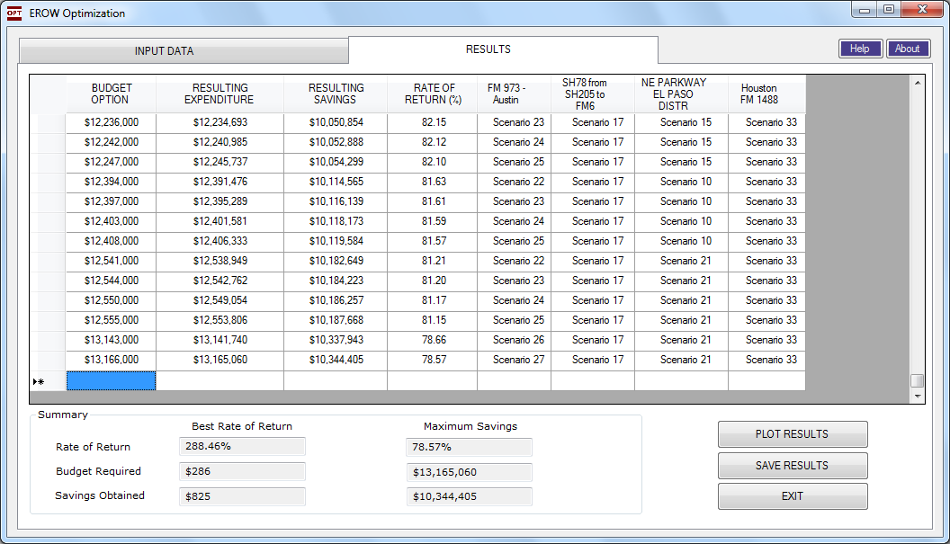
EROW Output Screen
Notes:
At the bottom of the results table you can view the scenarios selected for the Maximum Savings scenario.
If you desire to view the results graphically, click on the Plot Results button.

Slide 56
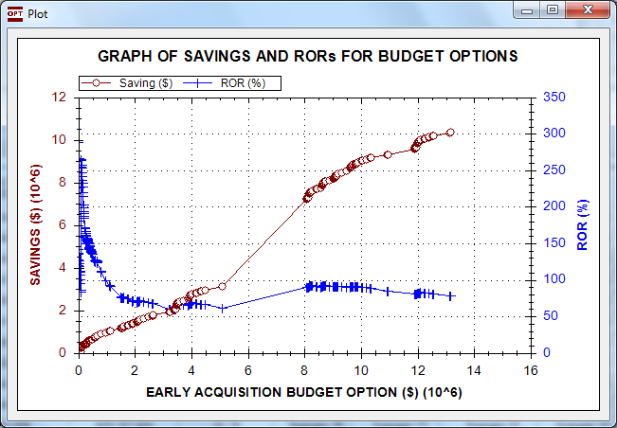
EROW Output Screen
Notes:
Plotting results is especially useful when we have to deal with large numbers of possible solutions since it allows visualization of the trend pattern of the solutions. In this plot the rates of return are shown in blue for each considered budget increment. The total savings estimated for each incremental budget are shown in red.
The ROR plot indicates the highest ROR occurring at a rather low early acquisition budget. There is a second peak in rate of return at a budget of approximately $8 million. A peak in the rate of return indicates a more preferable budget option, all other considerations being equal.
Let me say a word about the budget options between $5 million and $8 million. To determine what happened here, one has to go the results screen, and study the selected scenarios at each of these two budget possibilities.

Slide 57
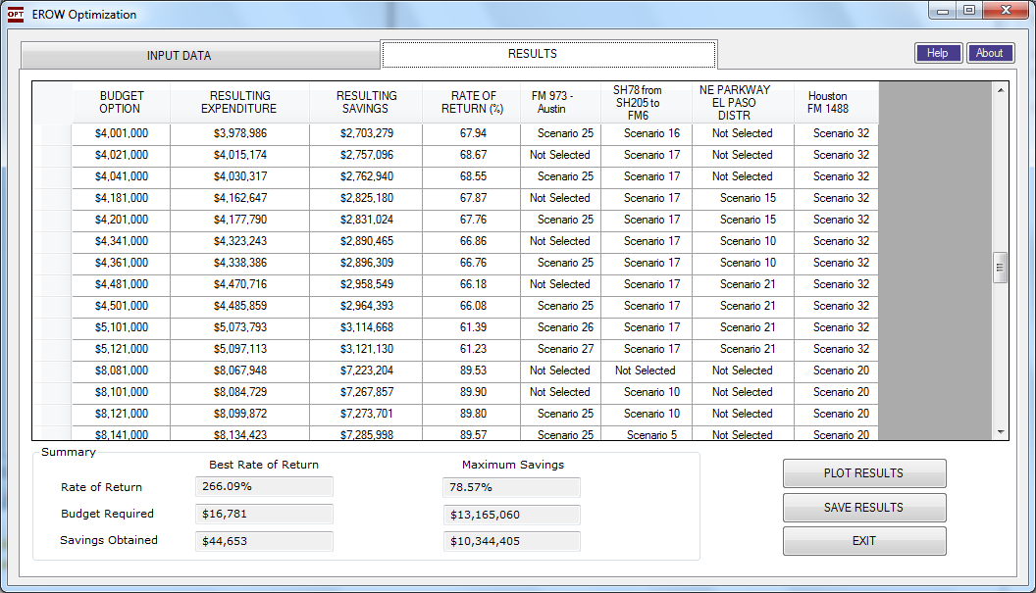
EROW Output Screen
Notes:
And this is what we found. There was no budget increment that met the MARR criteria between these two budget options until there was adequate budget to include a high-cost scenario from the Houston District project. This is the type of thing that can occur when considering multiple parcels from multiple projects and with highly differing parcel costs involved.

Slide 58
Review of Data Analysis
Notes:
We promised to take a quick look at the data, overall, from the four single projects we have analyzed.

Slide 59
Comparison of TAMSIM Input from the Four Districts – Project Information
Project Description | County Type | Total Number of Parcels | Months from Schematics to ENV Clearance |  |  | Months from ENV Clearance to ROW Release |  |  | Target Completion Date | Nominal Inflation Rate % | Additional Cost Increase Due to Speculation %/year
 |  |  | Min. Time | Most Likely Time | Max. Time | Min. Time | Likely Time | Max. Time
Austin: FM 973 | Urban | 20 | 12 | 18 | 36 | 4 | 4 | 12 | 36 | 6 | 5
Dallas: SH78 | Urban | 10 | 12 | 18 | 36 | 2 | 4 | 12 | 50 | 3 | 15
El Paso: NE Parkway | Rural | 19 | 48 | 60 | 108 | 1 | 1 | 4 | 120 | 3 | 0
Houston: FM1488 | Metro | 28 | 18 | 24 | 36 | 48 | 60 | 72 | 108 | 9 | 150/15
Notes:
This is a basic comparison of the projects from the four districts. As shown in the table the Austin and Dallas projects are considered to be urban county projects whereas the El Paso project is a rural county project and the Houston project is a metro project.
In the Houston District project, the district ROW personnel expect some speculative activities and a 150% speculation increase was initially selected. This was changed to the 15% per year value for the analysis. On the other extreme, the El Paso District doesn’t expect speculative activity, and so their value was set at zero.
Houston appears to be experiencing the highest normally expected annual cost increases for ROW, estimated at 9% per year.
Another observation is that much longer time durations are expected for the El Paso project than for the projects in the other three districts.

Slide 60
Comparison of TAMSIM Input from the Four Districts – Parcel Information
Project Description | Total Number of Parcels | Number of Parcels with Likelihood of Improve-ment | Cost Multiplier for Improve-ments | Number of Parcels with Possible Condem-nations | Multiplier for Duration of Condem-nation | Multiplier of Cost for Condem-nation | Mean Duration to Posses-sion from ROW Release | Average Parcel Cost, $1000s | Median Parcel Cost, $1000s | Max Parcel Cost, $1000s
Austin: FM 973 | 20 | 0 | 1 | 16 | 1.485 | 1.869 | 14 ~ 29 | 157 | 28 | 1,087
Dallas: SH78 | 10 | 6 | 2 ~ 6 | 10 | 1.5 | 1.5 | 12 | 24 | 10 | 61
El Paso: NE Parkway | 19 | 2 | 2.5 | 11 | 1.661 | 1.3 | 4 ~ 18 | 455 | 115 | 2,756
Houston: FM1488 | 28 | 26 | 2 ~ 2.5 | 28 | 1.25 | 1.3 | 15 ~ 18 | 565 | 154 | 6,750
Notes:
Possible Improvements: Austin has no parcels considered likely to have additional improvement made on them prior to acquisition. This is due to the specific circumstances on this project. It’s not generally the case in the Austin area. The Houston project has about 90% of their parcels in this category and the Dallas project has 60% of the parcels with the possibility of improvements.
Condemnation Possibility: Dallas and Houston saw a possibility of condemnation on all of their project’s parcels. Austin saw that possibility in about 80% of their project’s parcels. El Paso has about half of their project’s parcels in this category.
Improvement Cost Multiplier: Dallas used multipliers ranging from 2 to 6 depending on the location and specific situation with each parcel. The other districts seeing potential parcel improvements placed the amount of cost after the improvement at 2 to 2.5 times the current parcel value.
Average Parcel Cost: Parcels from the Houston and El Paso projects have much higher mean and median costs. The El Paso project higher costs resulted from their parcel sizes being much larger. The unit price/SF of El Paso land is lower than in the other districts.

Slide 61
Summary
District | Number of Parcels | Mean Cost Without Early Acquisition (1,000s) | Avg Cost per Parcel (1000s)
Austin | 20 | $5,098 | $254.88
Dallas | 10 | $788 | $78.78
El Paso | 19 | $9,110 | $479.49
Houston | 28 | $32,177 | $1,149.18
Notes:
Here is some additional breakdown of mean parcel costs from the four projects.

Slide 62
Discussion on Tool Applications and Potential Benefits to Users in Districts
Notes:
When we set out, our goal was to develop one or more tools that could benefit both district personnel in decision-making and individuals in the ROW Division and TxDOT administration when developing ROW acquisition budgets. This is the point where we will really appreciate your comments on what you think after this orientation and demonstration of these two tools.
Do you see either or both of the these tools being useful in western region districts? If so, how?
What do you think is potentially the best application for TAMSIM and EROW in district ROW sections?
Do you have suggestion how either of these tools could be made easier to use?
Do you have other thoughts on how their usefulness could be improved?

Slide 63
Final Questions?
Adjourn

