Slide 1
Construction of Cast-in-Place Post-Tensioned Concrete Pavement
Collection of Pictures
TxDOT Implementation Project 5-4035
Texas Tech University

Slide 2
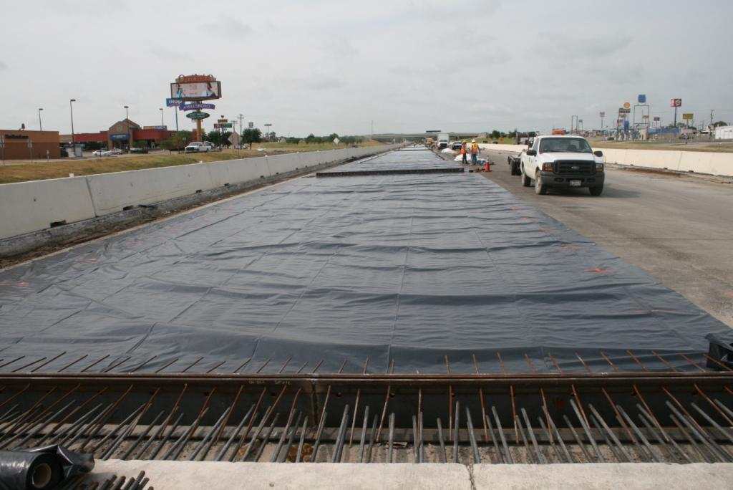
Notes:
First phase: polyethylene sheet and armor joint placed. Gap slab shown between 14-in CRCP and 9-in PCP

Slide 3
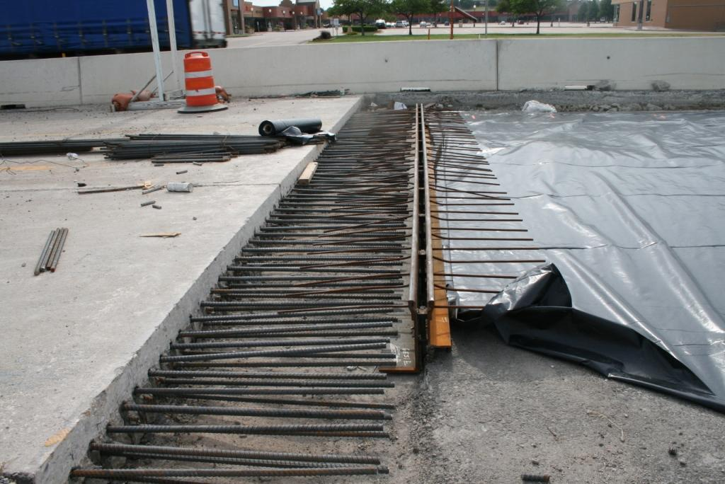
Notes:
Gap slab between 14-in CRCP and 9-in PCP

Slide 4
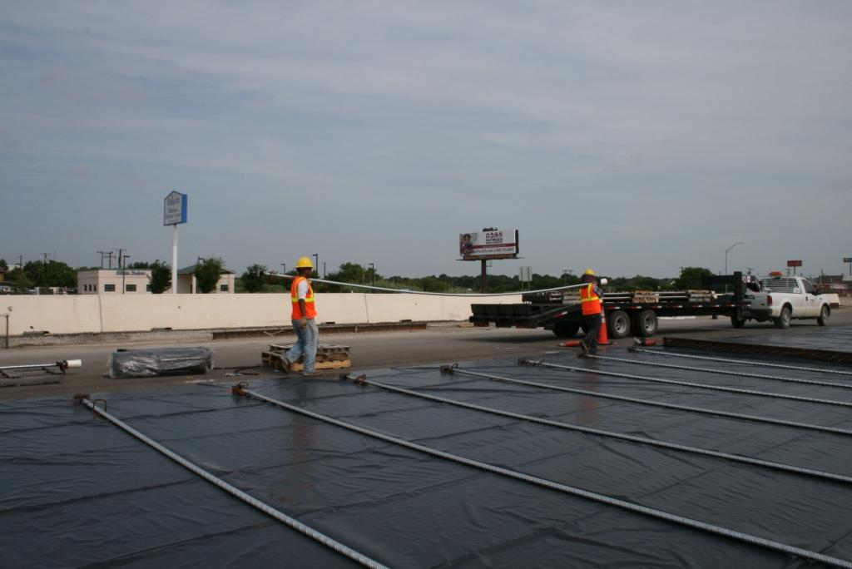
Notes:
Placing transverse post-tensioning bar (1-in diameter at 6-ft spacing)

Slide 5
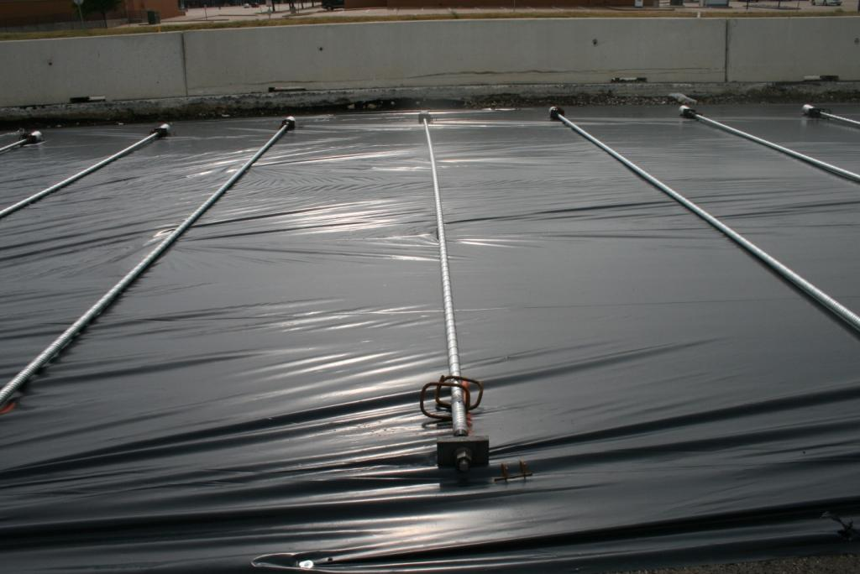

Slide 6
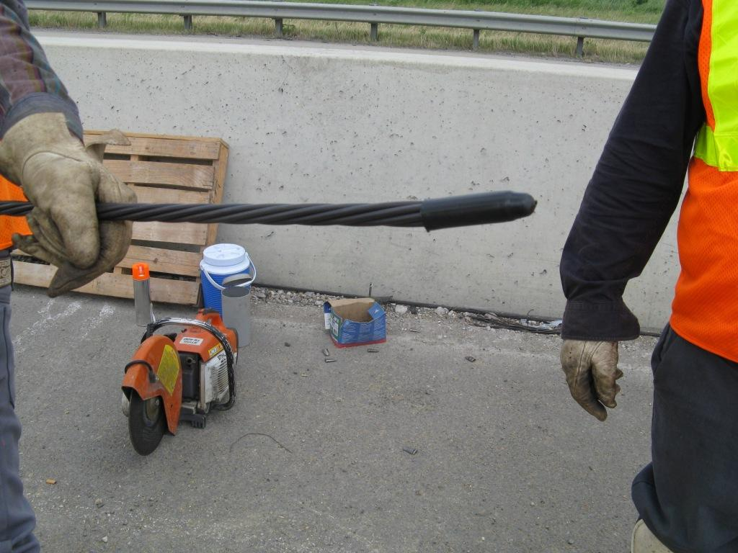
Notes:
Assembly of longitudinal tendons

Slide 7
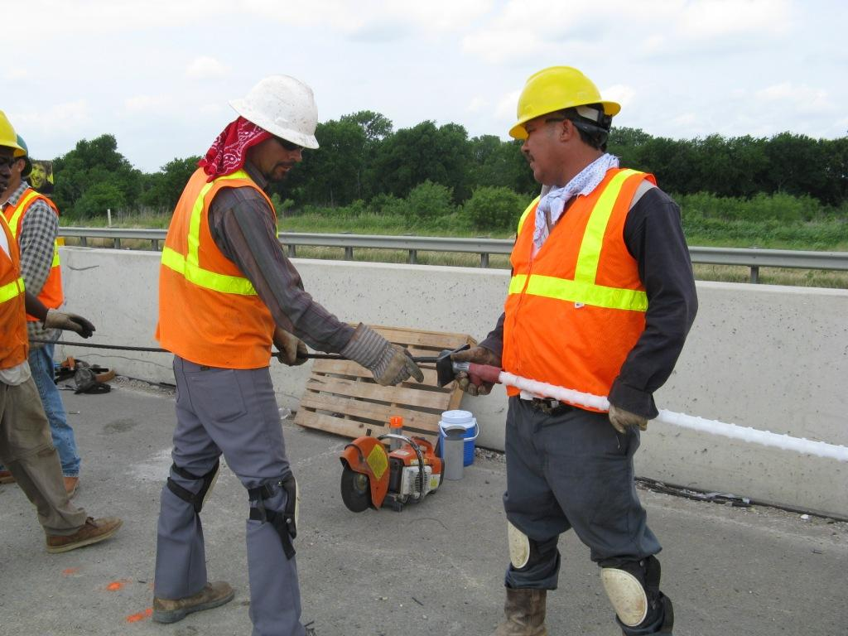
Notes:
Assembly of longitudinal tendons

Slide 8
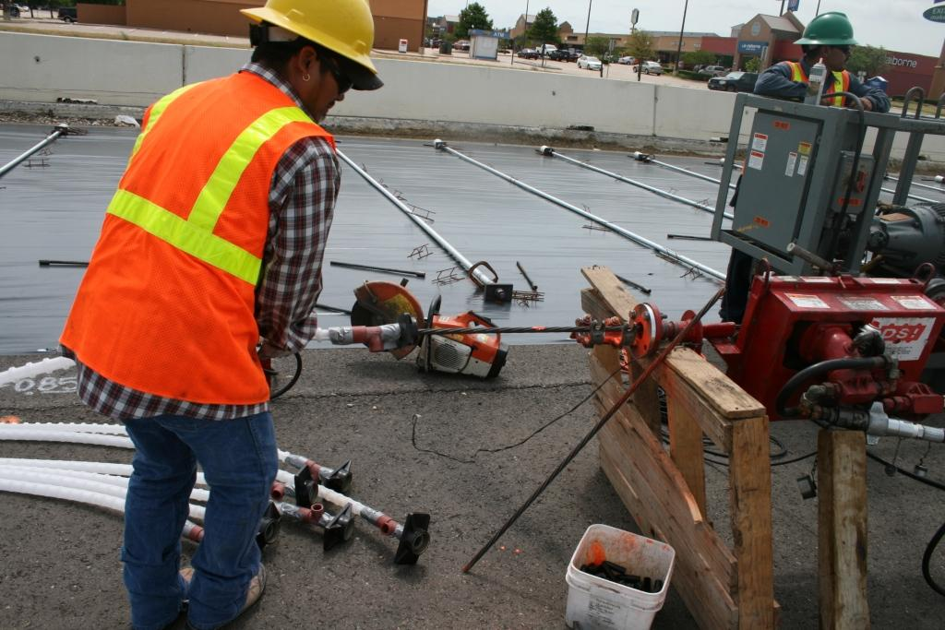
Notes:
Later on, they used machine to assemble longitudinal tendons – improved efficiency

Slide 9
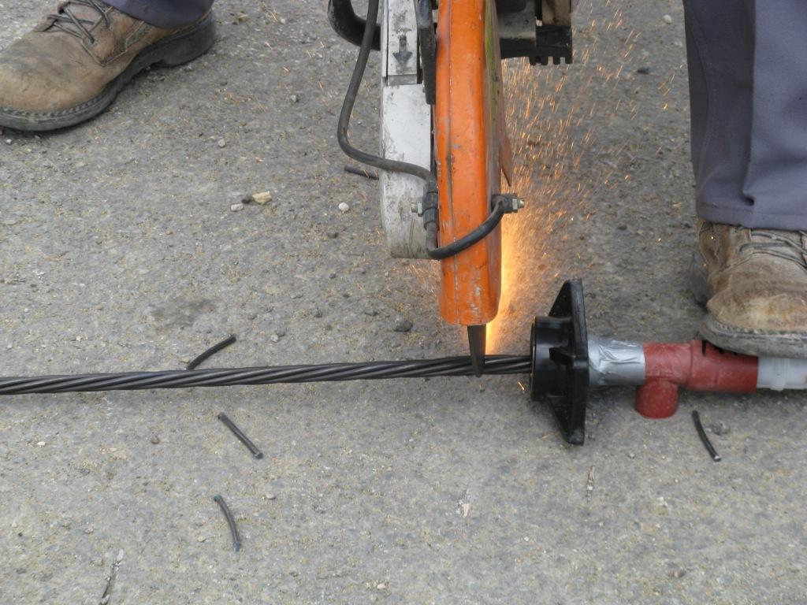
Notes:
Cutting the tendon at the right length: early-stage practice

Slide 10
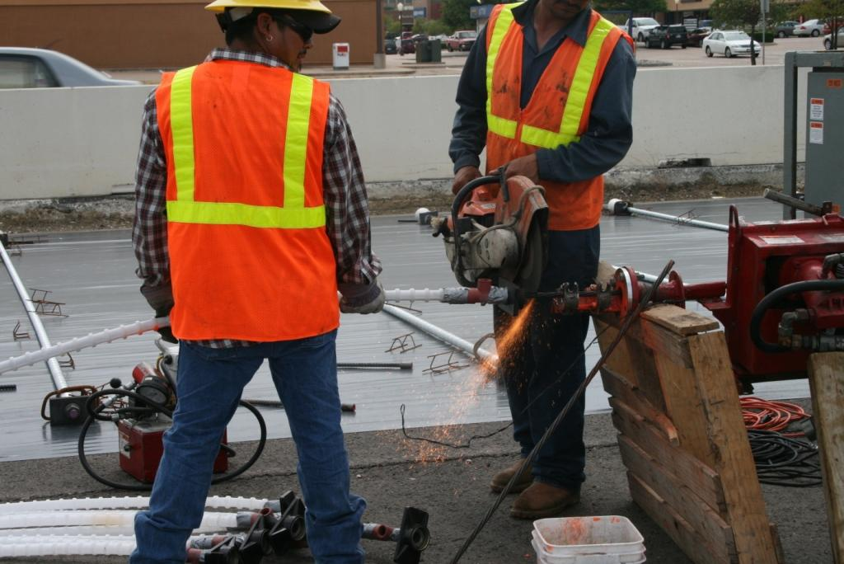
Notes:
Cutting the tendon at the right length: improved practice

Slide 11
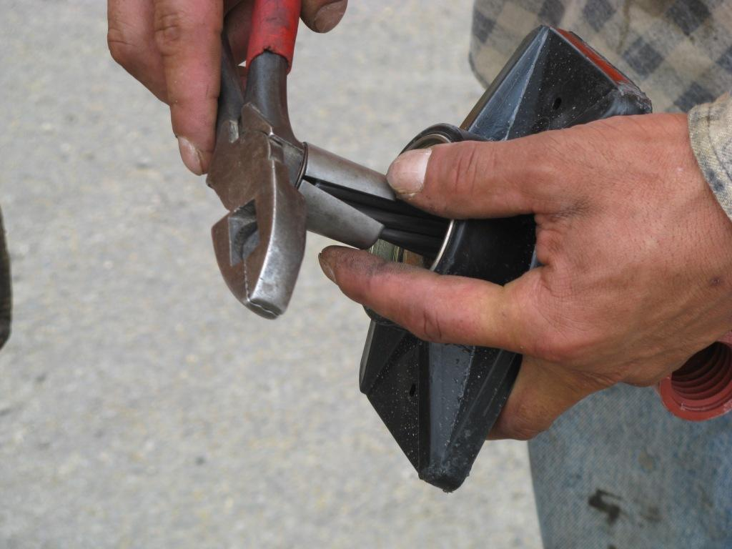
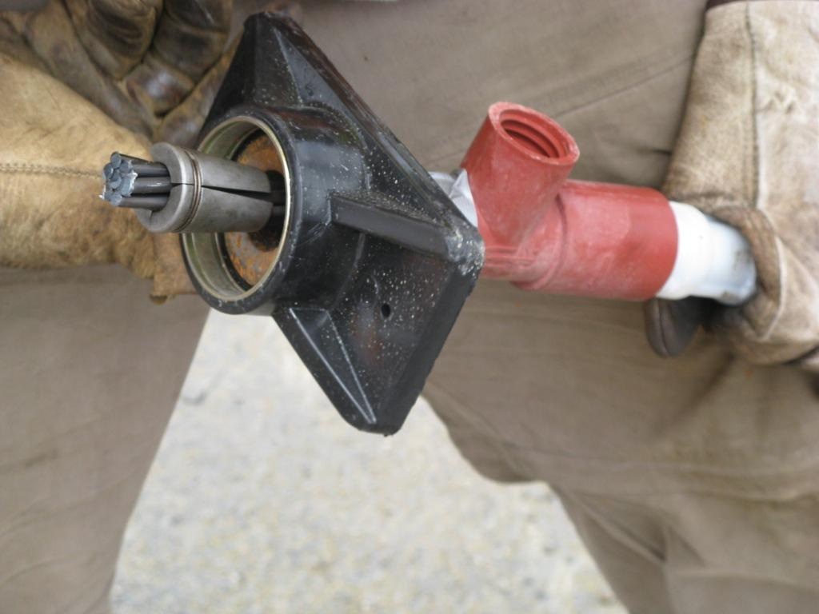

Slide 12
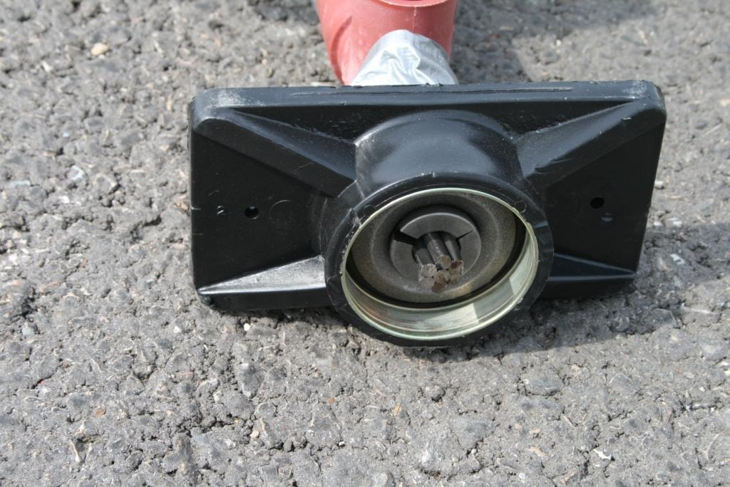
Notes:
Close-up view of assembled dead end anchor

Slide 13
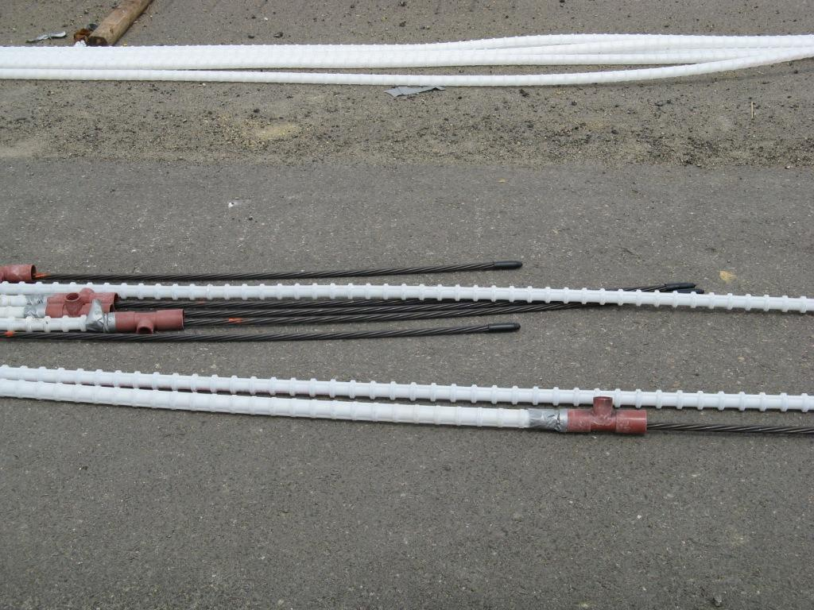
Notes:
The other end of longitudinal tendon assembly

Slide 14
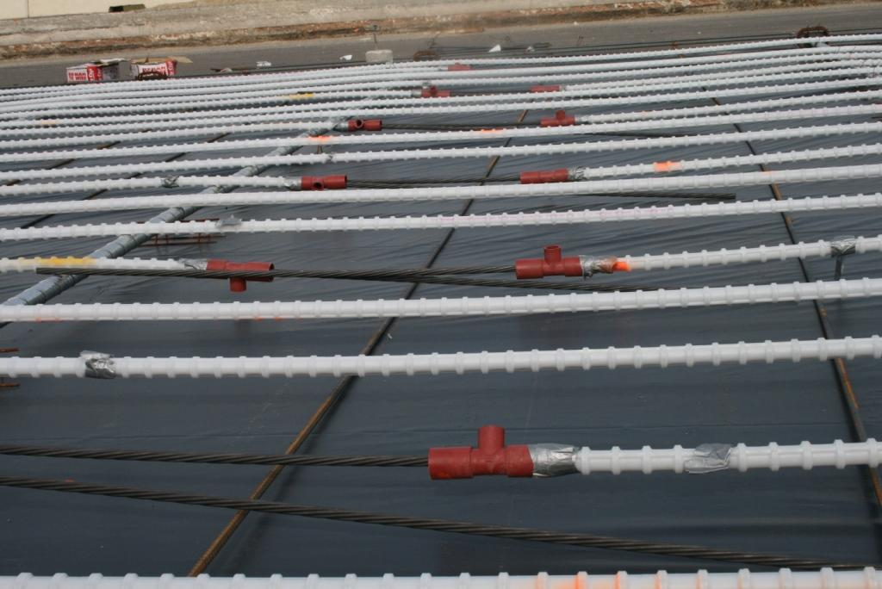
Notes:
Tendons at stressing pocket locations

Slide 15
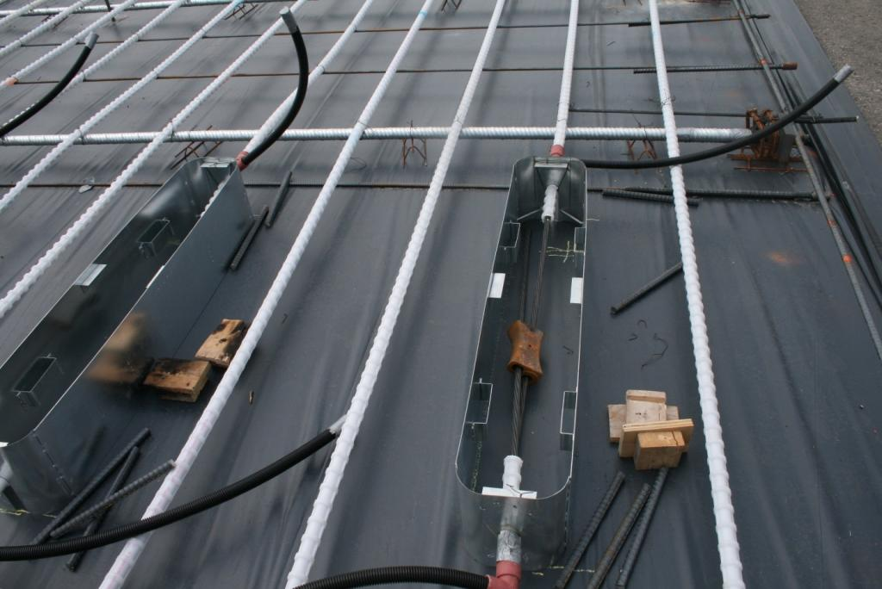
Notes:
Stressing pockets

Slide 16
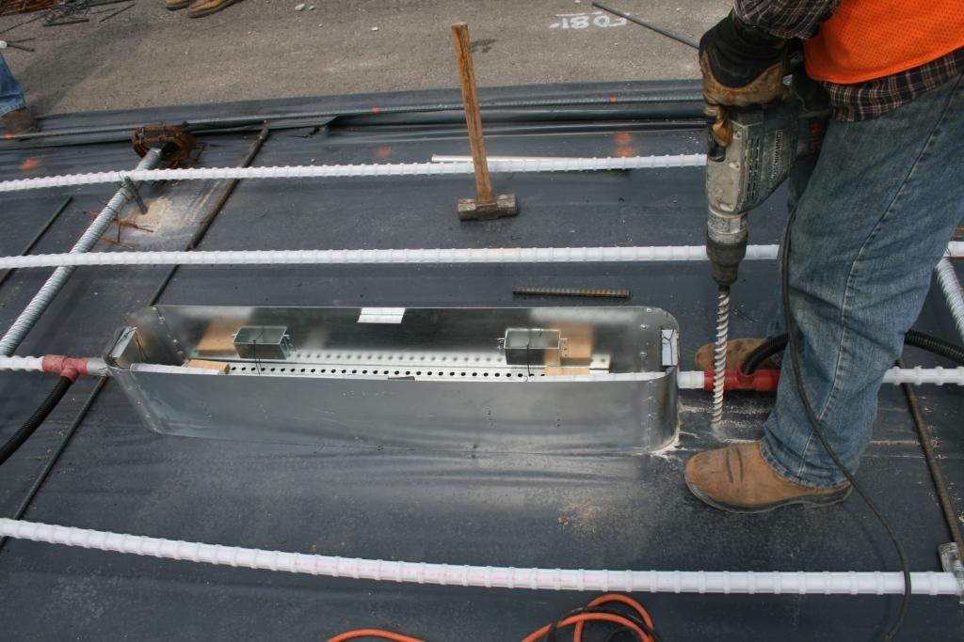
Notes:
Stressing pocket installation

Slide 17
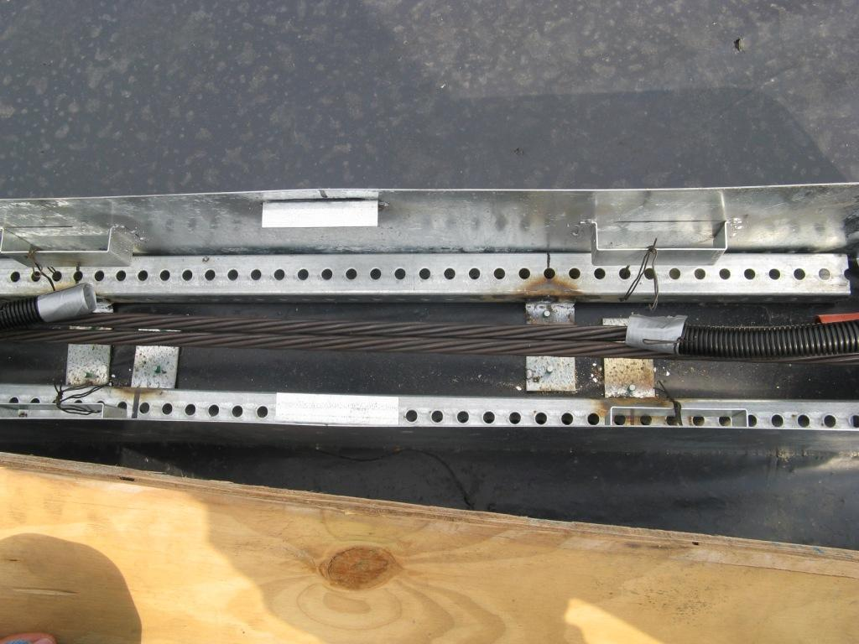
Notes:
Close-up view of stressing pocket (8-in wide x 48-in long)

Slide 18
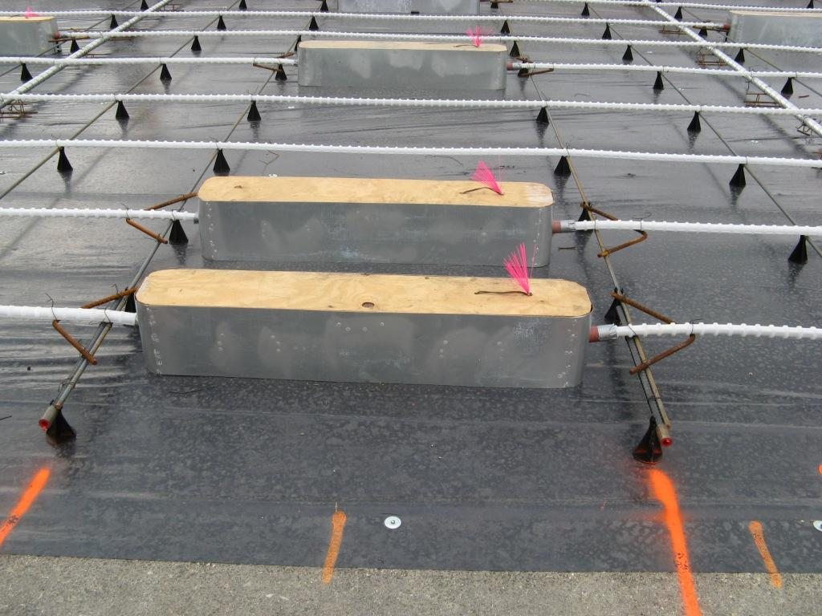
Notes:
Stressing pockets with cover on

Slide 19
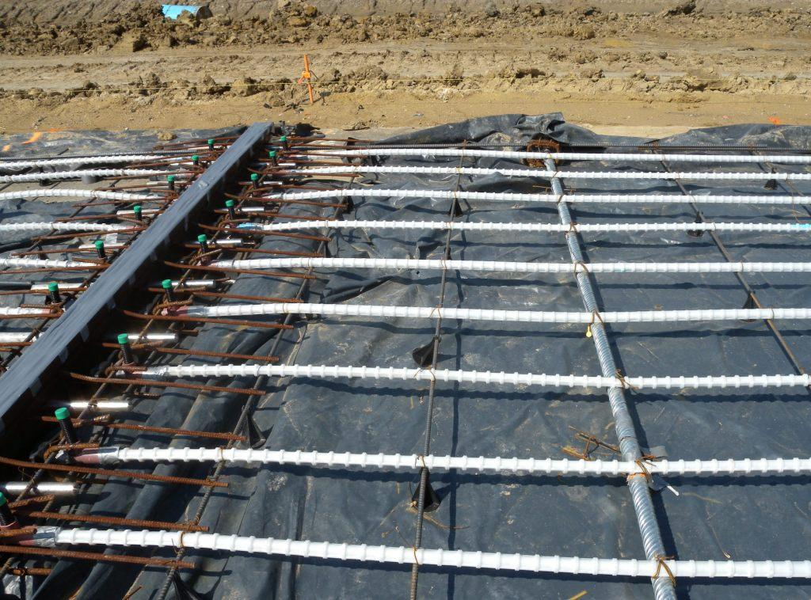
Notes:
Maturity meter (i-button) in place at the first transverse post-tensioning bar (direction of concrete placement from right to left, so that the strength estimate using maturity is somewhat conservative)

Slide 20
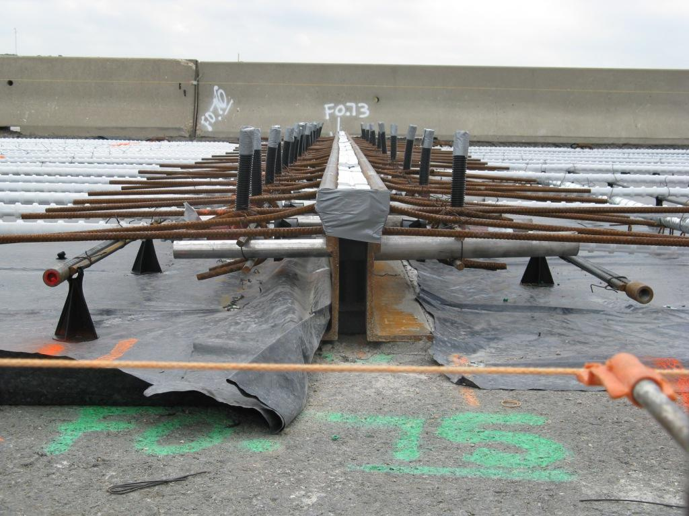
Notes:
Armor joint with anchor bars and stainless steel dowels along with grout tubes

Slide 21
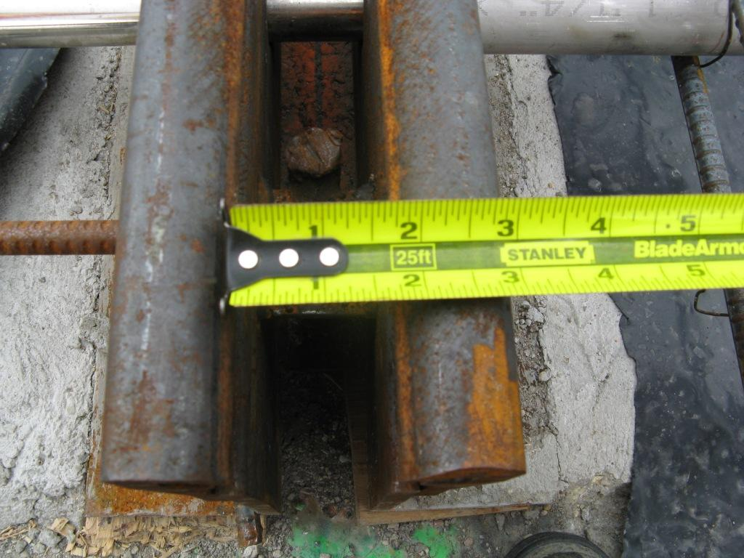
Notes:
Initial joint opening (3/4 inches0

Slide 22
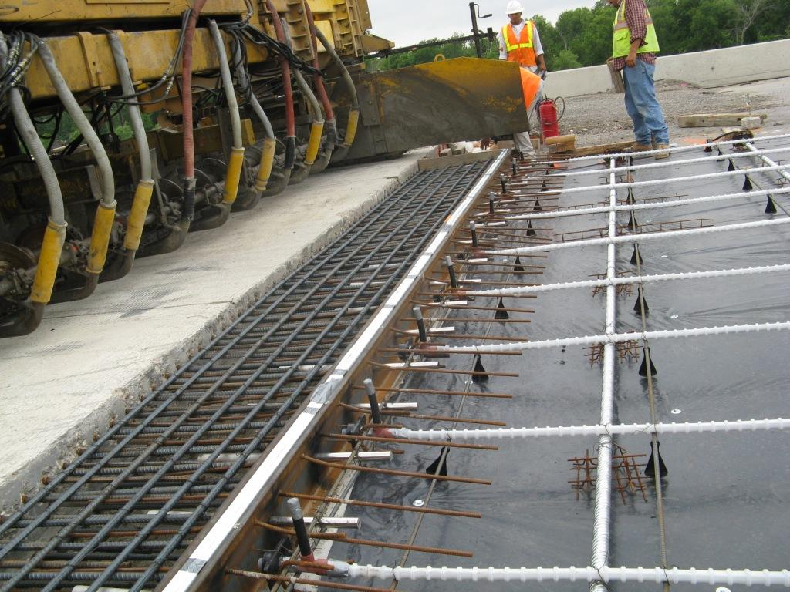
Notes:
First day of paving (May 27, 2008)

Slide 23
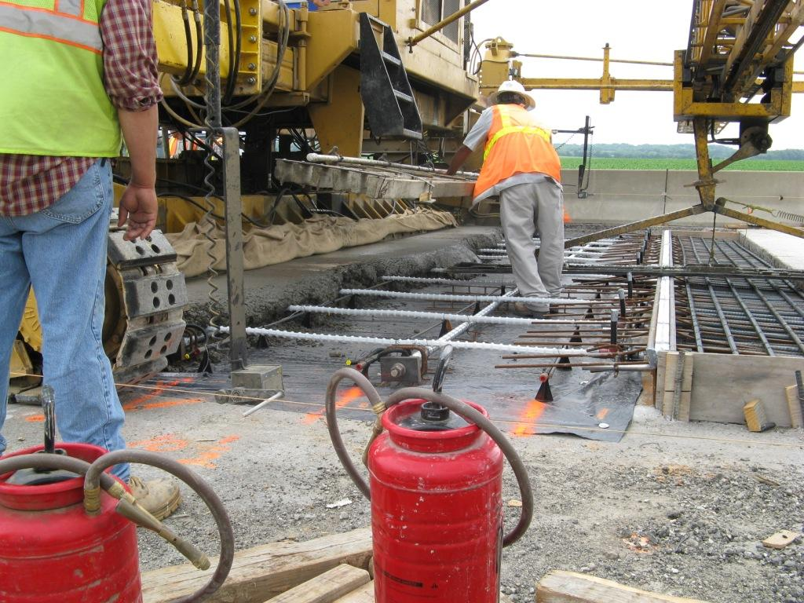
Notes:
Concrete placement started about 10-ft beyond the first armor joint, and the area between 14-in CRCP and this starting location was placed by hand

Slide 24
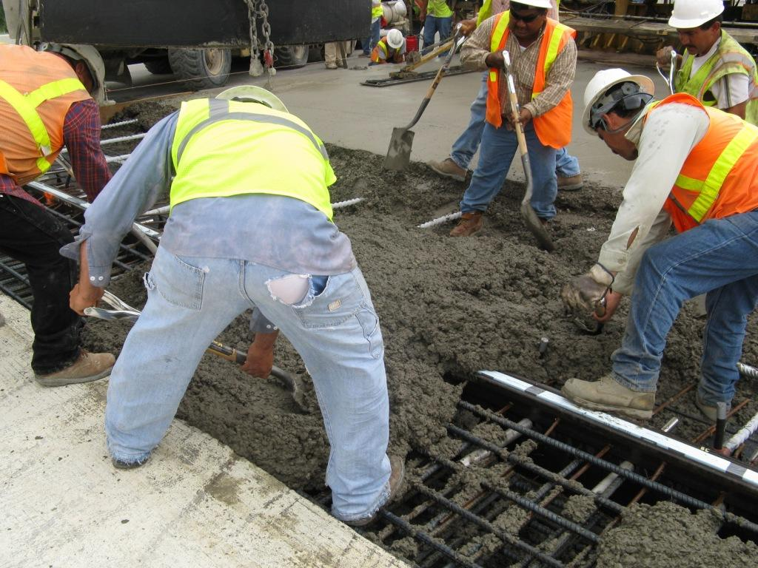
Notes:
Concrete placement by hand with forms on the side

Slide 25
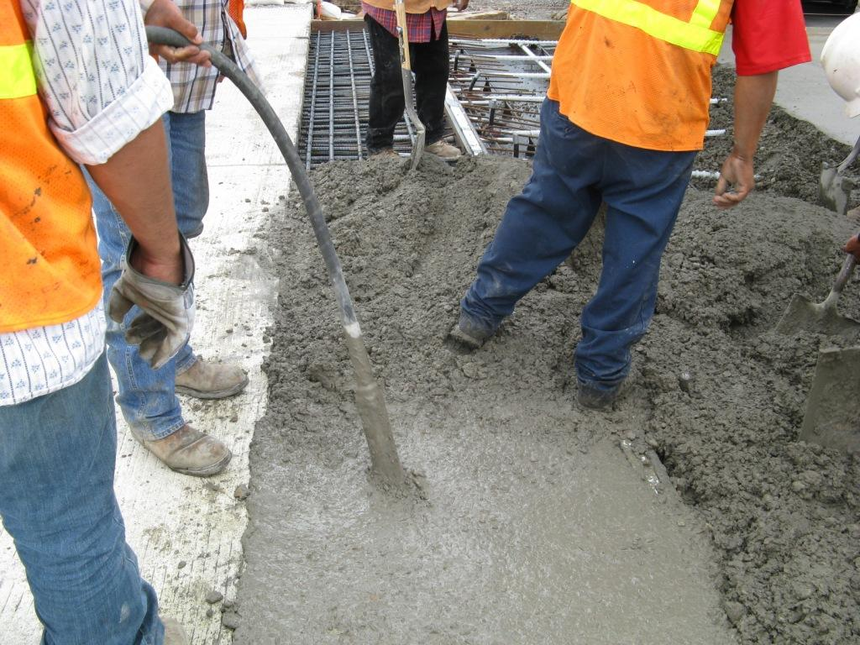
Notes:
Vibration of concrete at the gap slab

Slide 26
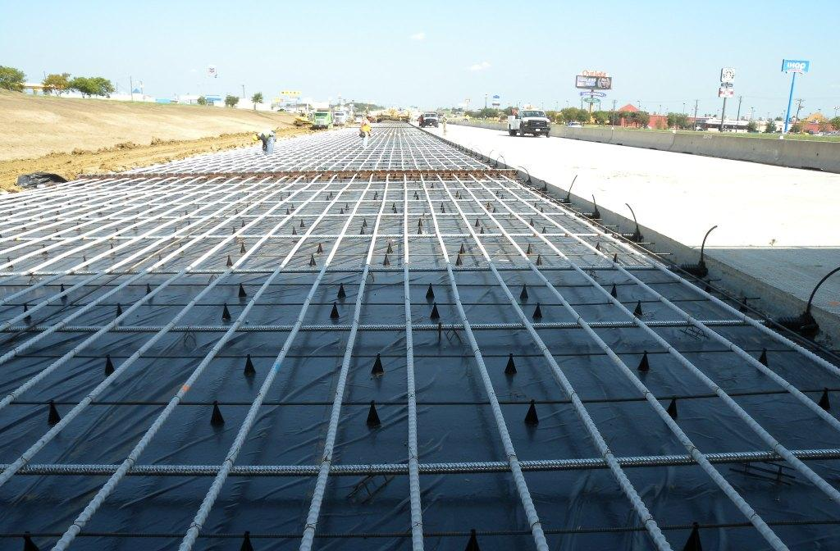
Notes:
Tendons ready and concrete placement in progress

Slide 27
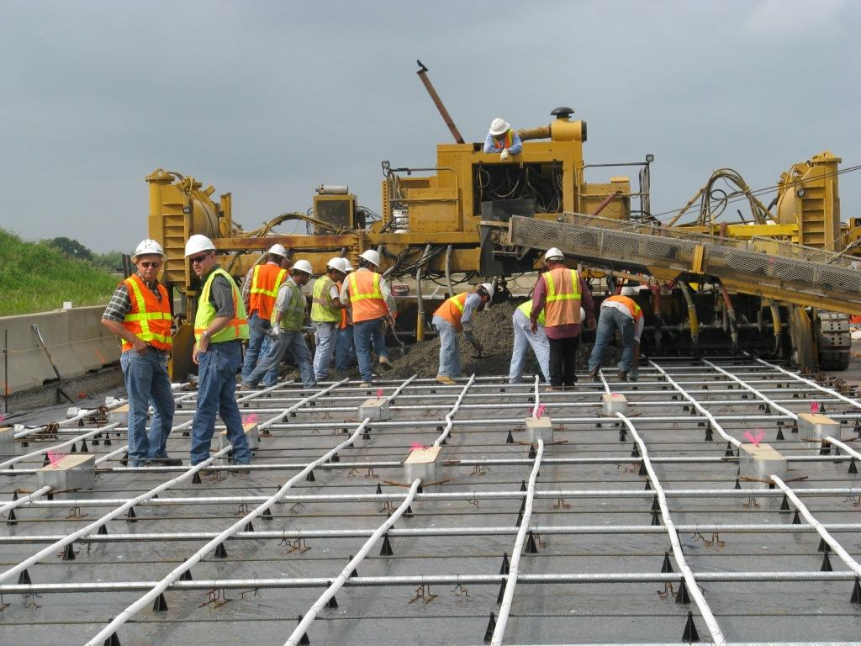
Notes:
Once the concrete paving started, there was not much difference in concrete placement between PCP construction and other PCC paving construction. Placer and spreader was used to supply concrete, and same type of slip form paver was used. The speed of the paver was comparable to or a little bit slower than that for normal PCC paving.

Slide 28
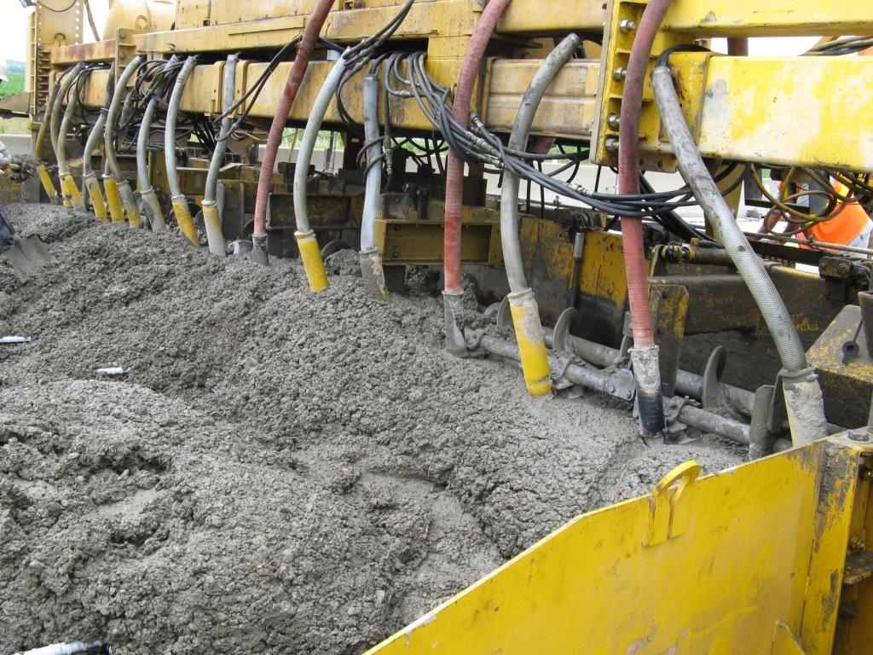
Notes:
Enough concrete in front of the paver

Slide 29
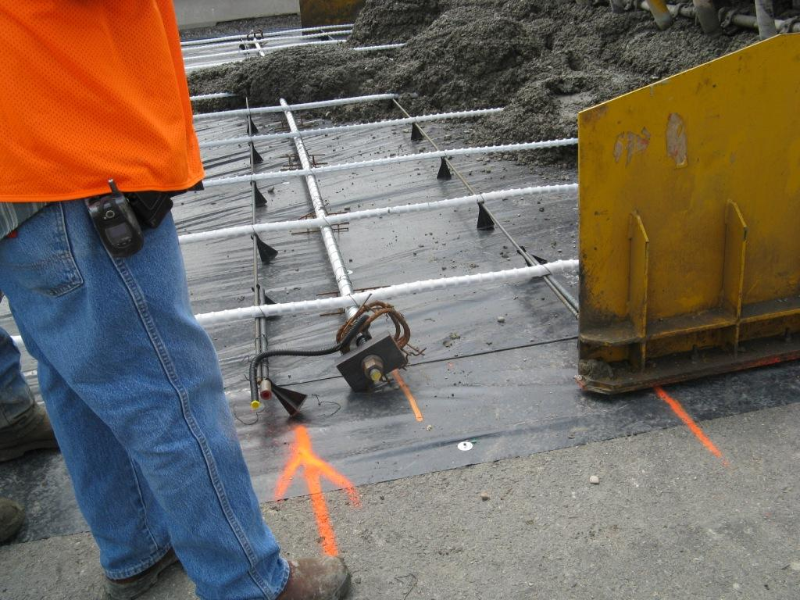
Notes:
On the first day, transverse reinforcements being pushed by concrete pressure

Slide 30
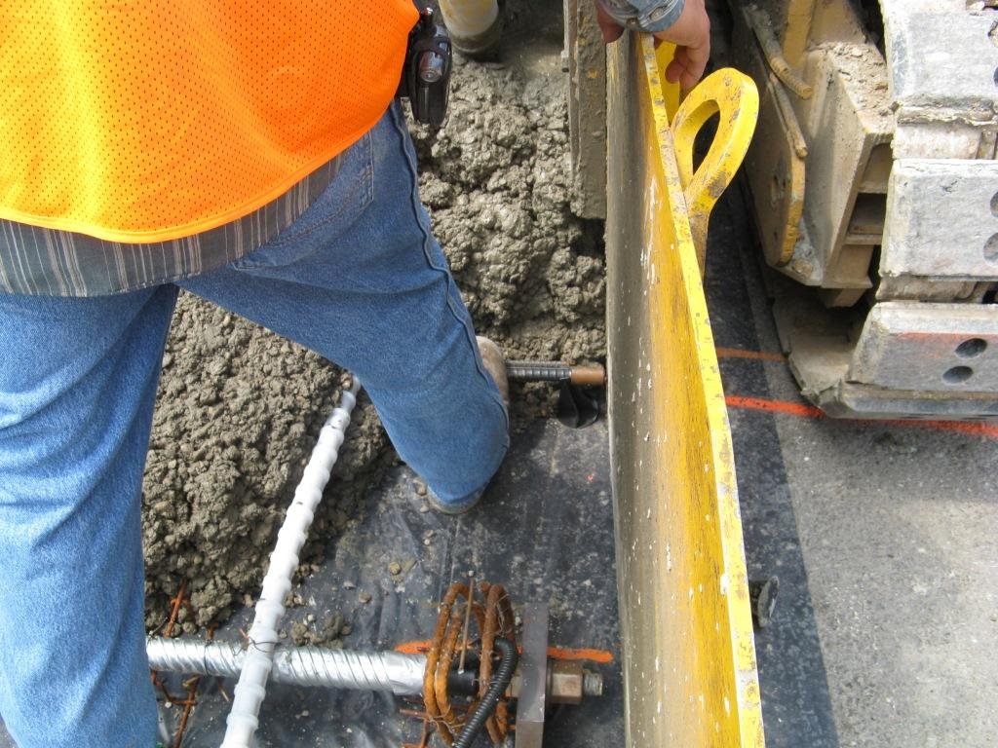
Notes:
Contractor trying to hold transverse steel while the paver is approaching

Slide 31
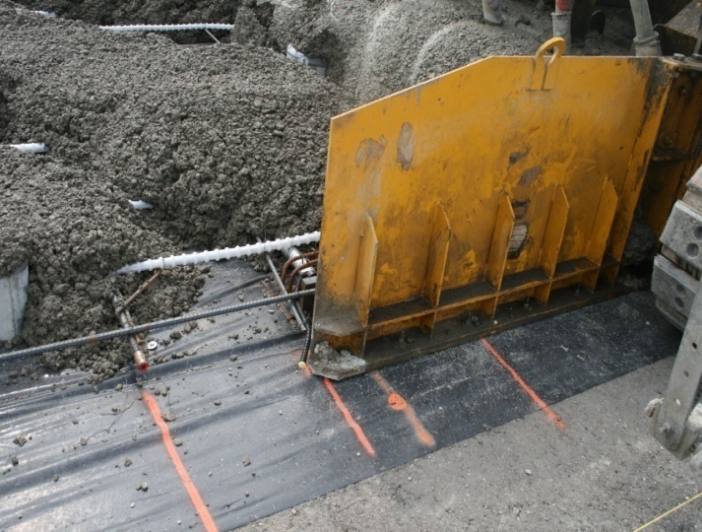
Notes:
Contractor came up with the idea of placing longitudinal steel and tie transverse reinforcements to the longitudinal steel. This helped a little in preventing transverse reinforcements being pushed.

Slide 32
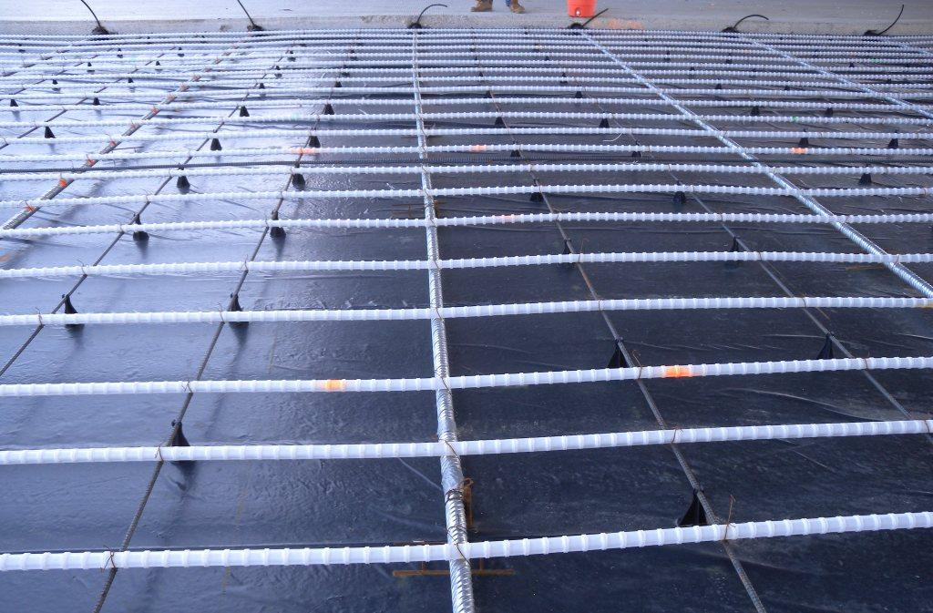
Notes:
Later, the contractor used bars that they hammered into the subbase, in addition to longitudinal steel described in the previous slide, to hold transverse post-tensioning bars. A total of four bars were driven into the subbase per transverse post-tensioning bar. These bars, however, were installed every third transverse post-tensioning bar. This practice needs further evaluation since the bars will restrain concrete volume changes and could result in pre-stress loss.

Slide 33
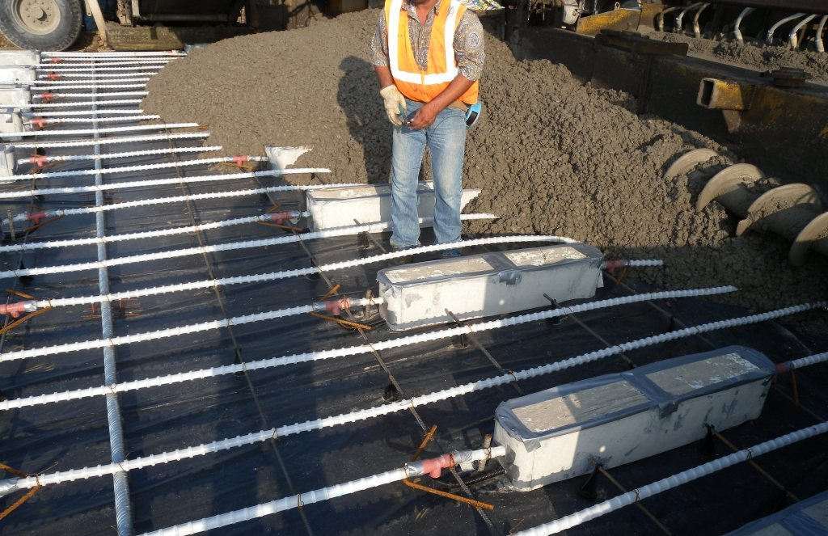
Notes:
With all the efforts to keep the reinforcements in place during concrete placement, undulations in longitudinal tendons are observed.

Slide 34
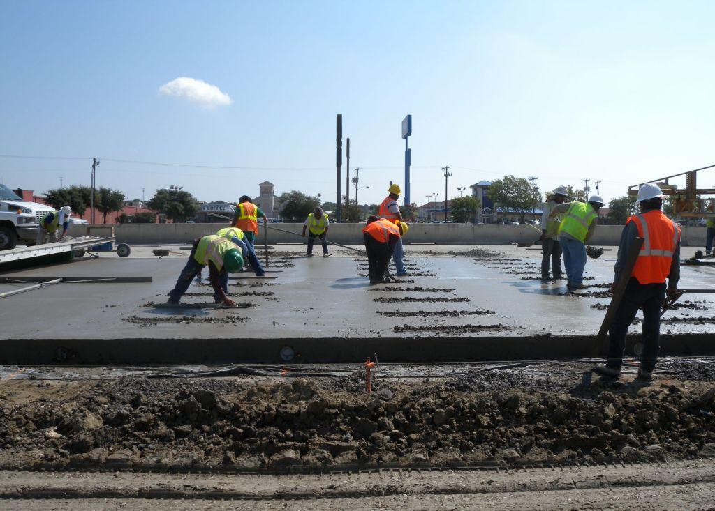
Notes:
Working on stressing pockets – quite labor intensive

Slide 35
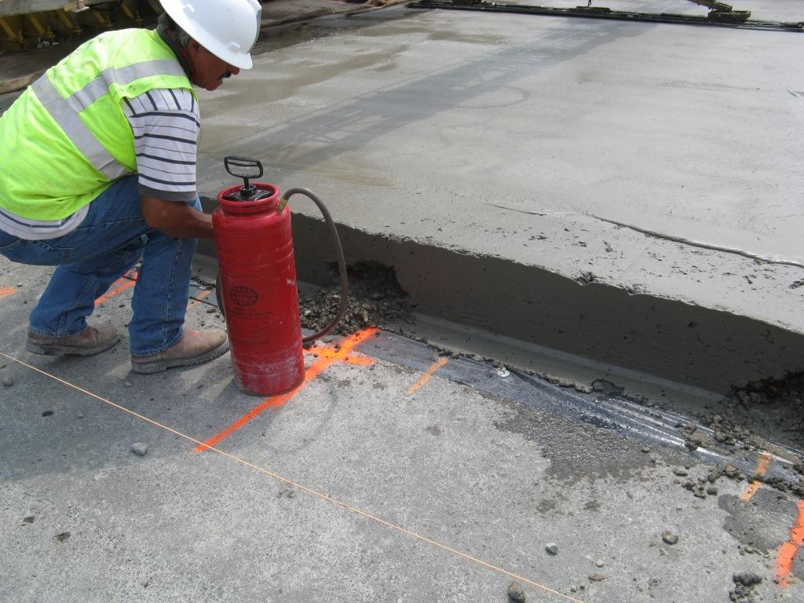
Notes:
Locating pockets for transverse post-tensioning bars assembly

Slide 36
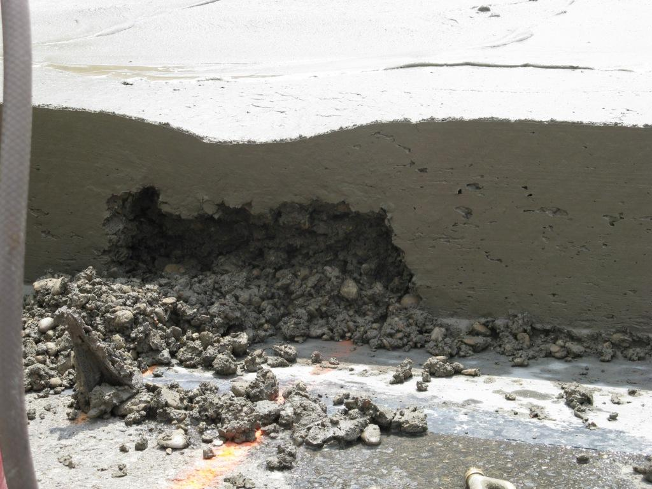
Notes:
Edge failure at the transverse post-tensioning bars assembly

Slide 37
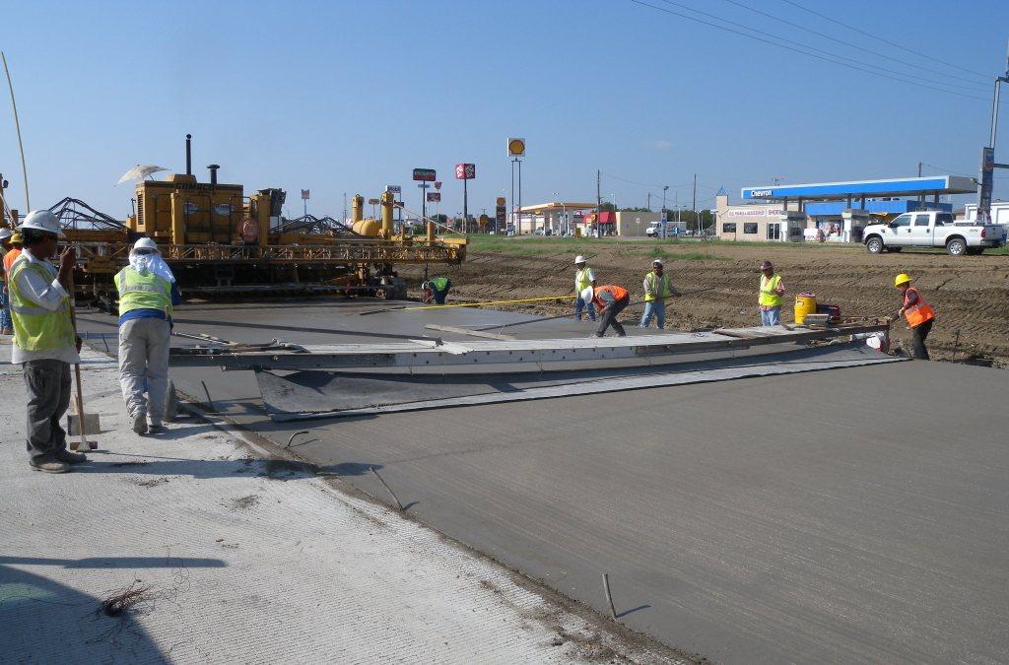
Notes:
Little difference in finishing operations from those for normal PCC pavements, even though it was stated that the finishers were able to “feel” as if the slab was moving while they were finishing with straight-edge (apparently due to plastic sheet underneath).

Slide 38
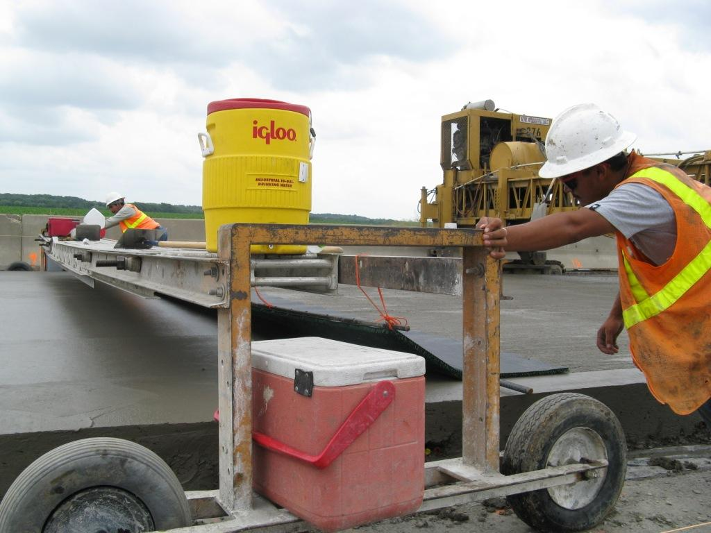
Notes:
Carpet drag operation – no difference from normal concrete paving

Slide 39
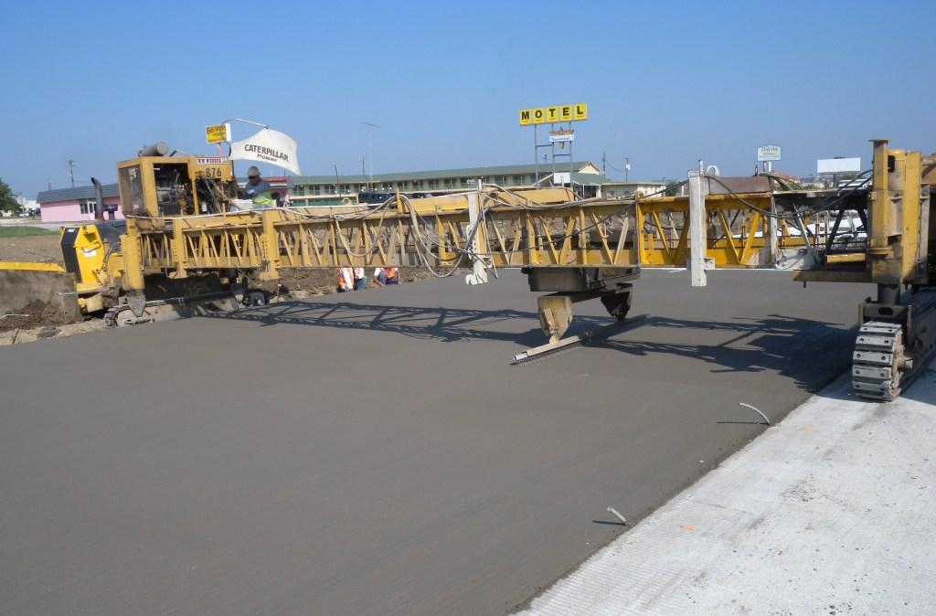
Notes:
Tining operations are the same. Grout hoses are shown for transverse post-tension bars

Slide 40
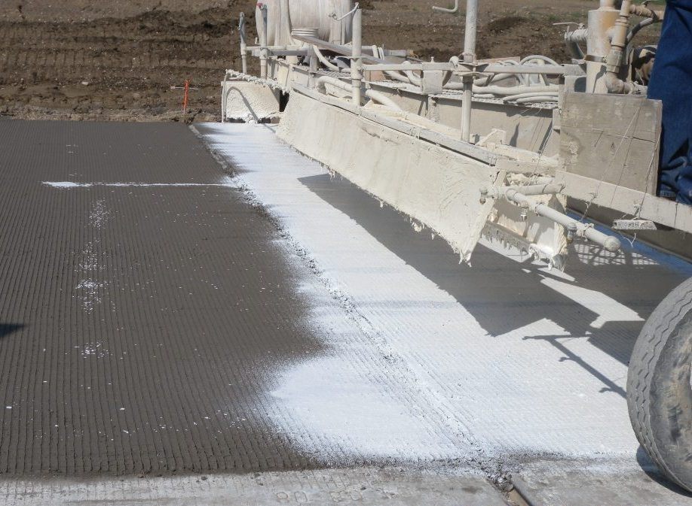
Notes:
No difference in curing machine operations

Slide 41
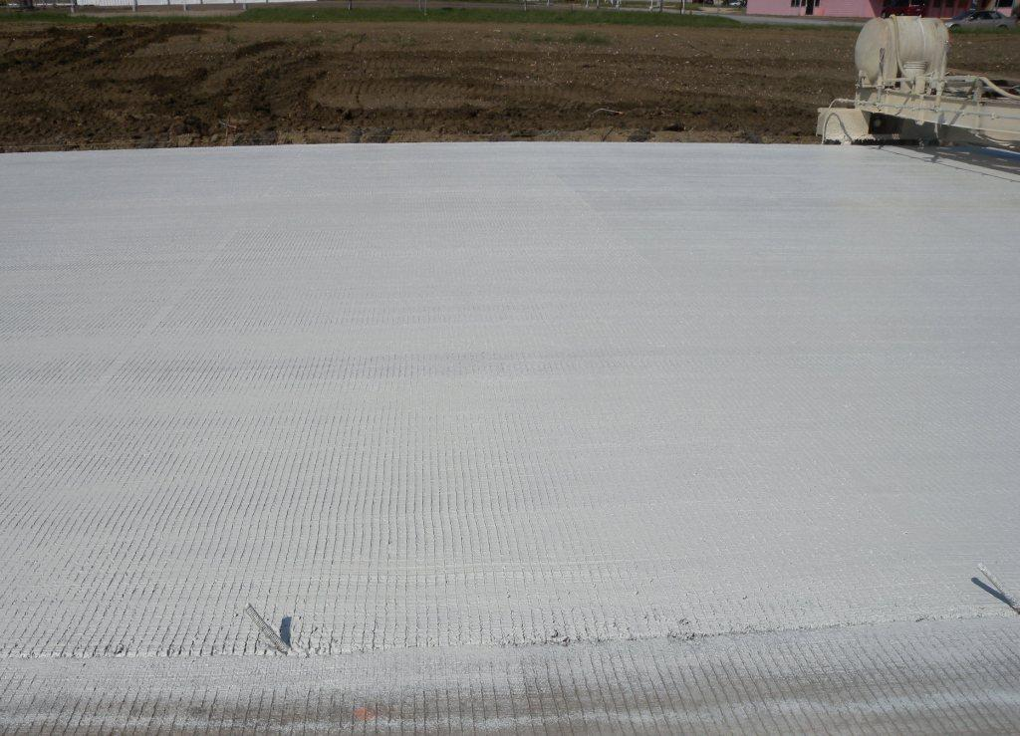
Notes:
Good curing

Slide 42
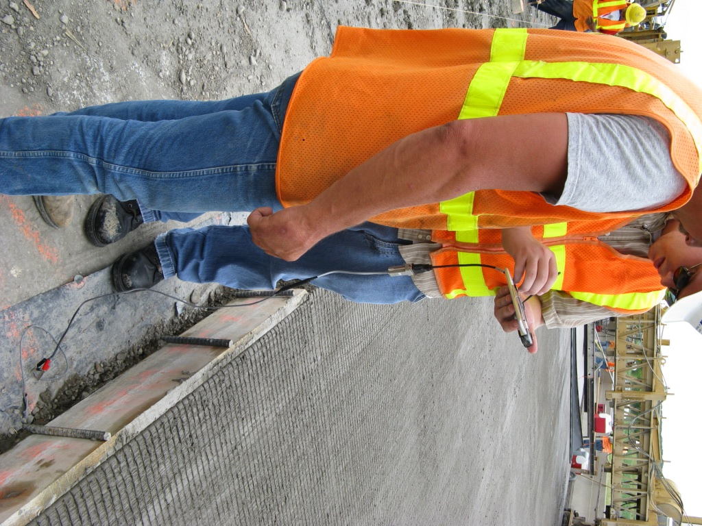
Notes:
Checking the maturity to estimate compressive strength for the time of initial post-tensioning

Slide 43
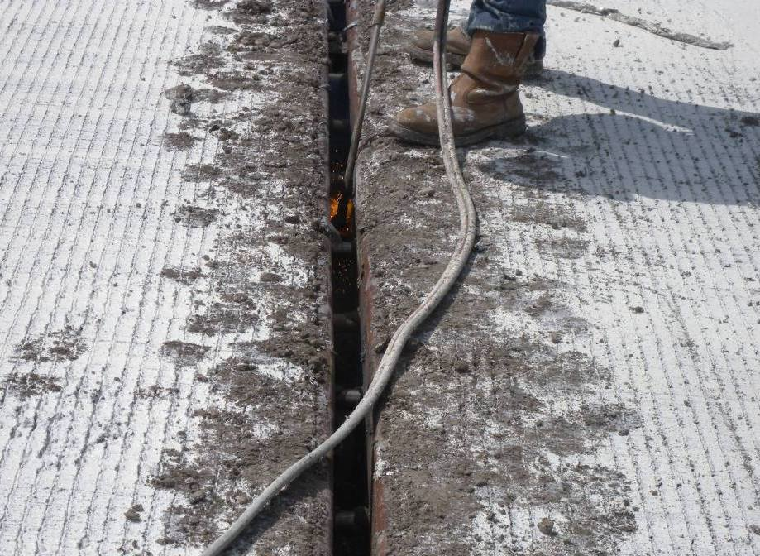
Notes:
Steel piece that holds the armor joint is removed before the initial post-tensioning is applied.

Slide 44
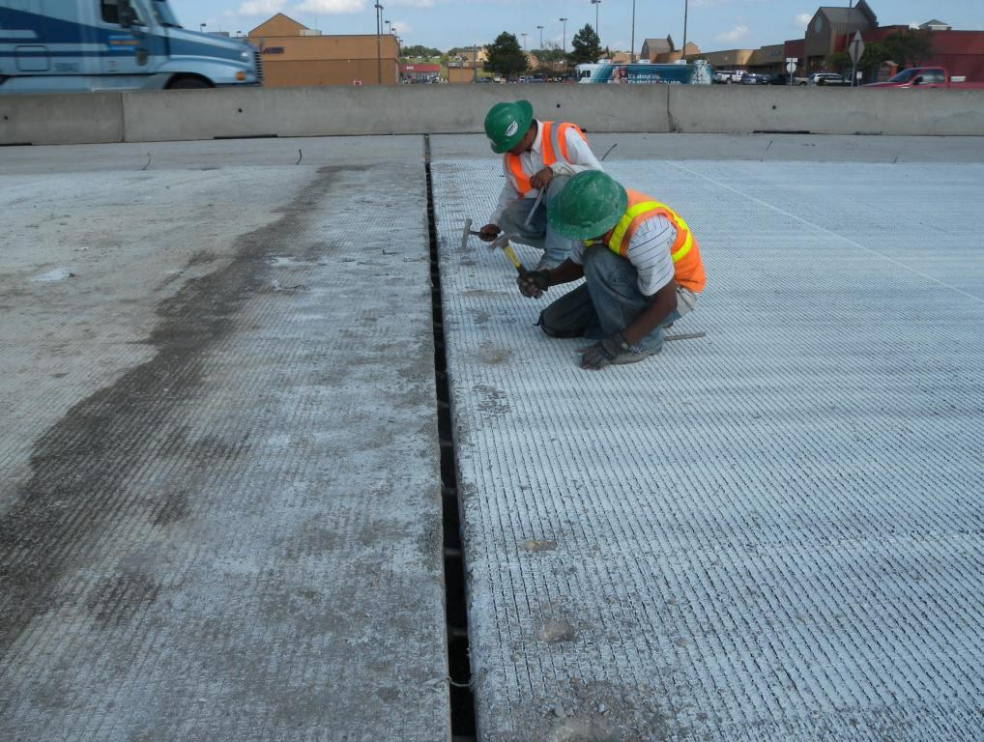
Notes:
Locating grout hoses chipping concrete to expose grouting hoses at armor joint

Slide 45
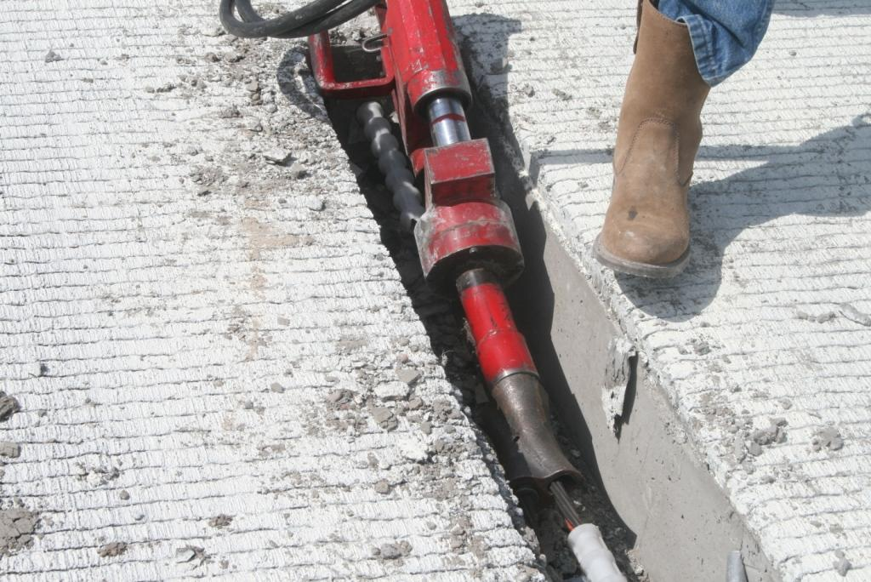
Notes:
Initial post-tensioning

Slide 46
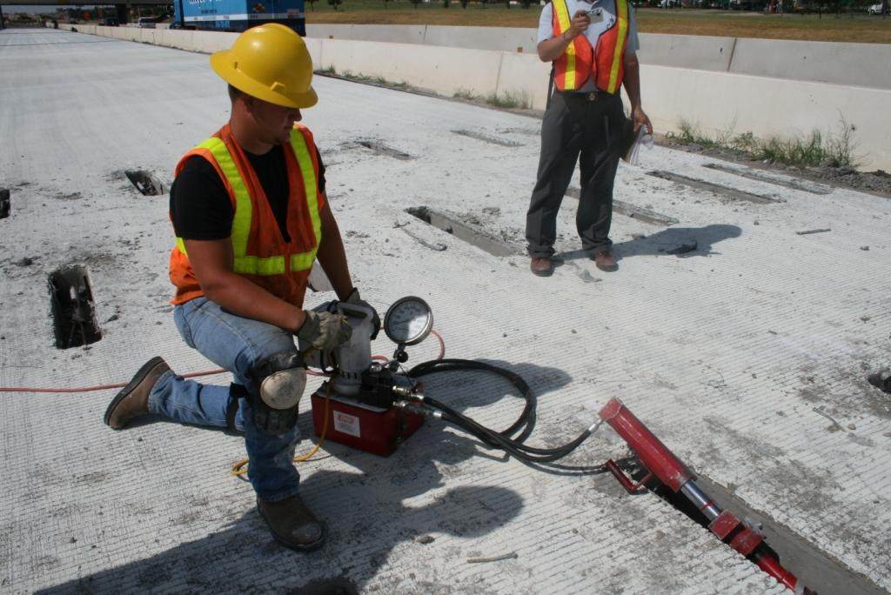
Notes:
Initial post-tensioning (target: 15 kips per tendon)

Slide 47
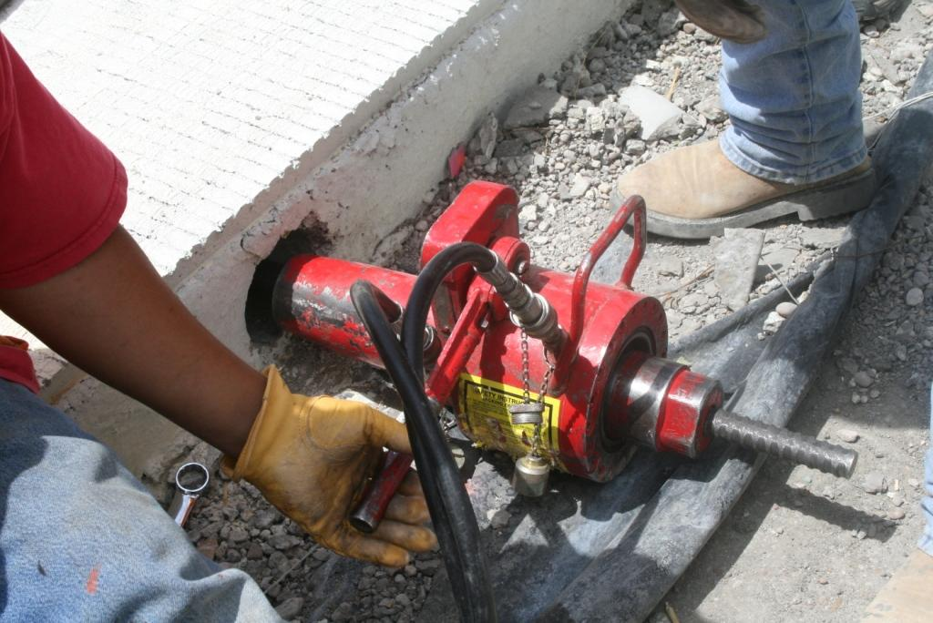
Notes:
Post-tensioning for transverse post-tensioning bar (target: 46.6 ksi per bar)

Slide 48
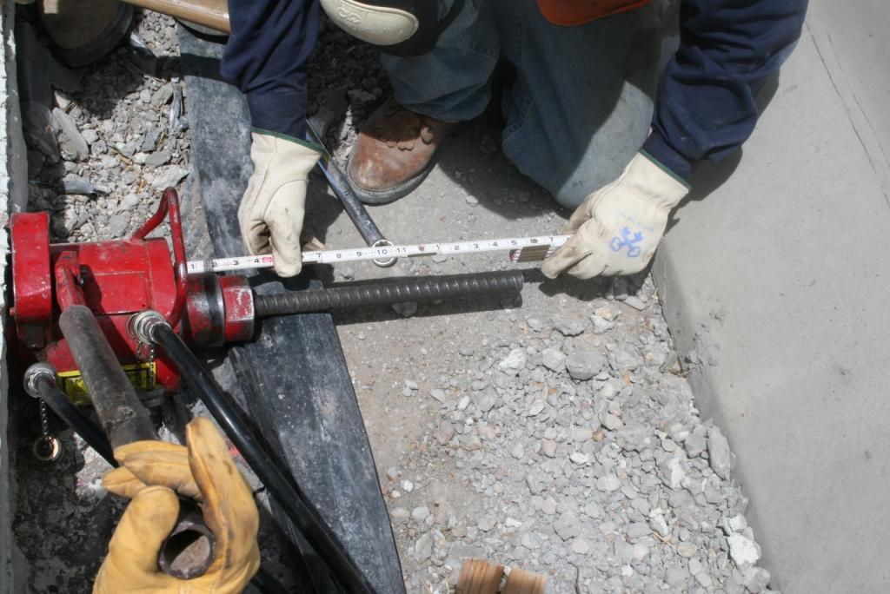
Notes:
Measuring the extension of transverse bar during post-tensioning operation

Slide 49
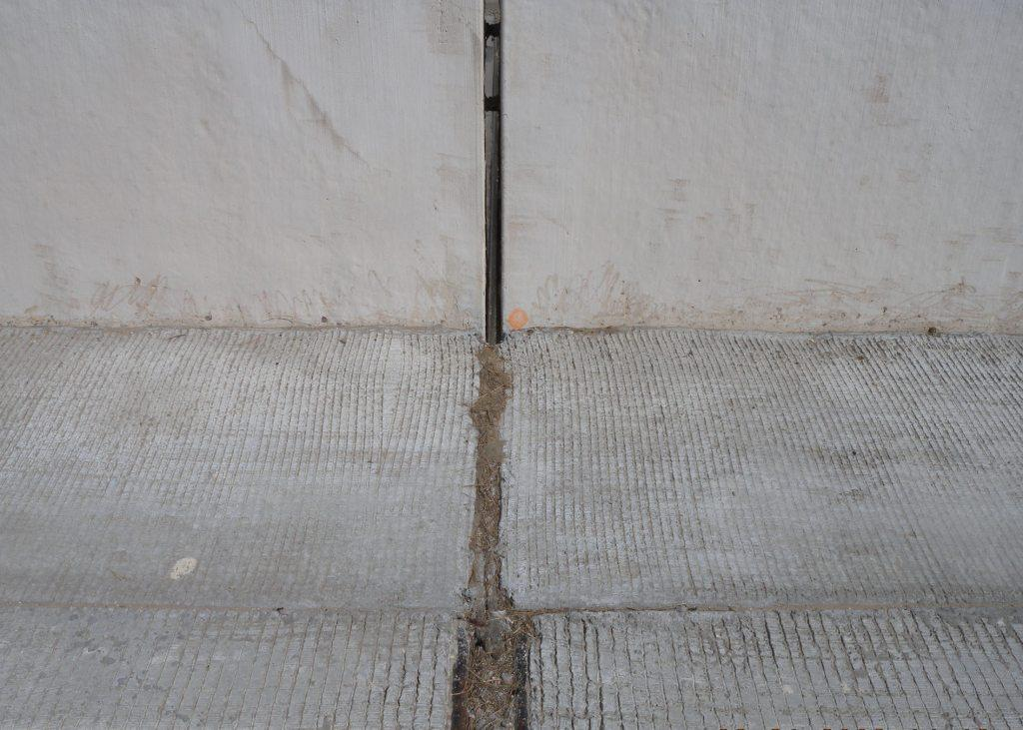
Notes:
CRCP gap slab

Slide 50
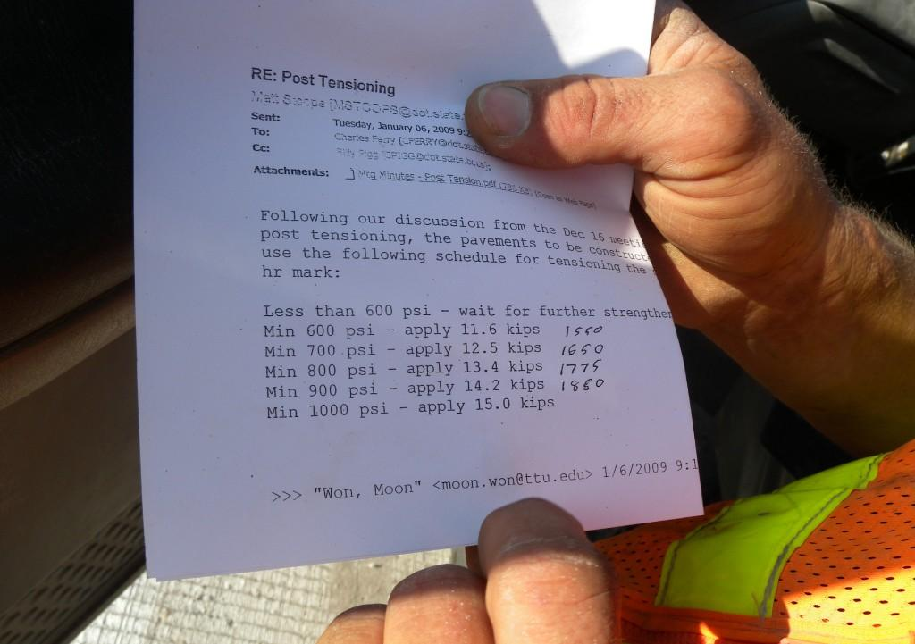
Notes:
Contractor looking at the sheet to determine how much post-tensioning force he has to apply. This table was to address low strength due to cold temperature. The numbers in the far right column are the pressure they will go by on the gage in slide 46.

Slide 51

Notes:
A transverse crack was observed on the slab placed on Aug 4, 2008. The crack was near the center of the slab.

Slide 52

Notes:
Longitudinal crack was also observed on the slab placed on August 4, 2008.

Slide 53
Instrumentation

Slide 54
Testing Setup

Slide 55

Additional
VWSG location
Additional
VWSG location
VWSG
RH Gages
Stressing Pockets
Notes:
Over view of gages installed

Slide 56

Notes:
Vibrating wire strain gages placed in longitudinal and transverse directions, also at different depths

Slide 57

Notes:
Relative humidity sensors at different depths

Slide 58

Notes:
Slab displacement gages installed along the edge of the slab

Slide 59

Notes:
Connecting wires to data logger

Slide 60

Data Logger
Notes:
Semi-permanent data logger

