Slide 1
Basic Hydrology & Hydraulics: DES 601
Module XXX
TITLE

Slide 2
Module Outline
Background
Applicability
Using the Tool
Module 1

Slide 3
Acronyms
HDM: TxDOT Hydraulic Design Manual 2015 Ed. (on-line)
HDS2: FHWA-NHI-02-001 Highway Hydrology
ROT: Rule-of-Thumb
Module 1

Slide 4
Background
Culverts, bridges, and other obstructions change the water surface profile in a channel
The addition or removal of flow from a stream may affect the water surface downstream and possibly upstream
The effect on the water surface near the structure is known by modeling the receiving stream
Module 1

Slide 5
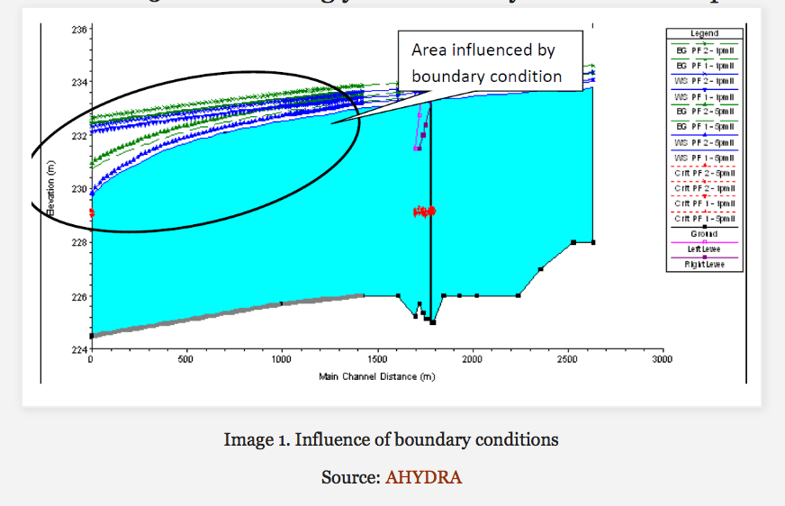
Background
Boundary effects can propagate into region of interest
Limited guidance on where to locate boundaries in HDM standard-step backwater method
Want boundary effects small in region of interest
Region of interest

Slide 6
Background
The designer would like to avoid modeling an entire stream system (many structures) to study the change at single location (one structure)
TxDOT Research 0-6841 examined existing literature and conducted a HEC-RAS study to develop Rules-Of-Thumb (ROT) for selecting boundary location distances
Module 1

Slide 7
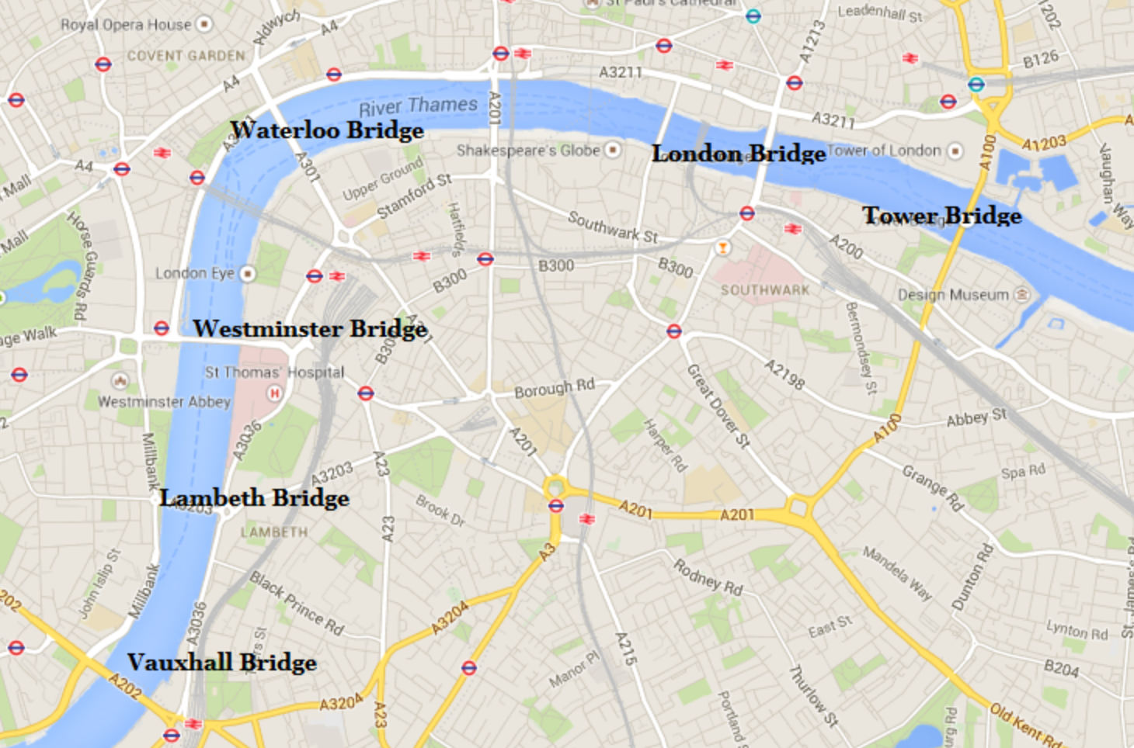
Background
How far do boundary effects extend?

Slide 8
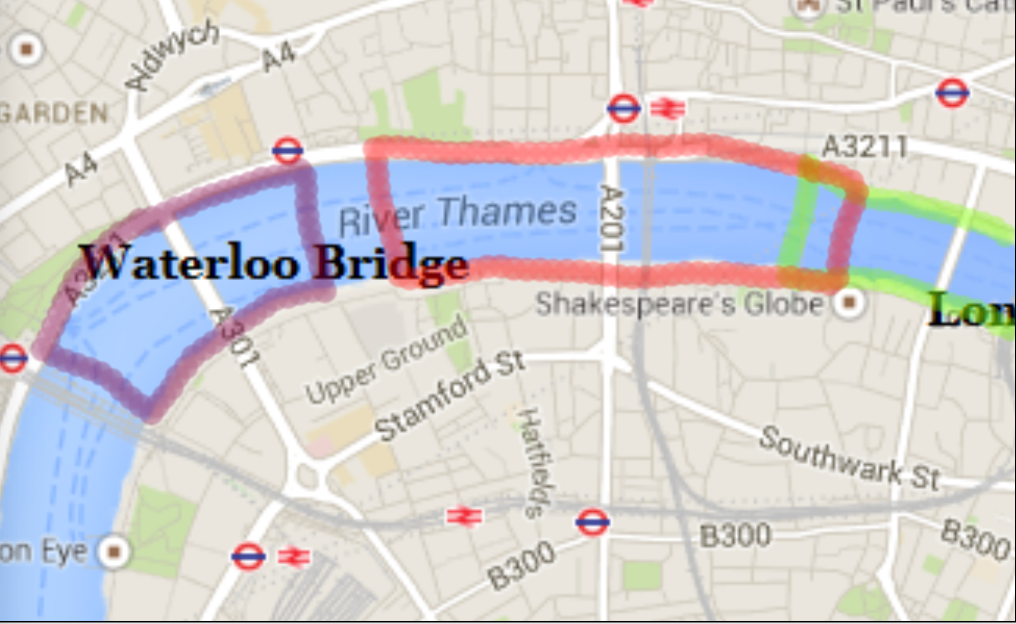
Background
How far do boundary effects extend?
Boundary here
Structure of Interest
ROT Boundaries overlap Consider upstream bridge
Treat As Single Bridge

Slide 9
Applicability
ROT are intended for examining a single location
Also identifies if additional locations should be included
Locate boundary distances for structure of interest
If nearby structures boundaries have overlap, then include these in overall modeling effort

Slide 10
Rules-Of-Thumb
Four rules emerged from the study:
Boundary distance is approximately where the estimate is the result of Equation 4 Modeling a Change in Flowrate through Detention or Additional Pavement on the Receiving Stream, FHWA/TX-15/0-6841-1

Slide 11
Rules-Of-Thumb
Four rules emerged from the study:
Boundary distance is approximately 20 to 30 bank full channel widths Wildland Hydrology, 2013. References in support of stream restoration, erosion control, and geomorphology. Accessed on July 7, 2013 at http://www.wildlandhydrology.com/html/references_.html

Slide 12
Rules-Of-Thumb
Boundary distance approximately 100 to 500 feet approaching (upstream) and 300 to 1,500 feet departing (downstream) Nebraska Department of Roads. (2015). Hydraulic Analysis Guidelines. Bridge Division.

Slide 13
Rules-Of-Thumb
Boundary distance L approximately where D is bank full depth and S₀ is the channel slope. Samuels, P. (1989). Backwater Lengths in Rivers. Proceedings of the Institution of Civil Engineers (p. 571582). Great Britian: Hydraulics Research. Castellarin, A., Baldassarre, G. D., Bates, P., and Brath, A. (2009). Optimal Cross-Sectional Spacing in Preissmann Scheme 1D Hydrodynamic Models. Journal of Hydraulic Engineering , 96-105.

Slide 14
Rules-Of-Thumb
The four rules produce different results, but most are of similar magnitude
Ultimate decision is designer’s judgment
To facilitate the calculations involved a spreadsheet-based tool was built that implements the four rules, then the designer chooses a preferred rule and can use that value to establish modeling boundaries

Slide 15
Using the Tool
BoundaryDistanceRuleOfThumb-2015.xlsm
Implements the various ROT distances; the designer must make the decision which guidance to follow, although the tool reports several different guidelines

Slide 16
Using the Tool – Needed Values
Reference Discharge – The original pre-change discharge at the location
Test Discharge – The added or reduced discharge at the location
Structure opening flow area
Far field flow area
Far field top width
Bank full flow depth
Bank full flow width
Curved or Straight Channel
Skewed or Aligned Hydraulic Structure

Slide 17
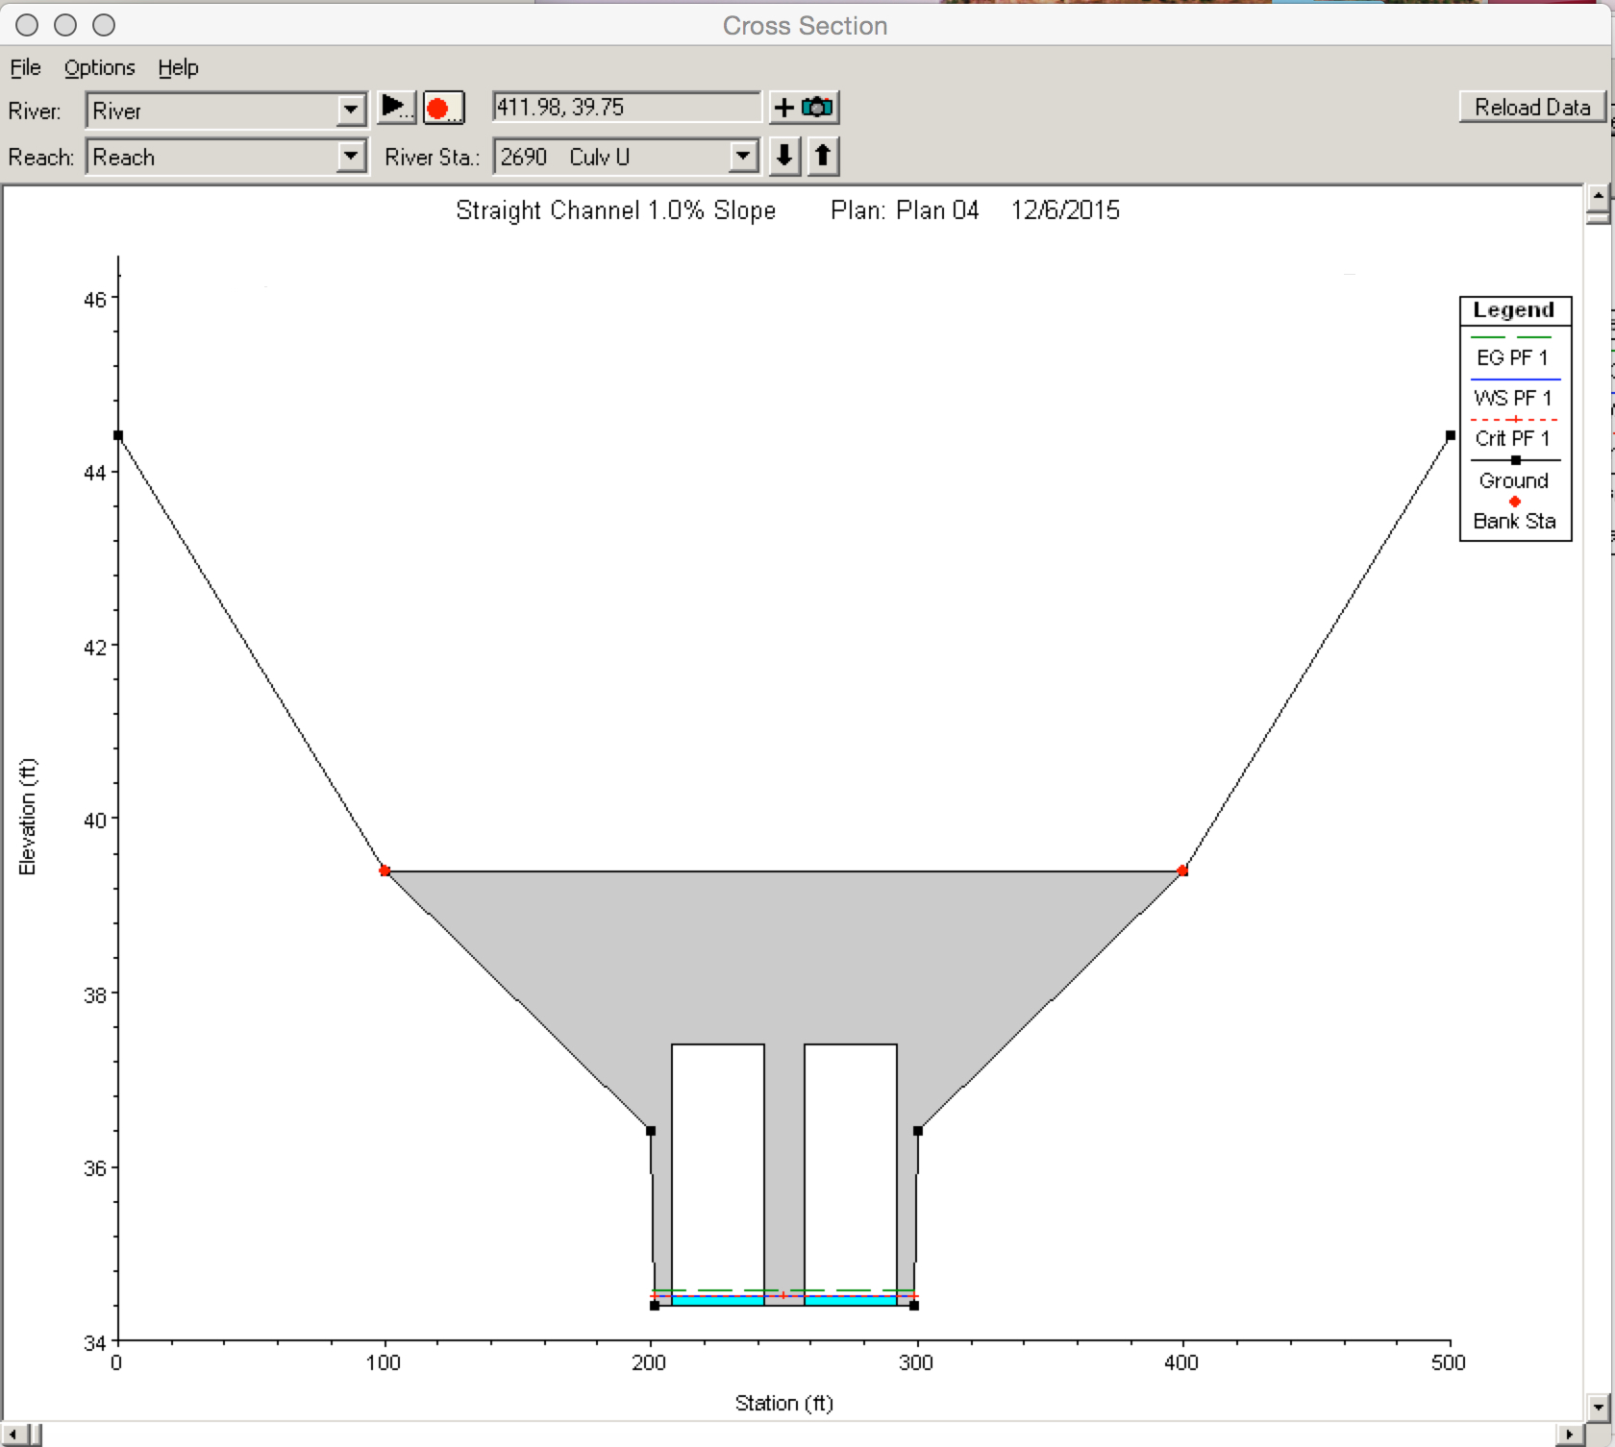
Structure Opening Flow Area
Elevation view looking downstream
Flow area of the structure at Soffit flow depth

Slide 18
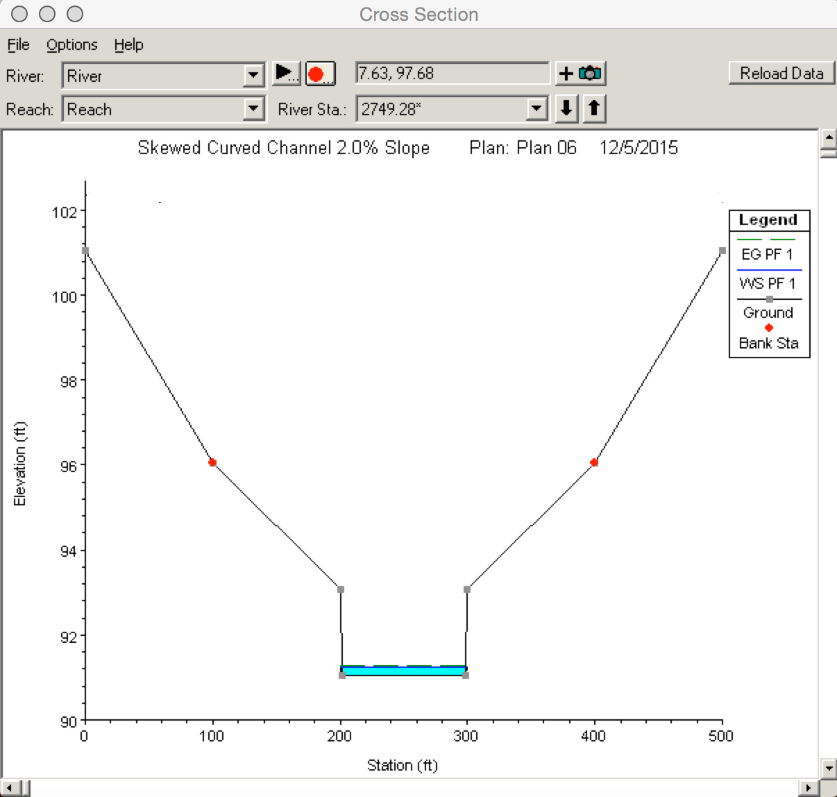
Far-field flow area
Elevation view looking downstream
Flow area of the channel away from the structure at the Soffit flow depth

Slide 19
Far-field top width
Elevation view looking downstream
Top width at reference and test flow depths (used in several, but not all ROTs)

Slide 20
Bank full flow depth
Elevation view looking downstream
Bank full flow depth (used in several, but not all ROTs)

Slide 21
Bank full flow width
Elevation view looking downstream
Bank full top width (used in several, but not all ROTs)

Slide 22
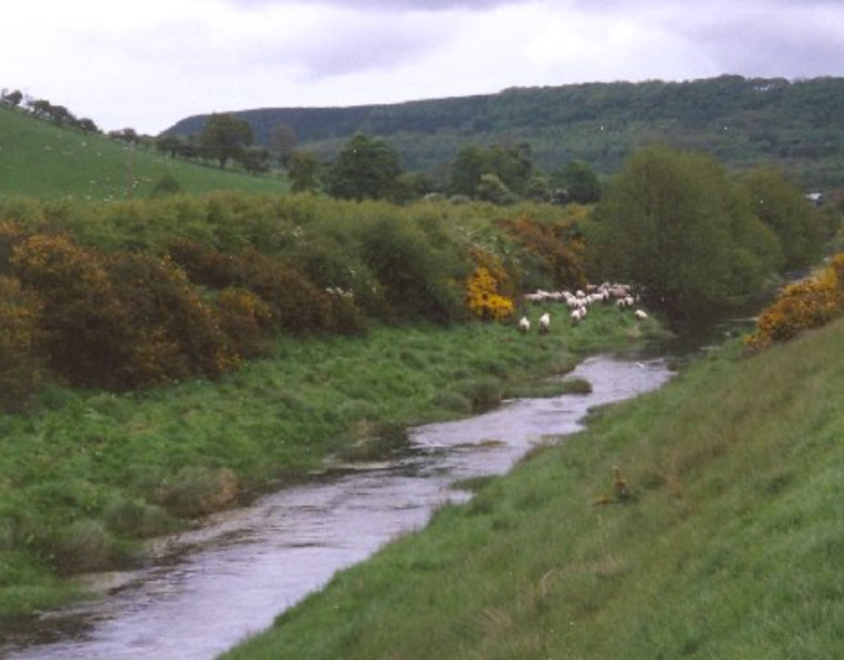
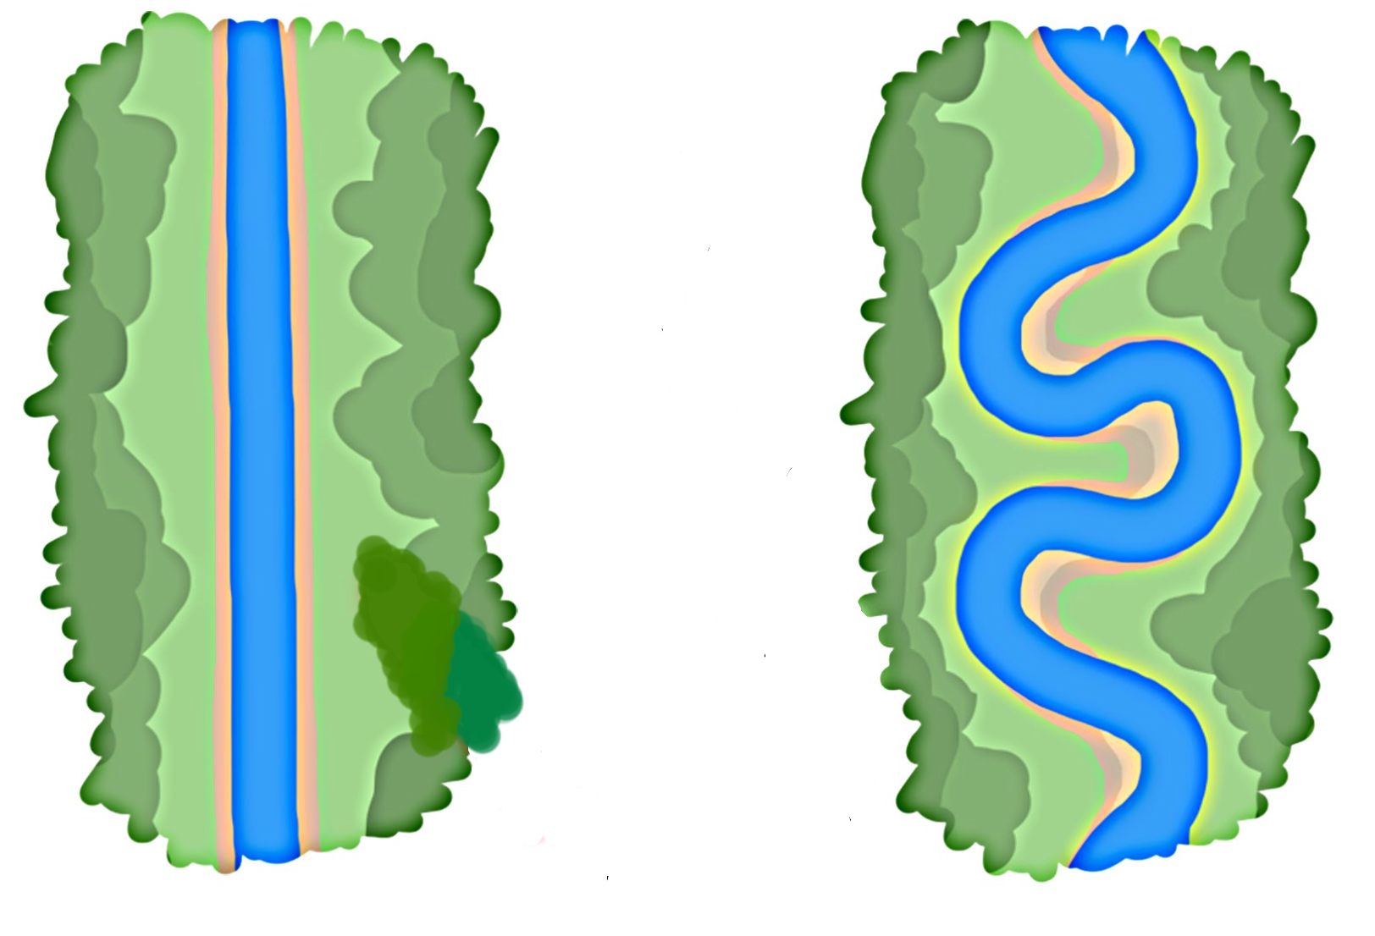
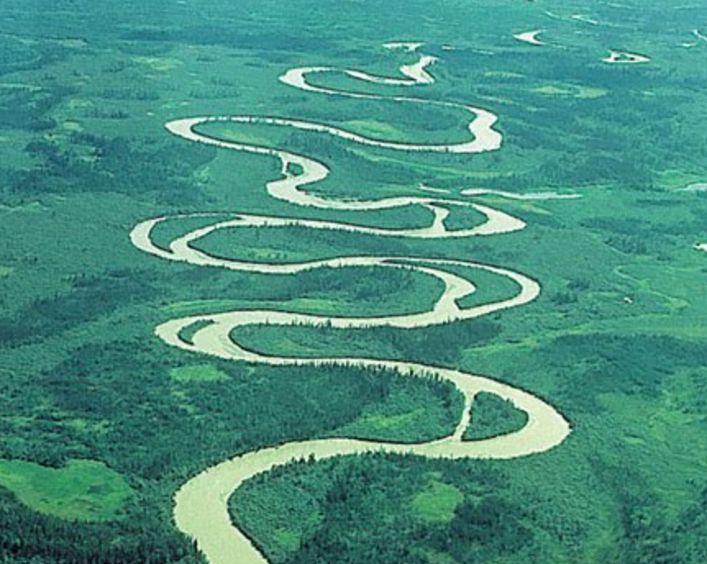
Straight or Curved Channel
Categorical Variable

Slide 23
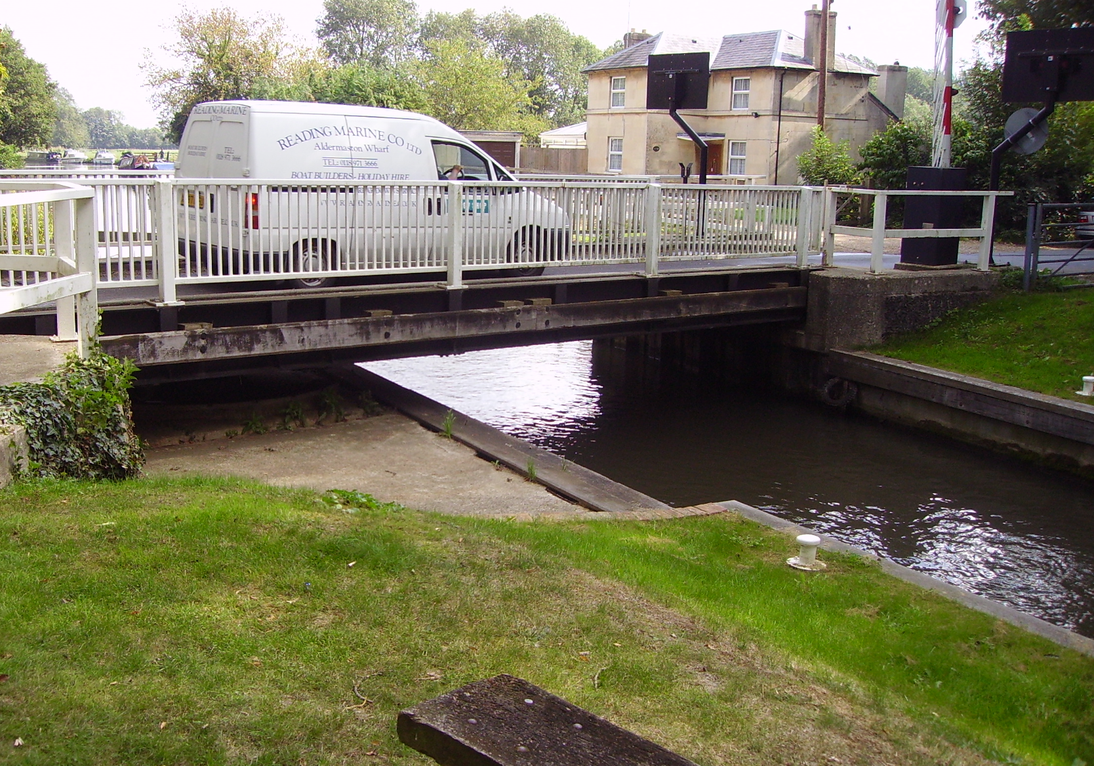
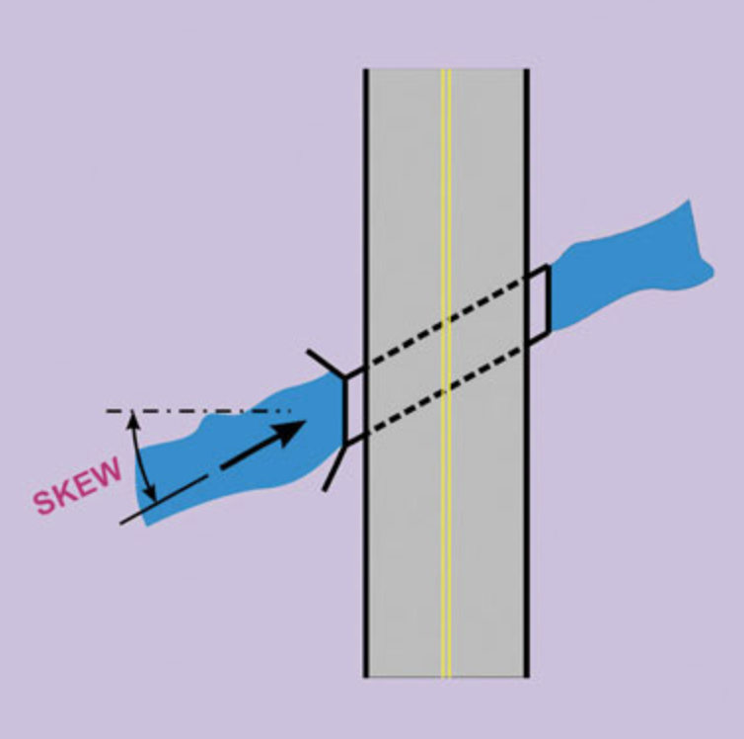
Aligned or Skew Structure
Categorical Variable
Skew (Skew Angle > 10)
No Skew (Skew Angle = 0)

Slide 24
Using the Tool -- Interface
Designer supplied input

Slide 25
Using the Tool -- Interface
Intermediate Calculations

Slide 26
Using the Tool -- Interface
ROT distances

Slide 27
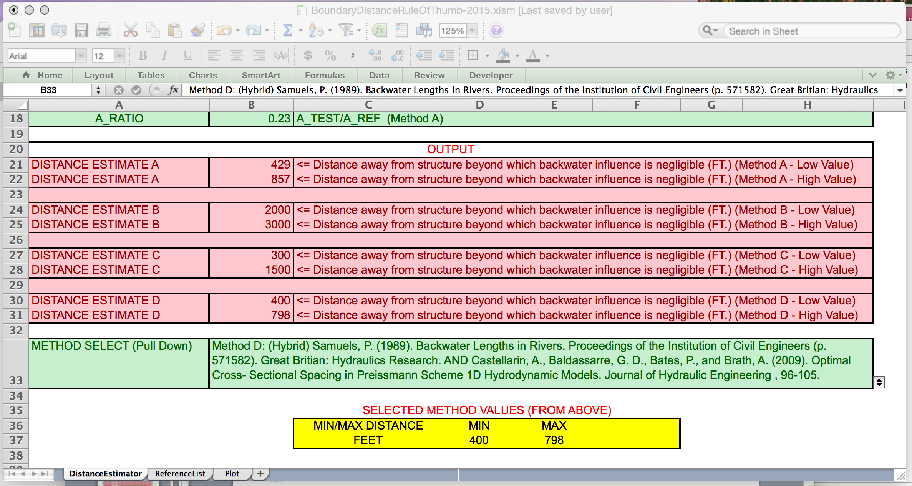
Using the Tool -- Interface
Method selection and reference
Selected distances

Slide 28
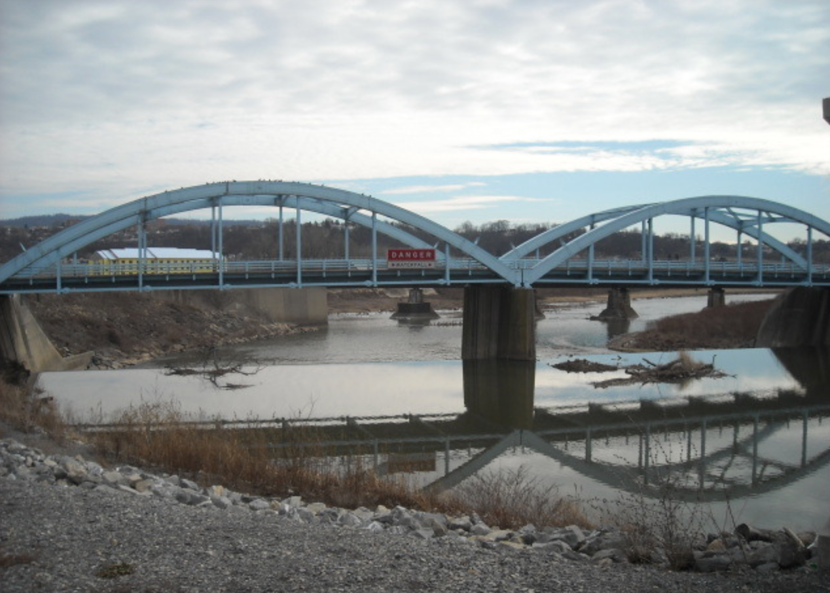
Using the Tool – Illustrative Example
Consider the bridges pictured
Determine where model boundaries should be placed to evaluate hydraulic impact of the pier(s)

Slide 29
Using the Tool – Illustrative Example
Consider the bridges pictured
Determine where model boundaries should be placed to evaluate hydraulic impact of the pier(s)

Slide 30
Using the Tool – Illustrative Example
Consider upstream (pictured) bridge first

Slide 31
Using the Tool – Illustrative Example
Consider upstream (pictured) bridge first
Flow

Slide 32
Using the Tool – Illustrative Example
Bridge #1 Cross Section
Far-Field Cross Section

Slide 33
Using the Tool – Illustrative Example Bridge #1
Reference Discharge : 1,180 cfs
Test Discharge : 50,615 cfs
Structure flow area: 8,400 sq. ft. (@ 30ft. deep)
Far field flow area: 14,100 sq. ft. (@ 30ft. deep)
Far field top width: 290 ft. (@ 30ft. deep)
Bank full flow depth: 10 ft.
Bank full flow width : 410 ft.
Curved or Straight Channel : Curved
Skewed or Aligned Hydraulic Structure : Aligned
Far-Field Cross Section

Slide 34
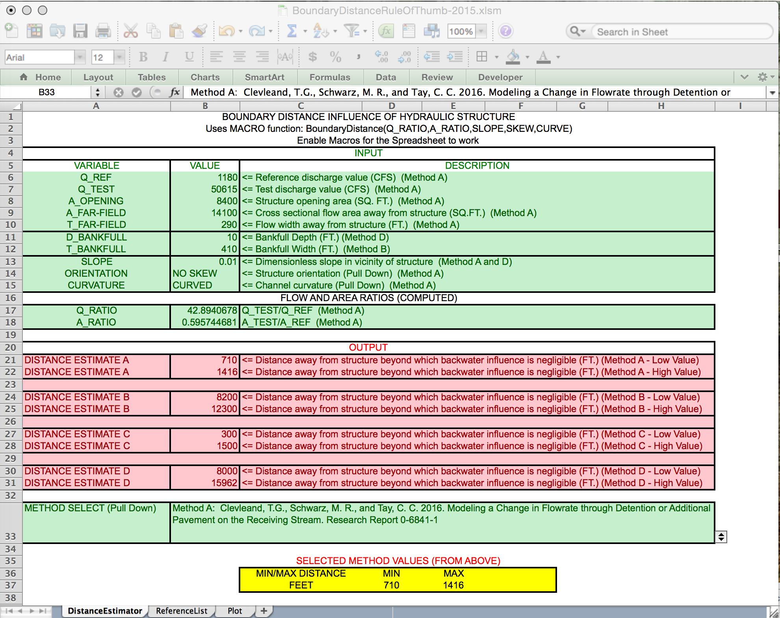
Using the Tool – Illustrative Example

Slide 35
Using the Tool – Illustrative Example
Bridge #2 Cross Section
Far-Field Cross Section

Slide 36
Using the Tool – Illustrative Example Bridge #2
Reference Discharge : 1,180 cfs
Test Discharge : 50,615 cfs
Structure flow area: 7,500 sq. ft. (@ 30ft. deep)
Far field flow area: 14,100 sq. ft. (@ 30ft. deep)
Far field top width: 290 ft. (@ 30ft. deep)
Bank full flow depth: 10 ft.
Bank full flow width : 410 ft.
Curved or Straight Channel : Curved
Skewed or Aligned Hydraulic Structure : Aligned

Slide 37
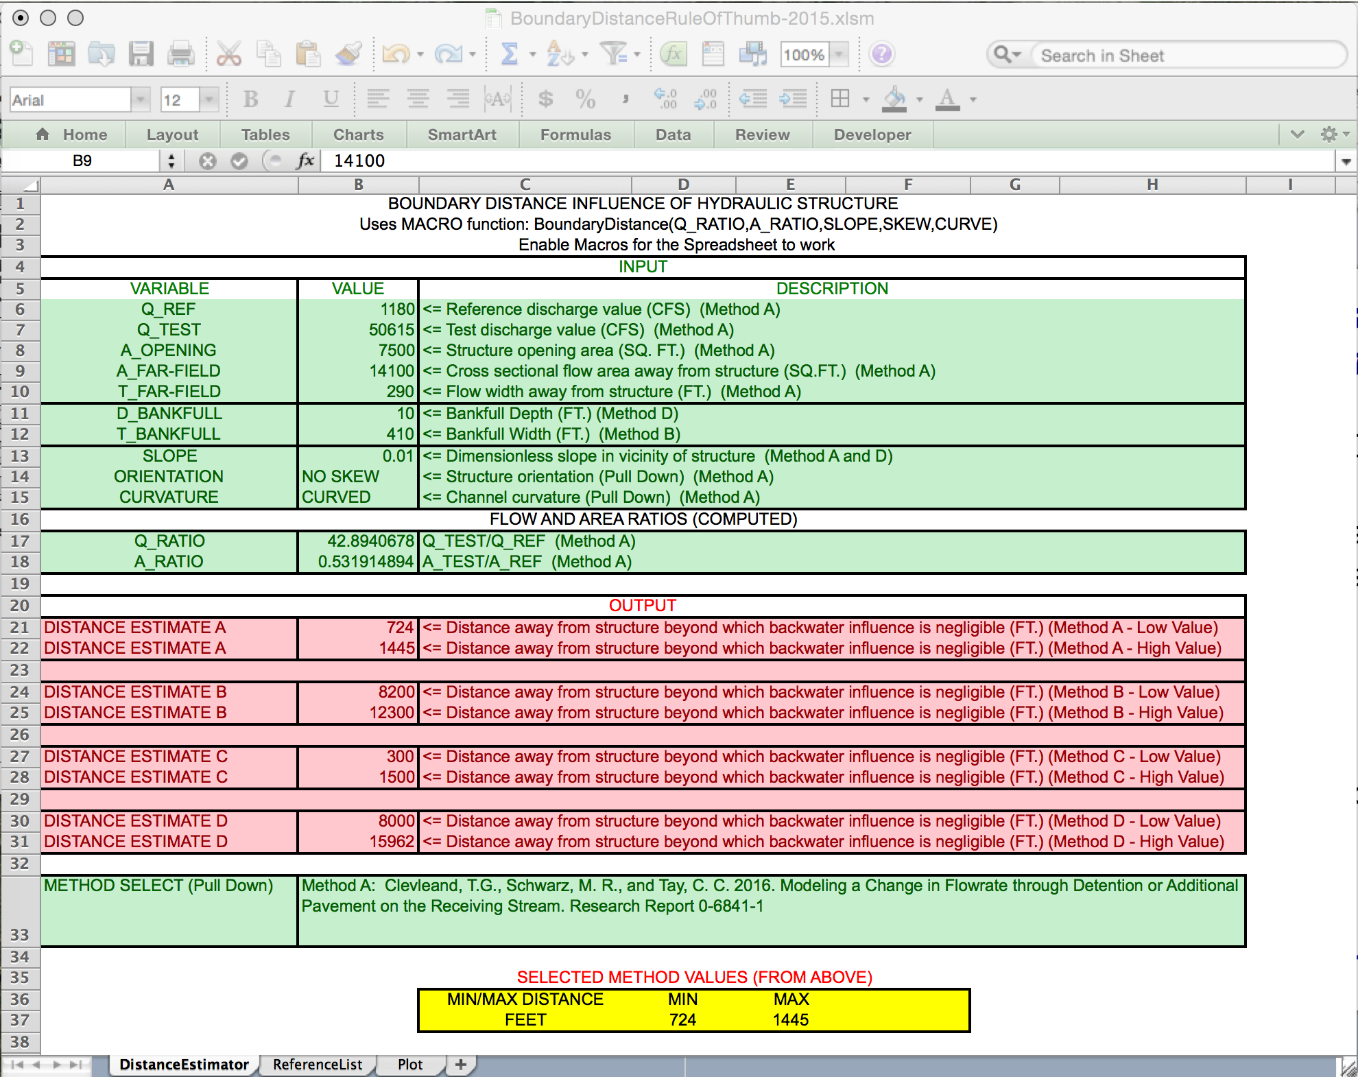
Using the Tool – Illustrative Example

Slide 38
Using the Tool – Illustrative Example
Results: Using Method A if more than 2861 feet apart, can treat separately min-max distances on model representation
Other methods different distances (designer must choose the method they will adopt)
1445
724
724
1445
>2861
1416
Flow
710
710
1416

Slide 39
Using the Tool – Illustrative Example
Results: Using Method A if less than 2861 feet apart, but more than 1431 feet apart, overlap on the upper ranges – designer must choose if treat as separate.
Other methods different distances (designer must choose the method they will adopt)
1445
724
724
>1431
1416
1445
710
Flow
710
1416

Slide 40
Using the Tool – Illustrative Example
If model is to include BOTH bridges, then upstream condition at least 1416 feet upstream of bridge 1 and and 1445 feet downstream of bridge 2
Other methods different distances (designer must choose the method they will adopt)
1445
724
724
>1431
1416
1445
710
Flow
710
1416

Slide 41
Summary
Tool to estimate model boundary locations based on a minimal description of the structure hydraulics and stream geometry
Helps avoid modeling an entire stream system for a change at one location, when a more localized model is appropriate (designer must decide)
Multiple methods are available:
Methods A and C are relatively close in numerical output
Methods B and D are relatively close in numerical output (but tend to be larger than A or C)

