Slide 1
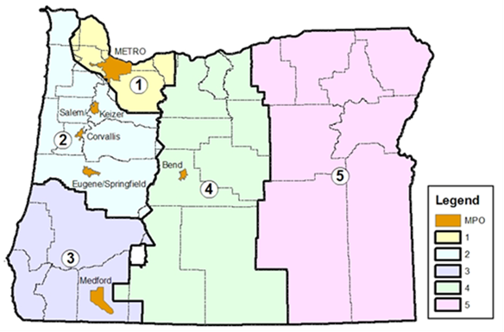
Examining the Impacts of a Vehicle Miles Traveled Fee for Daily Weekday Travel: A Case Study of Oregon
Presenters: Michael Moore, Andrew Waxman Ph. D., and Randy Machemehl Ph. D.
Background
Results
Equity Breakout
What are the revenue impacts of a vehicle miles travelled (VMT) fee system, and which road users are impacted?
1
CLUSTER ANALYSIS
Five Clusters
 | Local Commuters (w/ children) | Short Trippers (prolonged activities) | Short Trippers (quick errands) | Local Commuters (w/o children) | Long Distance Trekkers
Person Trips | 2 | 4 | 7 | 2 | 2
Activity Duration | 573 | 238 | 54 | 254 | 420
Trip Distance | 9.1 | 6.3 | 4.2 | 9.1 | 212.35
Trips by Car | 79% | 84% | 84% | 88% | 94%
Trips by School Bus | 10% | 4% | 1% | 3% | 0%
Five groups created exhibiting three main travel styles- local commuting, short trips, and long-distance travel.
Strained Highway Trust Fund
States increasingly taking on funding burden
Further stressors to Highway Trust Fund expected
A Case Study of Oregon
The data obtained from Oregon was collected from 2009-2012 and was representative of the State. The data included information on both travel and vehicle characteristics.
2
GAS TAX & VMT FEE
Difference between gas tax and equivalent VMT fee revenue generation is minimal.
Methodology
Key Takeaways
Data Collection
Socioeconomics | Mobility | Health
This study utilized household survey data from Oregon to analyze the revenue impacts of a switch to a VMT fee, with analyses to determine the impacts on various road user groups and socio-demographic groups. Key takeaways include:
Minimal change in revenue generation with switch to equivalent VMT fee
Important to consider revenue distribution in setting rates
Driver responses to fees will have impacts on VMT and revenue
1
2
3
3
EQUITY ANALYSIS
+
+
Cluster
Metric A
Metric B
Metric C
Cluster
Metric A
Metric B
Metric C
Cluster
Metric A
Metric B
Metric C
Analysis performed across various socio-demographics to determine burden.
1. Cluster Analysis
2. Gas Tax and VMT Fee Development
3. Equity Consideration
Income
Race
Survey Region

