Slide 1
5-1700 Long-Term Performance of Portland
Cement Concrete Pavement
- Training Materials -
March 2006
Center for Transportation Research
The University of Texas at Austin

Slide 2
Background
Concrete setting temperature (e.g., zero-stress temperature) has significant effects on CRCP performance.
Current specifications limit concrete temperature as delivered, not setting temperature.
There is a need to control concrete setting temperature in specifications.

Slide 3
Shadow Specifications
Primary objective of shadow specifications is to control concrete temperatures during cement hydration phase.
Shadow specifications require the use of temperature prediction program as well as temperature measuring devices.

Slide 4
Temperature Requirements in Shadow Specifications
The maximum concrete temperature for the first 24 hours after concrete placement shall not exceed 120°F.
Temperature difference between the top and the bottom of the slab for the first 48 hours after concrete placement shall be less than 25 °F.

Slide 5
  - Preparation -
  ■ Temperature prediction model
  ■ Temperature measuring devices
- Concrete Temperature Prediction -
■ Weather, materials & pavement structure
■ Temperature prediction at top, middle, & bottom of slab
If 120° F<Temp.
If 120° F>Temp.
■ Every hour in the morning
■ Every 2 hours after 12 p.m.
■ Only two sets at the predicted time of maximum concrete temperature and temperature differential
Insert temperature
measuring devices
■ Maximum concrete temperature shall not exceed 120° F
■ Temperature difference between the top and the bottom of the slab shall be less than 25° F

Slide 6
Temperature Predictions by PavePro

Slide 7


Slide 8
PavePro
- input variables -
General inputs
Mixture proportion
Materials
Environmental condition
Construction inputs

Slide 9
General Inputs
Pavement structure
Reliability
Project information

Slide 10
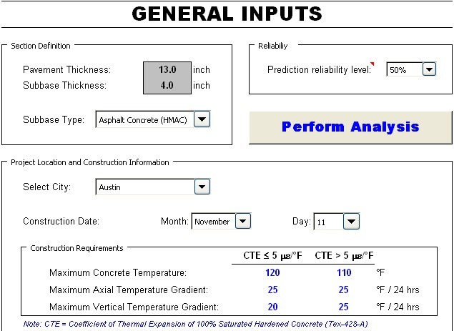

Slide 11
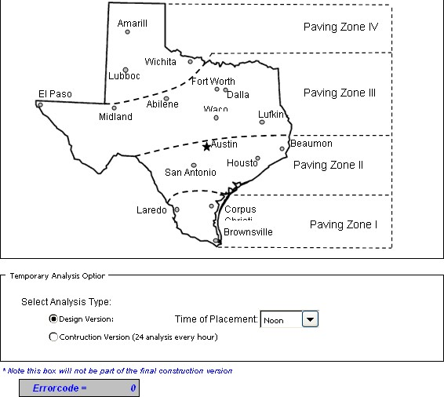

Slide 12
Mixture Proportion
Weight proportions of each ingredient

Slide 13
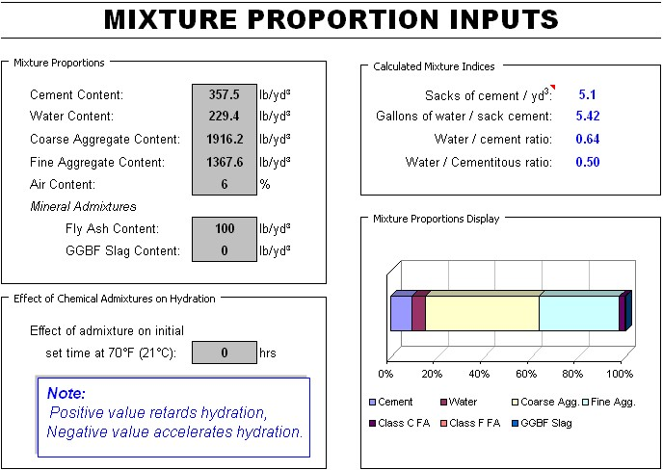

Slide 14
Materials
Chemical composition & hydration properties of cementitious materials
Information on coarse aggregates
Default values provided

Slide 15
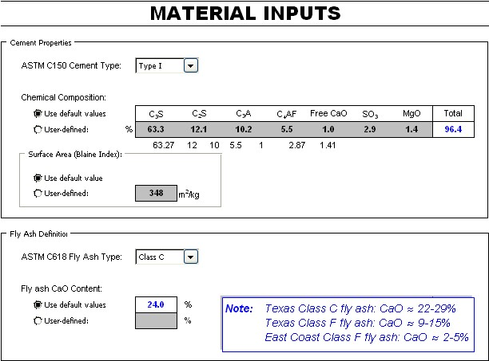

Slide 16
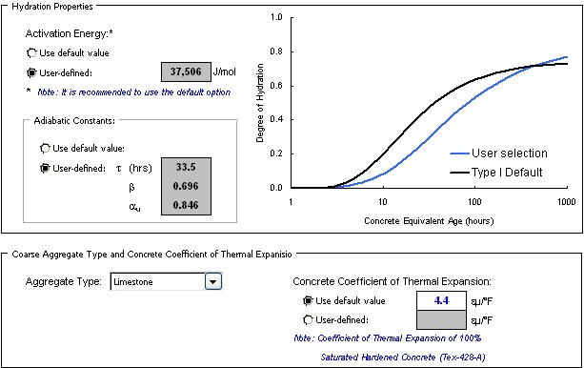

Slide 17
Environmental Condition
Ambient temperature
Relative humidity
Wind speed
Cloud cover

Slide 18
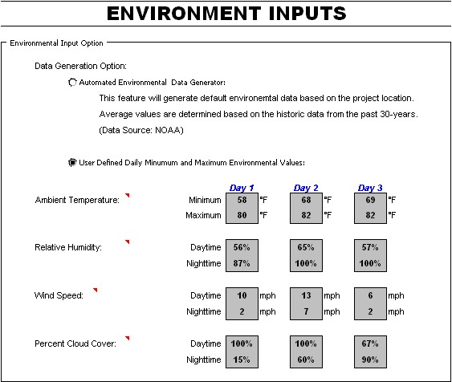

Slide 19
Environmental Input Source
http://www.srh.noaa.gov/ifps/MapClick.php?FcstType=digital&textField1=30.3153839111328&textField2=-97.7663345336914&site=ewx

Slide 20
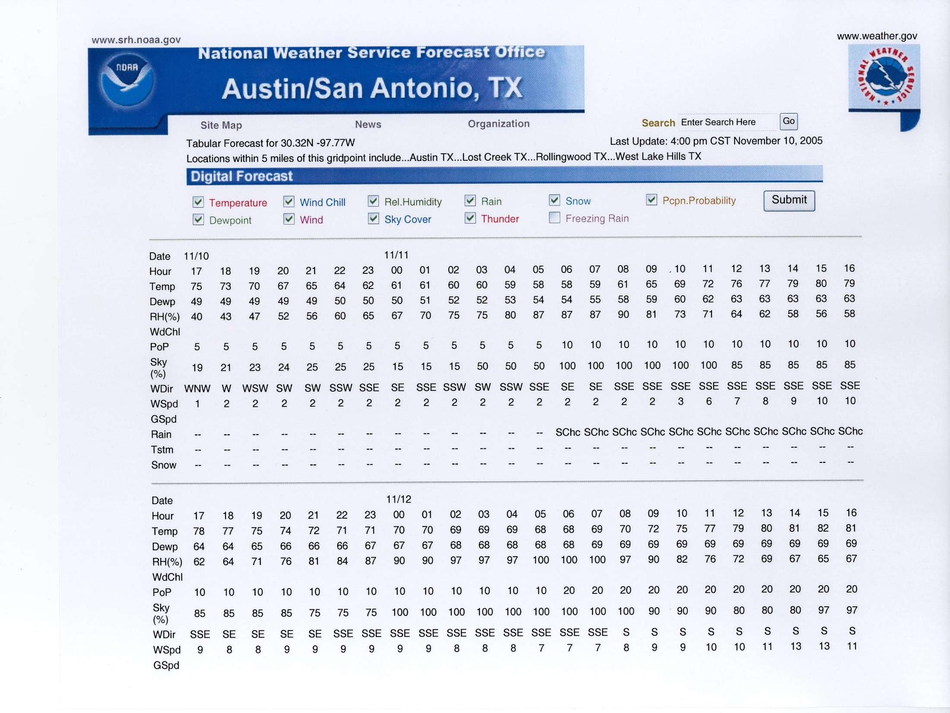

Slide 21
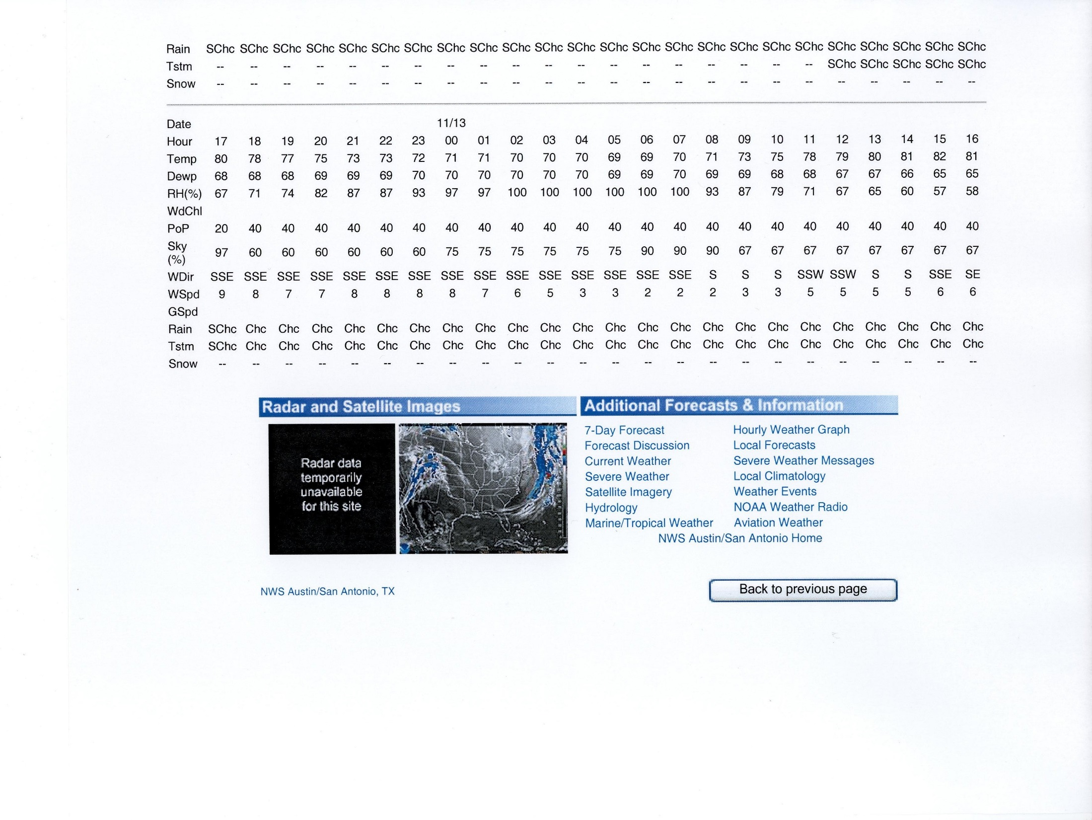

Slide 22
Construction Inputs
Fresh concrete temperature
Base course temperature
Curing method

Slide 23
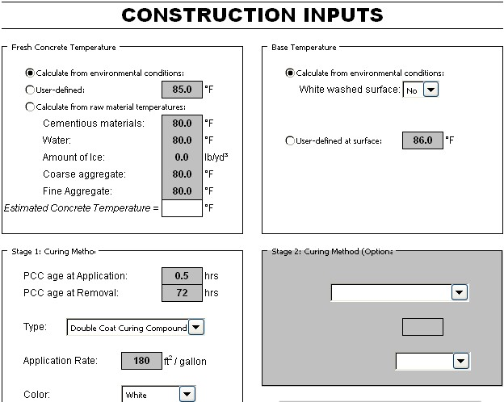

Slide 24
Temperature Predictions
- PavePro Output -

Slide 28
Predicted Temperatures at Top
Austin US183 Test Section

Slide 29
Predicted Temperatures at Middle
Austin US183 Test Section

Slide 30
Predicted Temperatures at Bottom
Austin US183 Test Section

Slide 31
Implementation of Shadow Specifications
-Test Sections-
US 183 in Austin
US 290 in Austin
US 59 in Houston

Slide 32
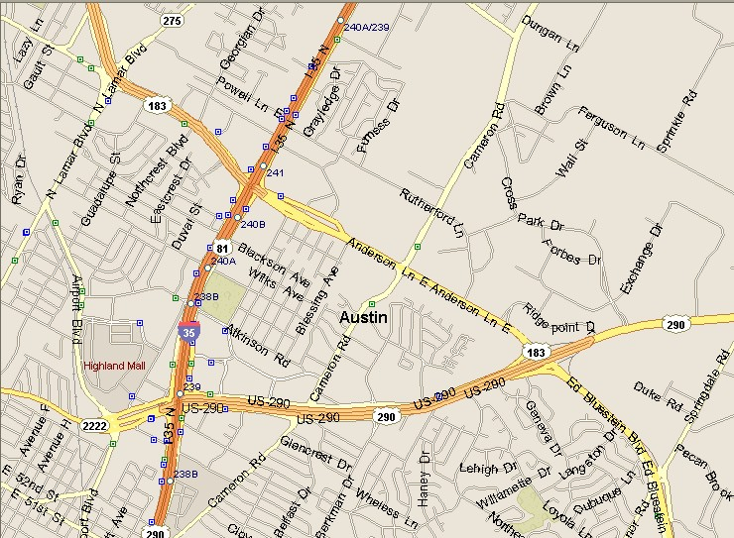
Austin US183 Test Section

Slide 33
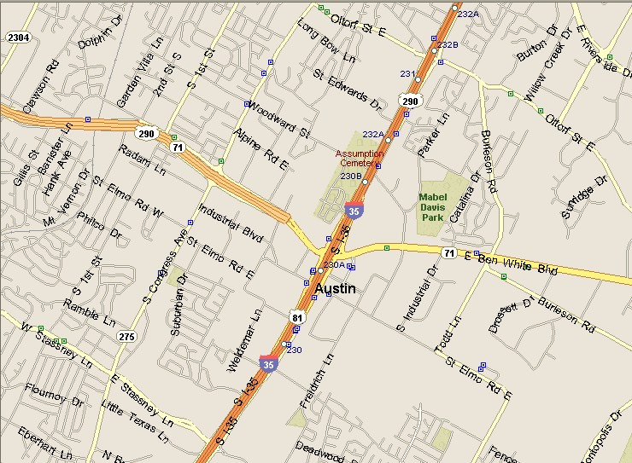
Austin US290 Test Section

Slide 34

Cleveland US59 Test Section

Slide 35
Pavement Structure of Test Sections
US 183 US 290 US 59

Slide 36
Concrete Mix Design used on Each Test Sections
Test Section | Unit | US183 | US290 | US59
W/C ratio Cement Factor Coarse Aggregate Factor Max. Aggregate Size Water Cement Coarse Aggregate Fine Aggregate Fly Ash Air Entraining Reducer Retarding | - Sk./cy - inch lbs/cy lbs/cy lbs/cy lbs/cy lbs/cy oz oz | 0.52 5.0 0.685 1.0 229 358 1916 1368 100 2.64 10.58 | 0.59 - - - - 336 1816 1287 152 - - | 0.44 5.5 0.740 Grade 2 215 362 1848 1265 131 0.83 4.14

Slide 37
Temperature Measuring Device
- I-Button Programming -

Slide 38
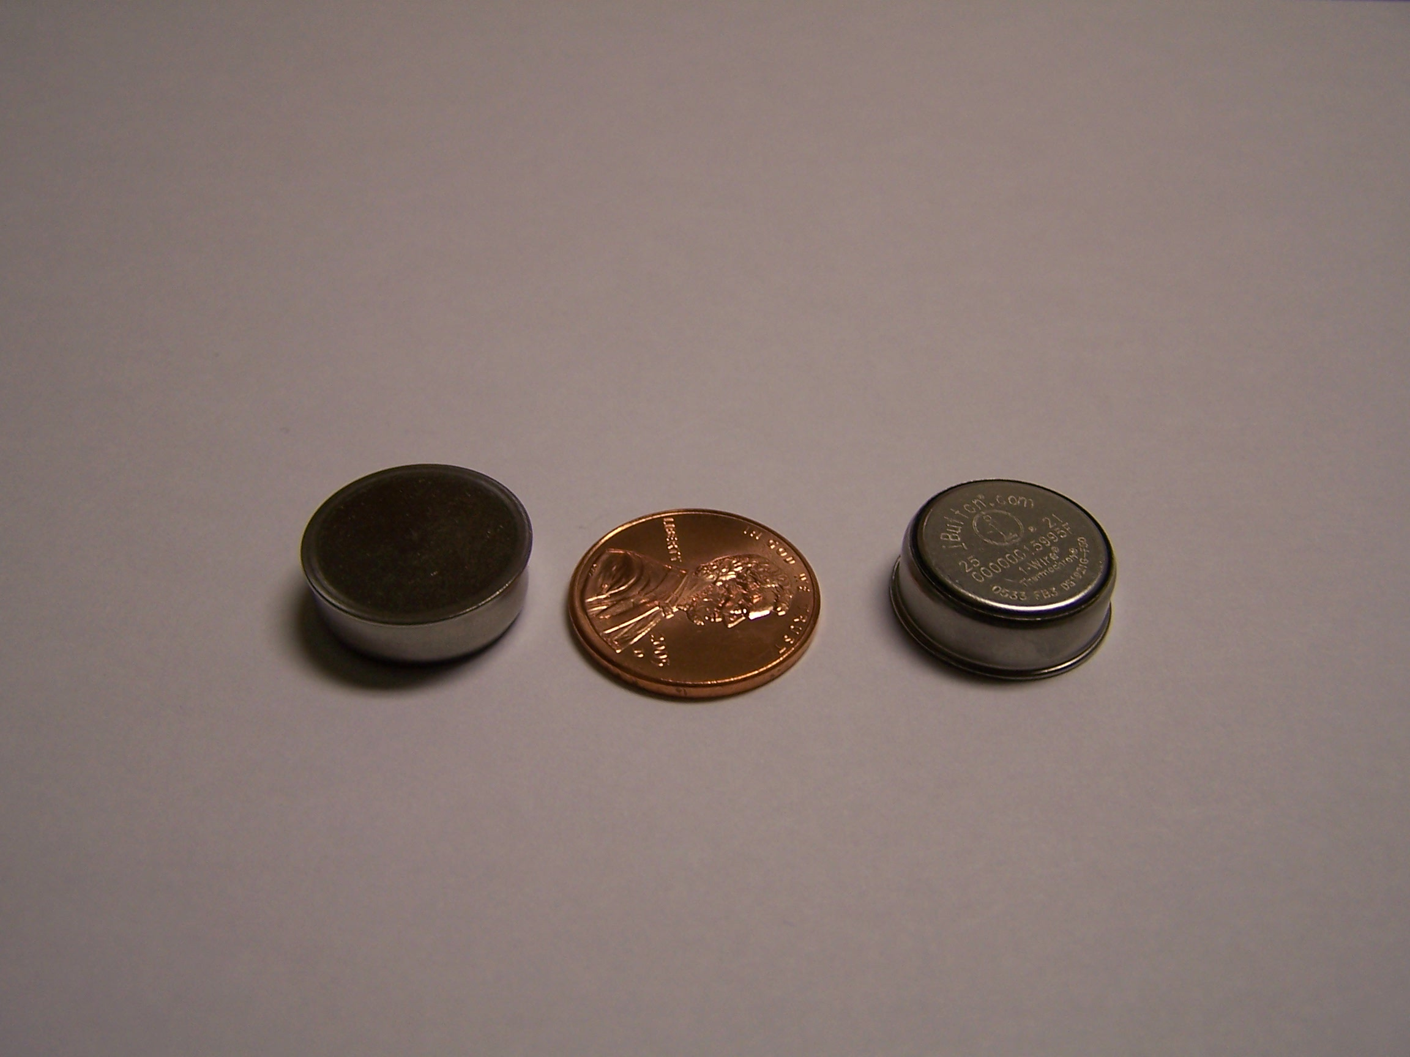
I-Button

Slide 39
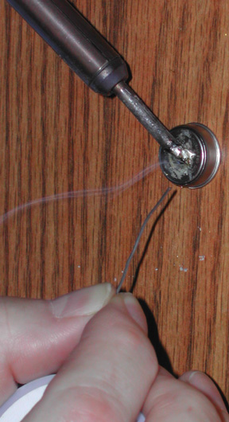
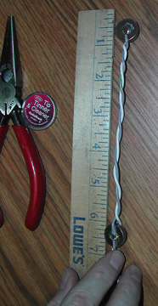
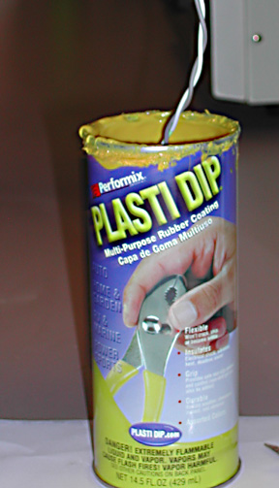
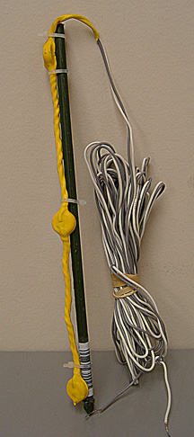
I-Button Assembly
Solder
Wire
Coat
Assemble

Slide 40
Long-Term Durability of I-Button Assembly
The integrity of the i-button assembly needs to be inspected prior to installation.
If i-buttons are not completely sealed, pore solutions in Portland cement concrete could cause electrical instability of the i-button assembly.
Testing is required to ensure the complete sealing of i-buttons.

Slide 41
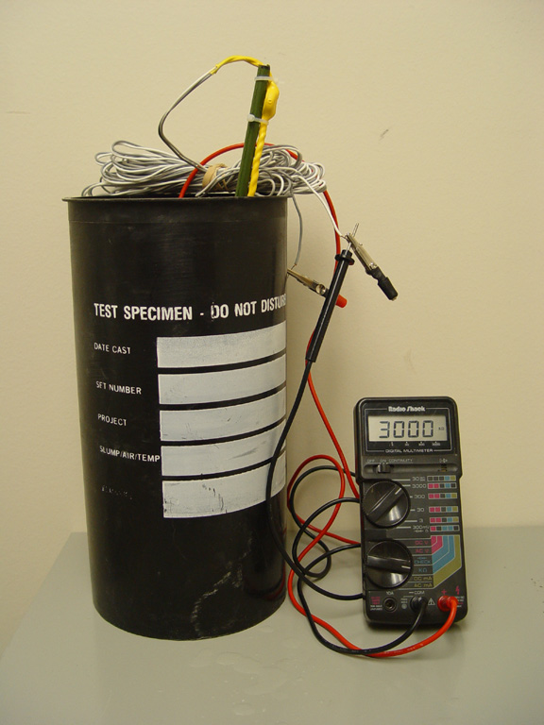
Testing Coating Integrity in a Salt Water Bath
I-Button Assembly
Salt Water Bath
Ohmmeter
~ 30k Ω = Short
> 30M Ω= Good

Slide 42
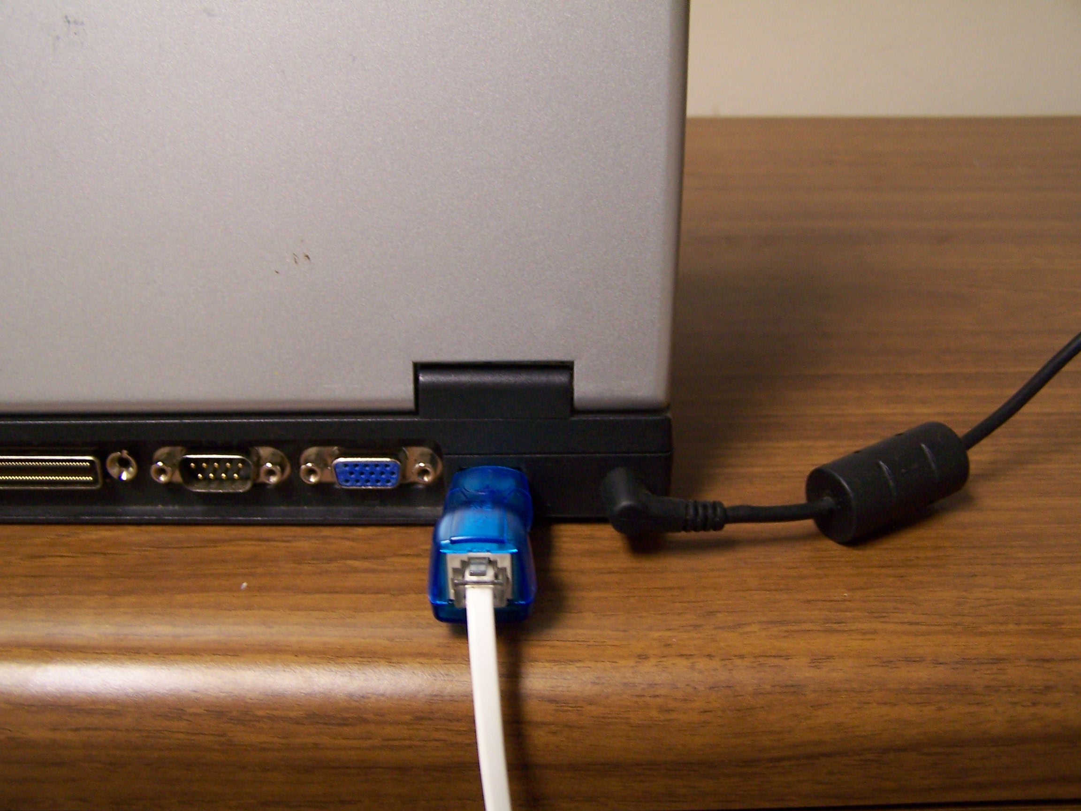
Connection of I-Button Assembly to Data-Logger (Laptop Computer)

Slide 43
I-button Software

Slide 44
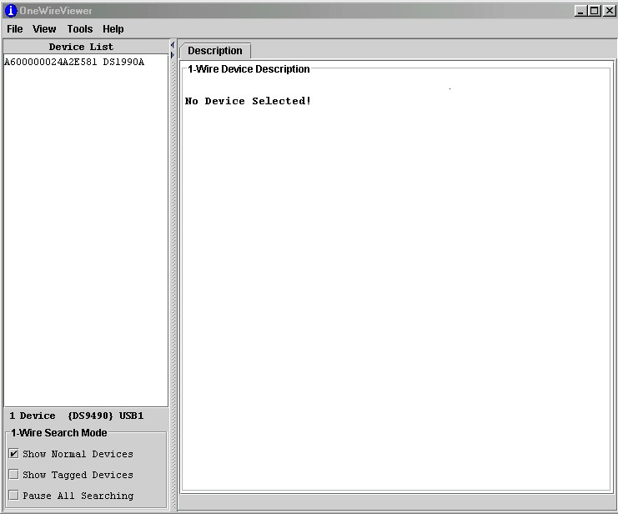

Slide 45
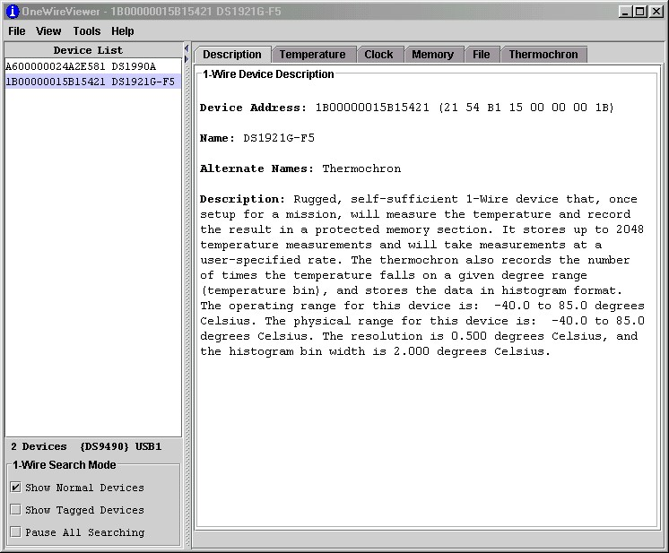

Slide 46
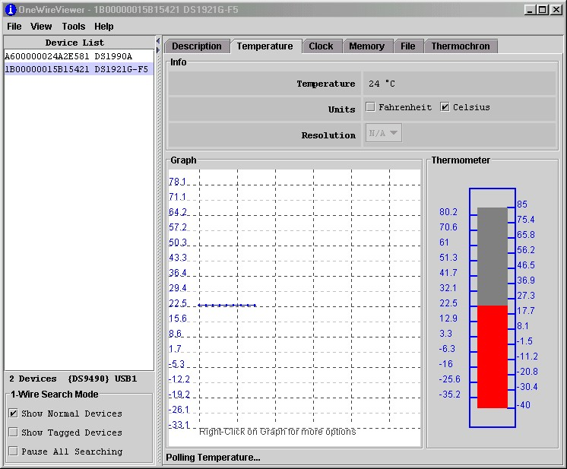

Slide 47
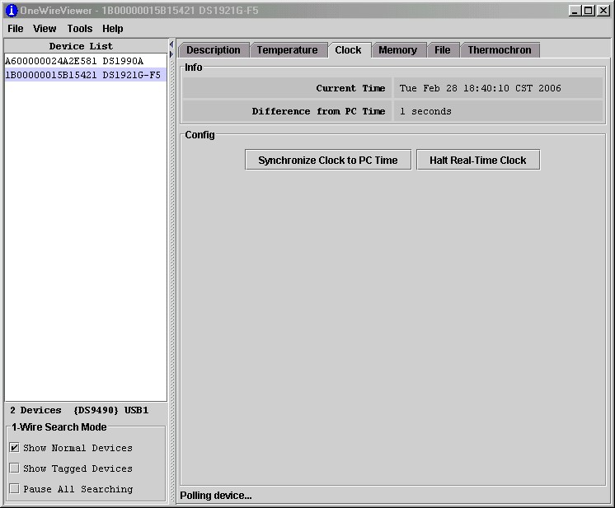

Slide 48
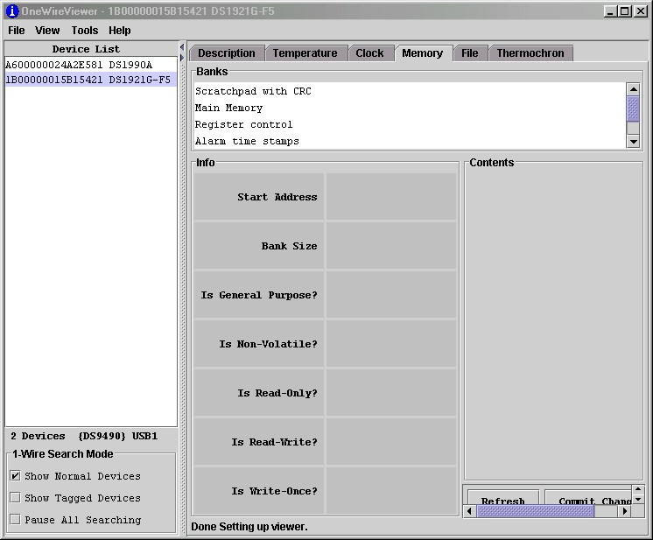

Slide 49
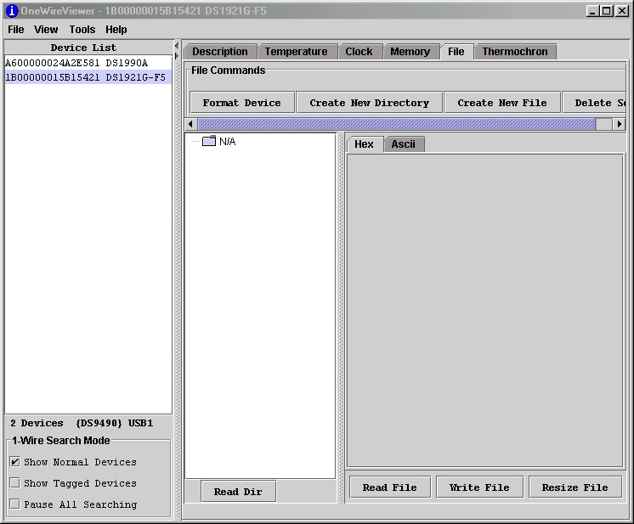

Slide 50
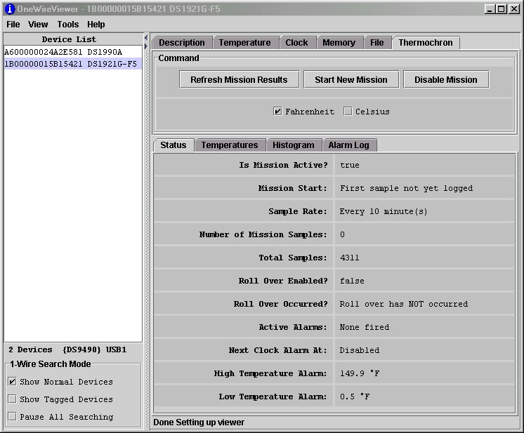

Slide 51
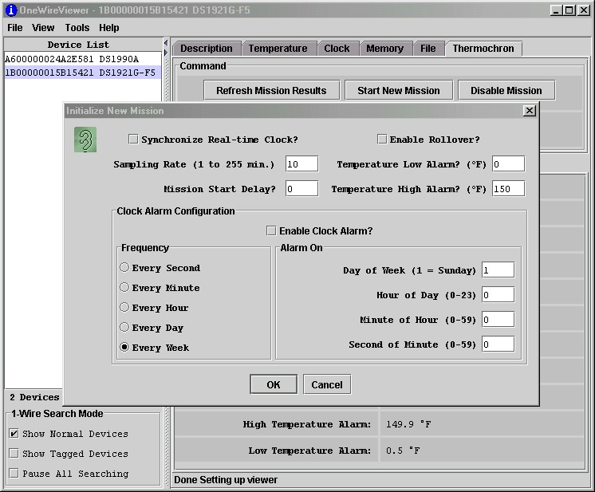

Slide 52
Installation of
I-Button Assembly

Slide 53
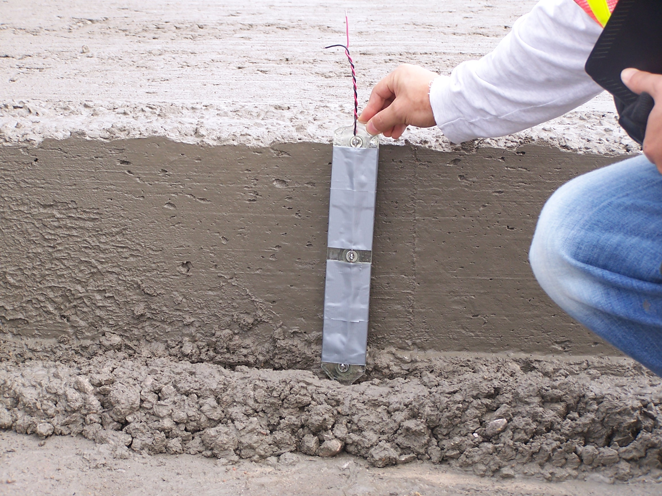
I-Buttons

Slide 54
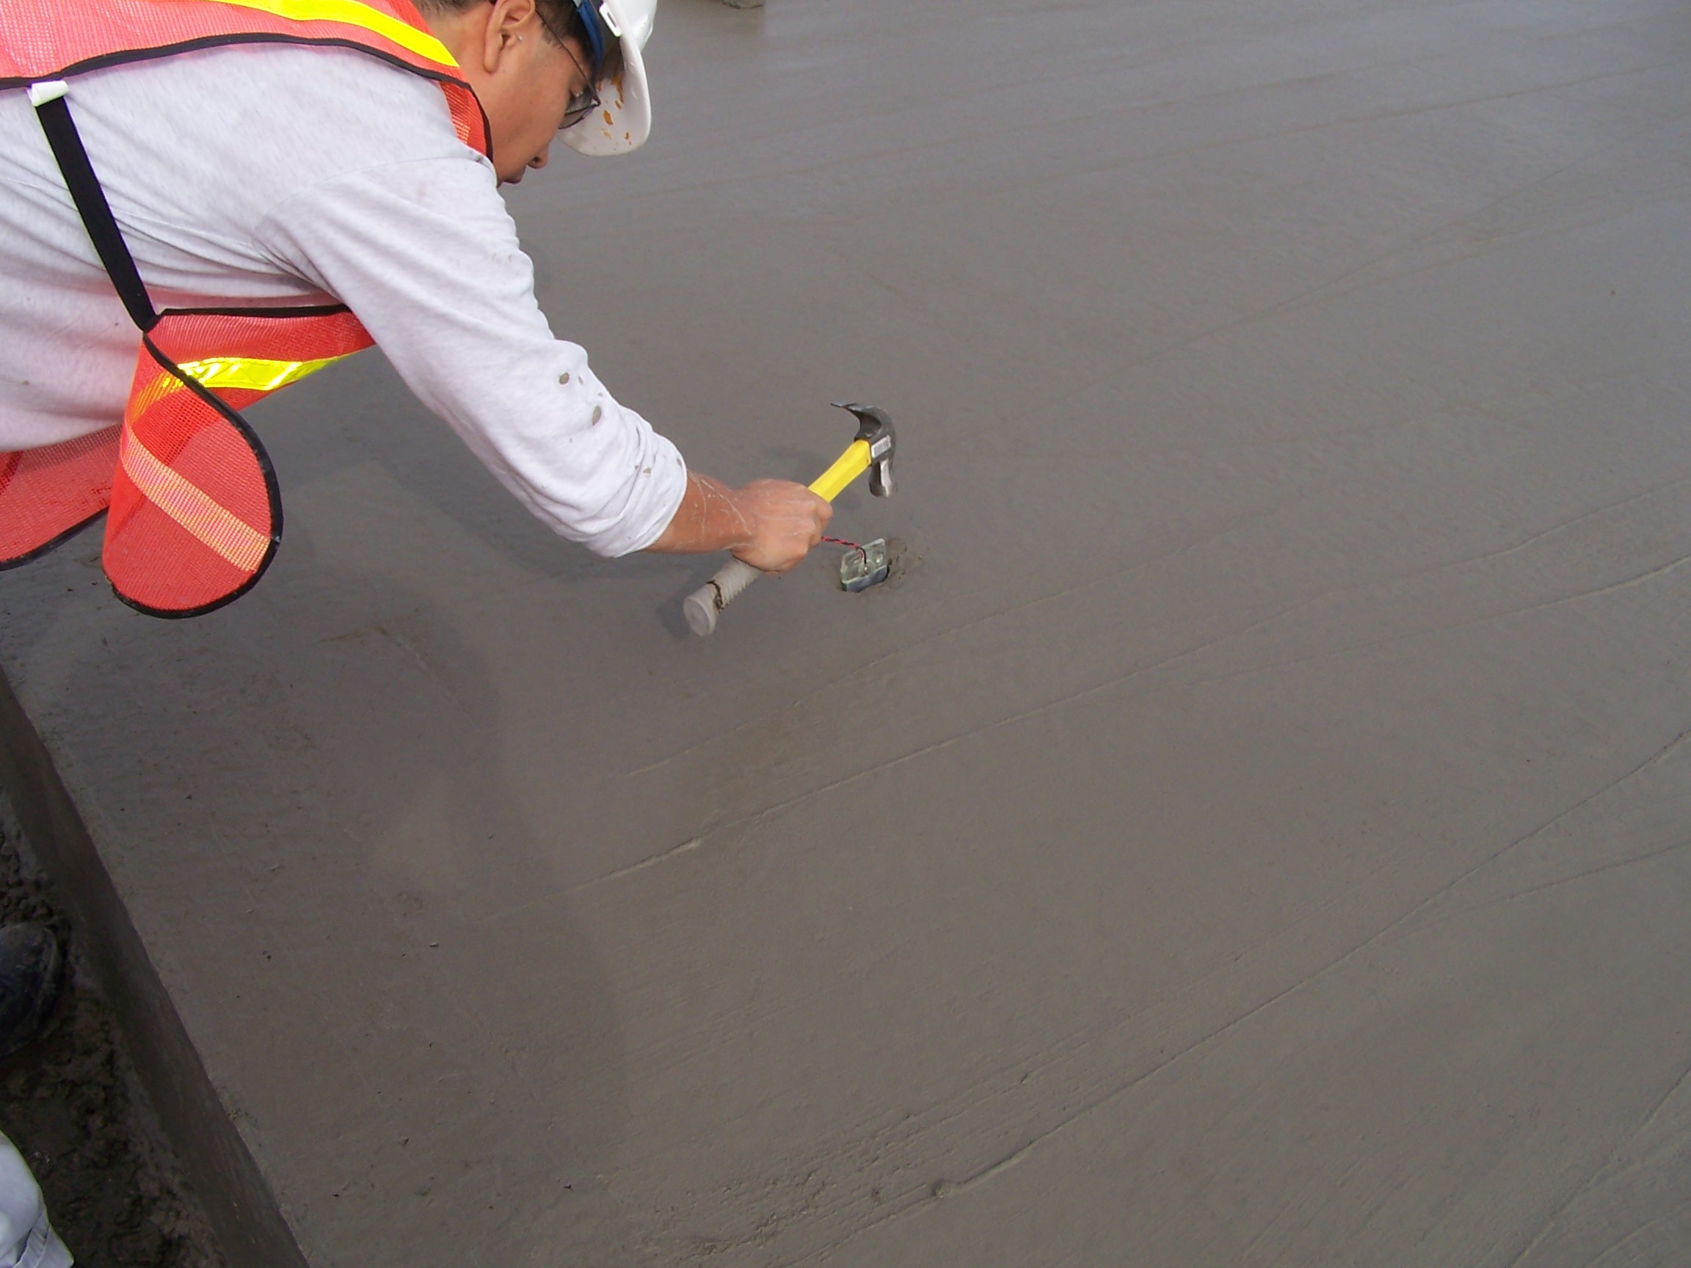

Slide 55
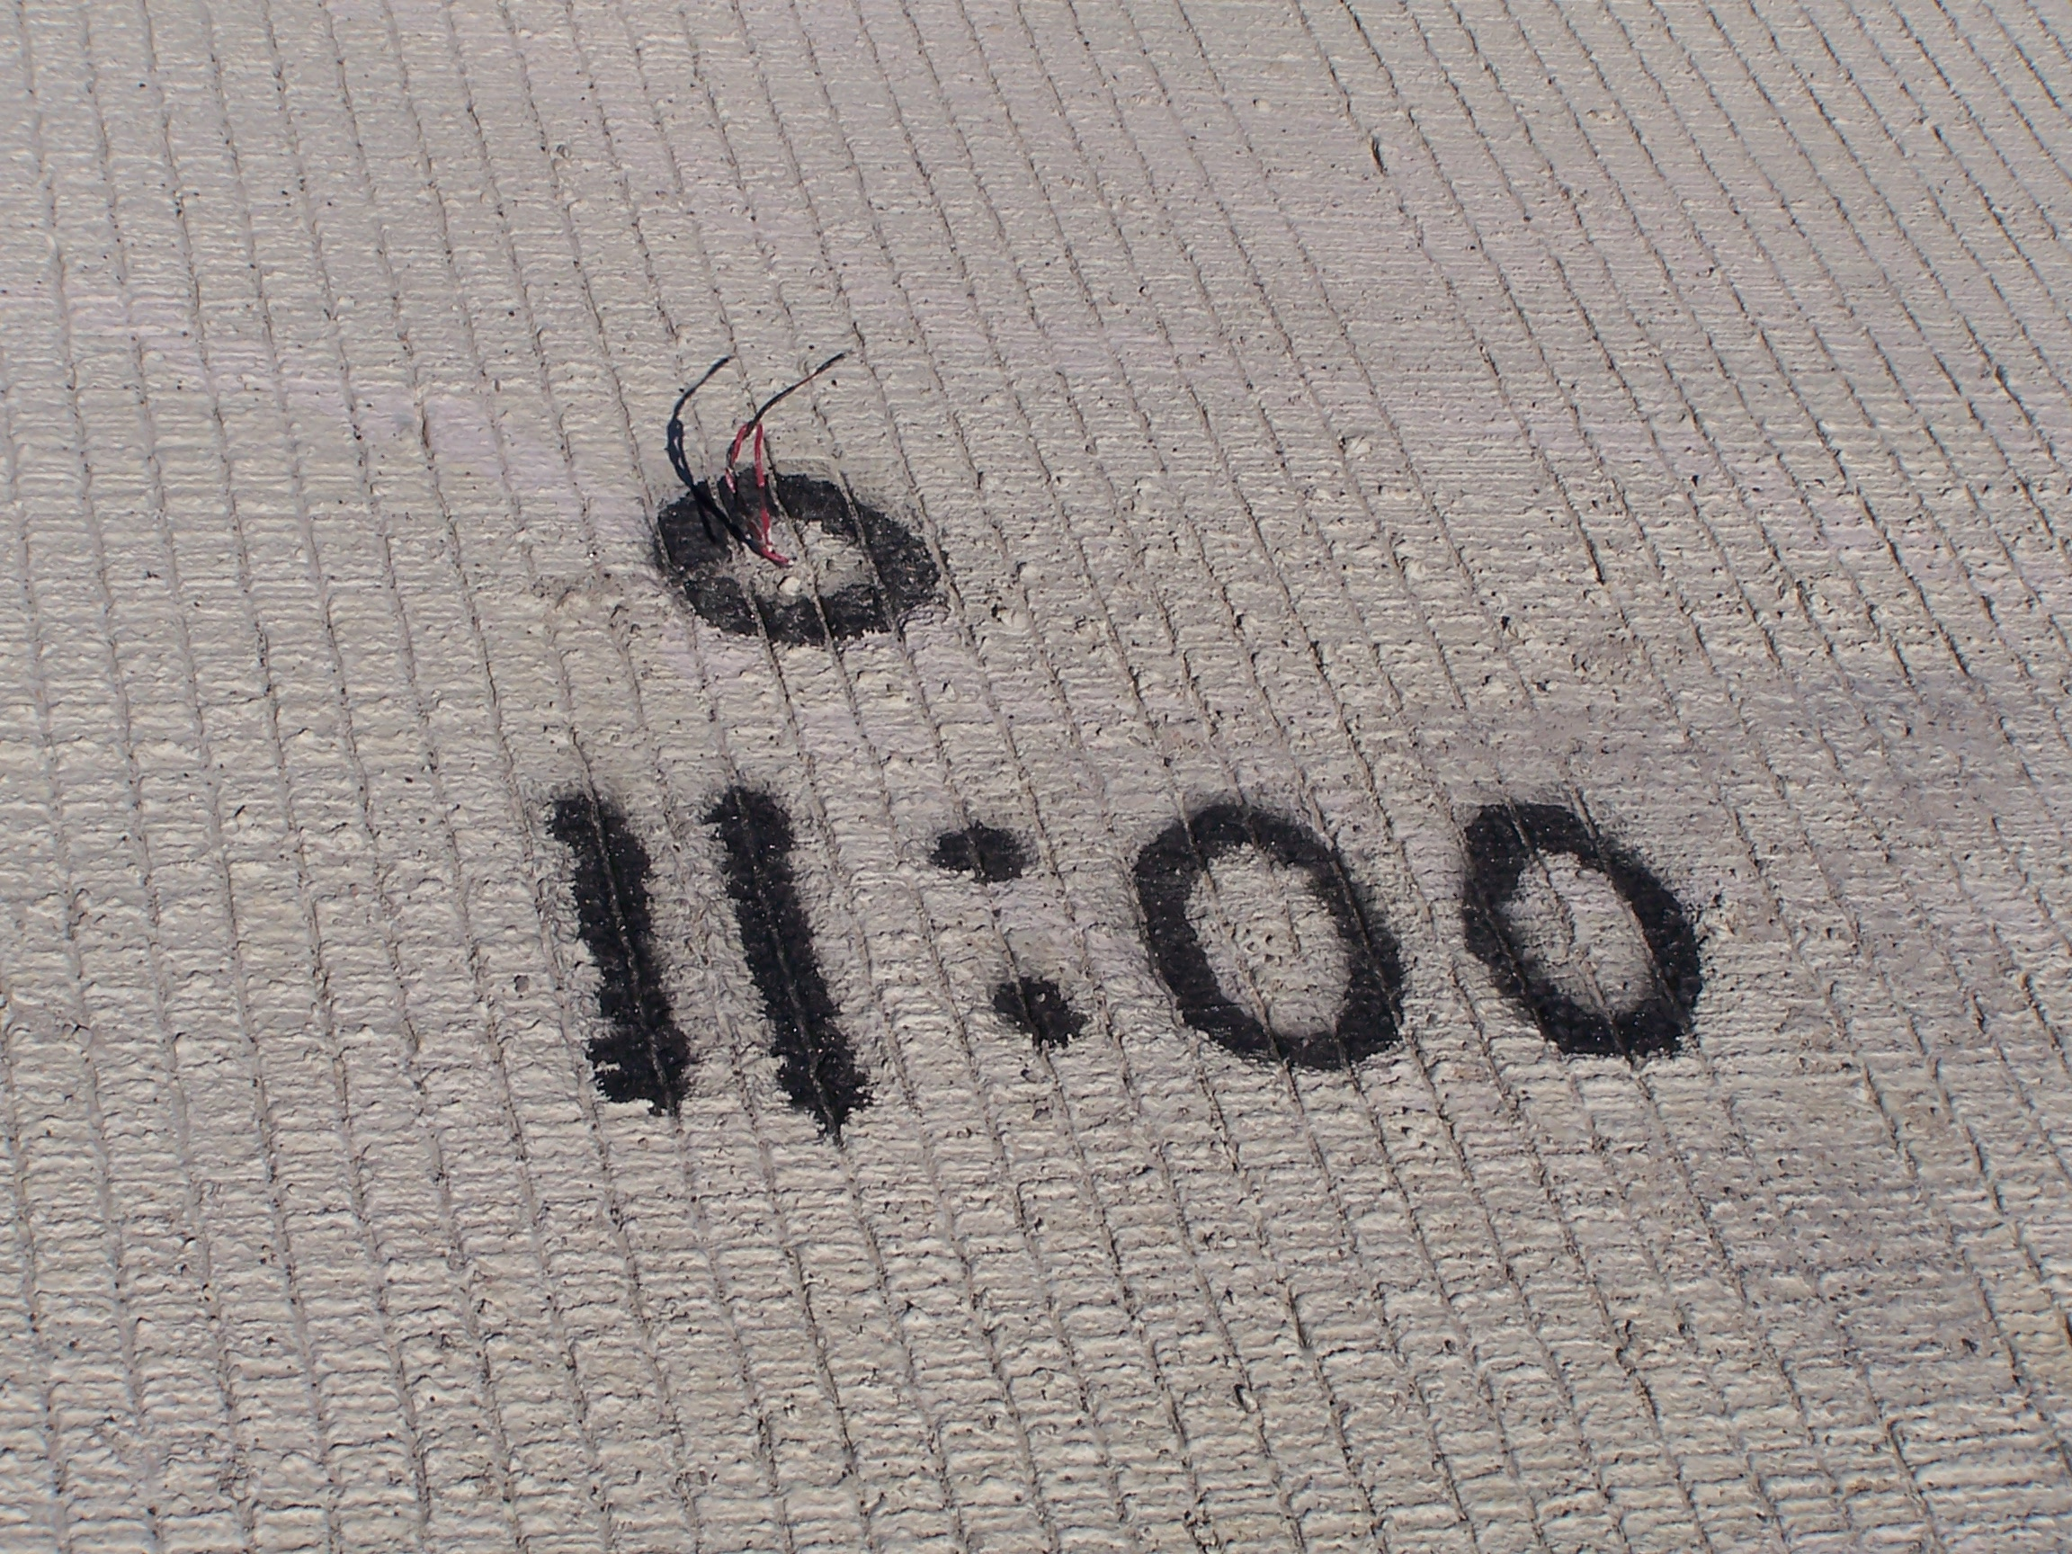

Slide 56
I-button Data Downloading

Slide 57
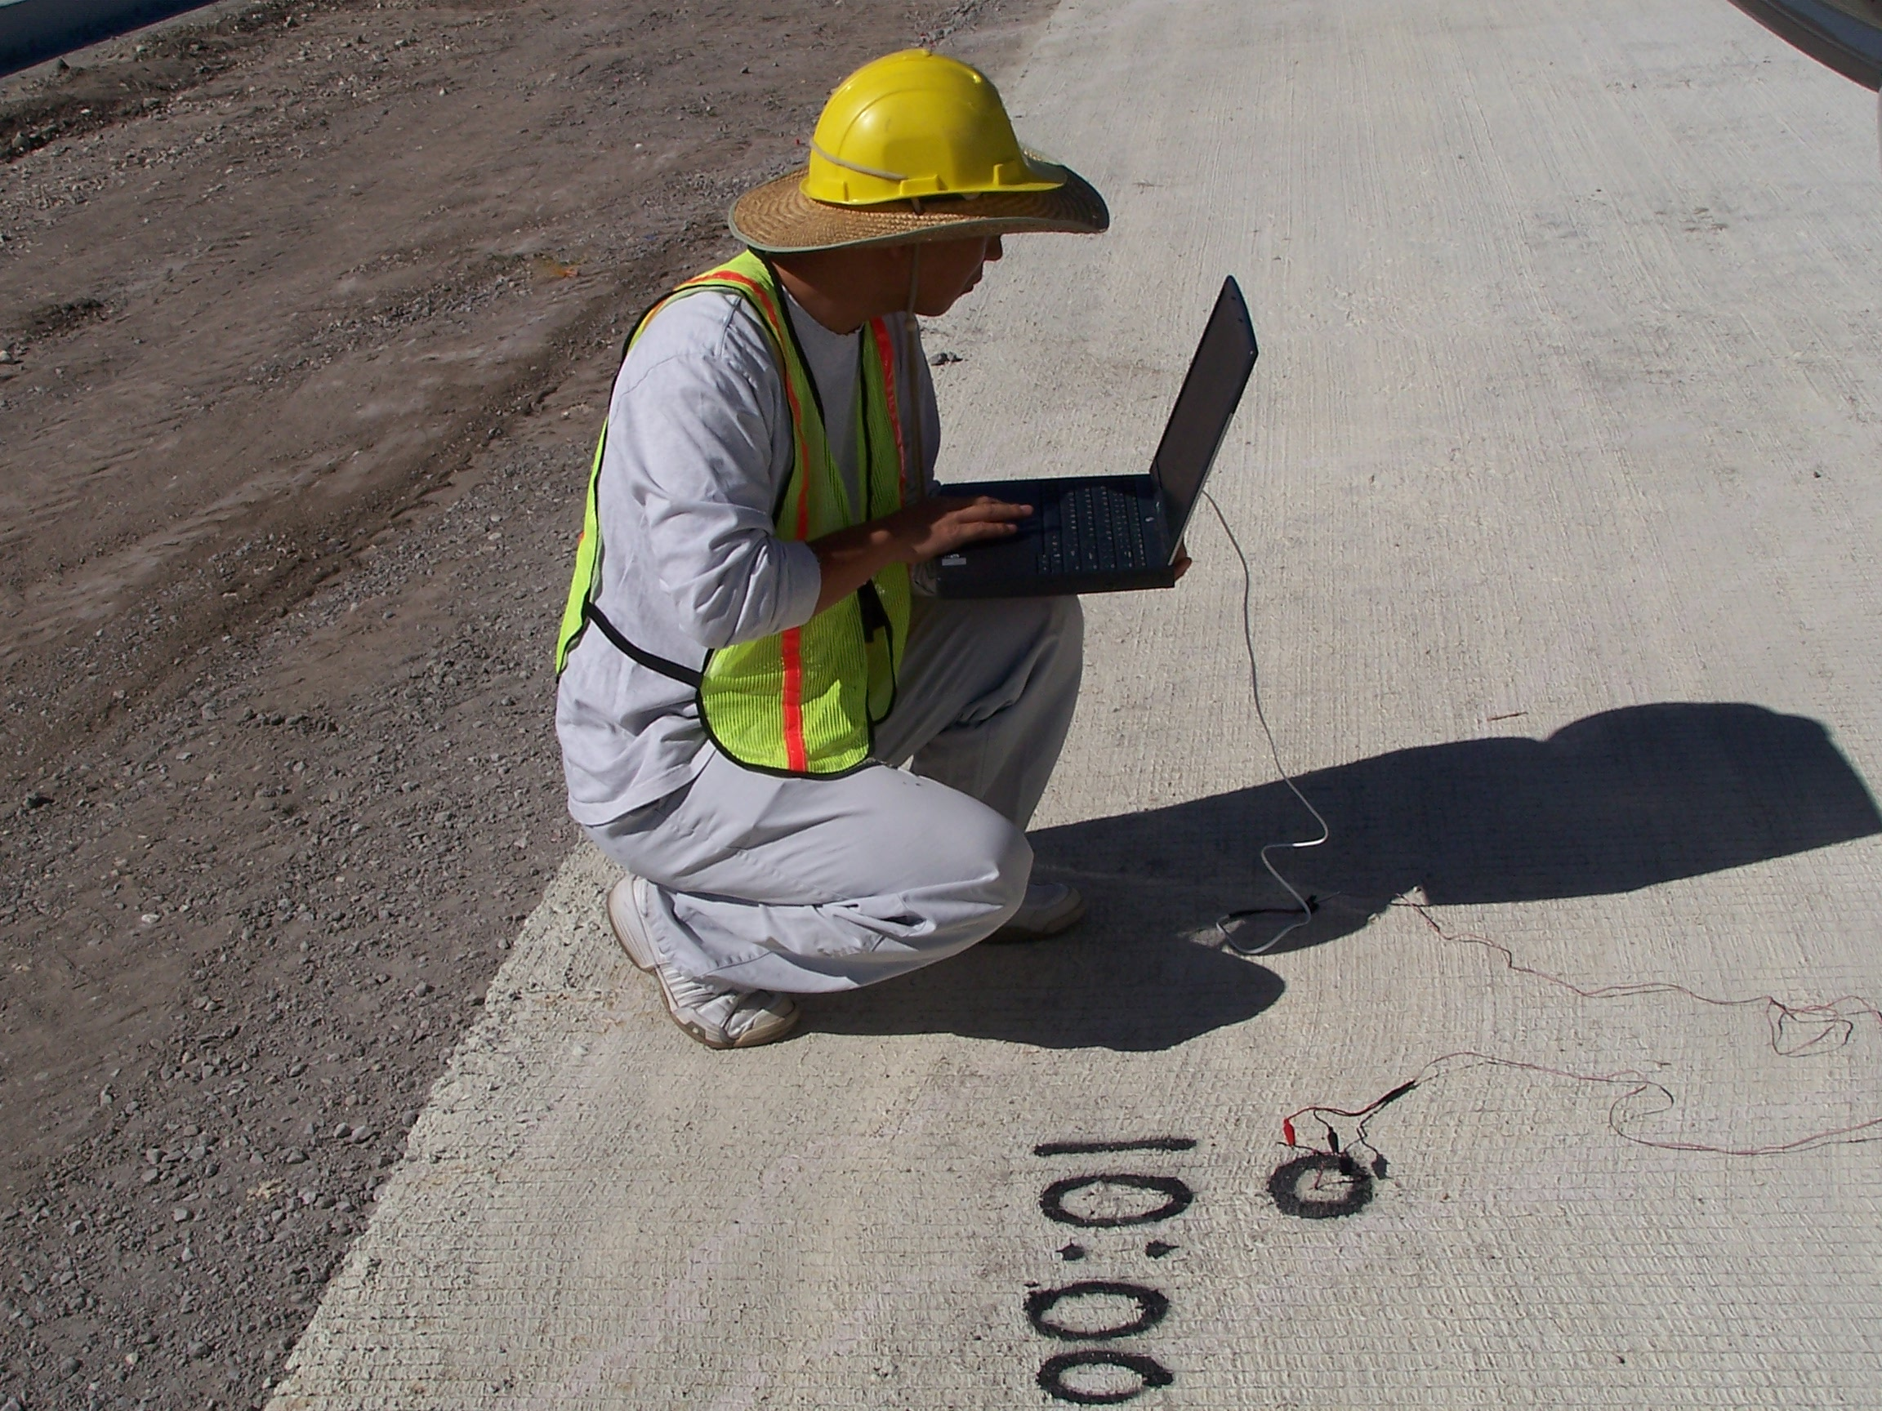

Slide 58
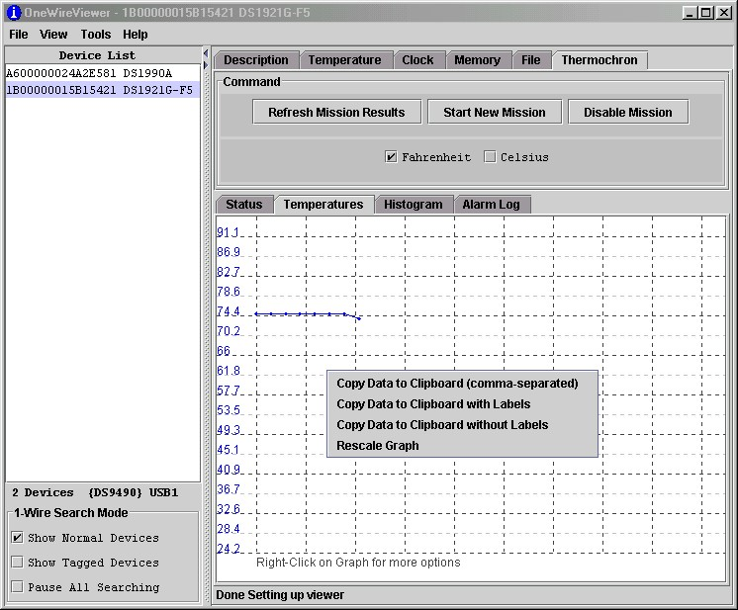

Slide 59
Processing of Downloaded Temperature Data

Slide 60
Processing Downloaded Data
Open the file with Excel

Slide 61
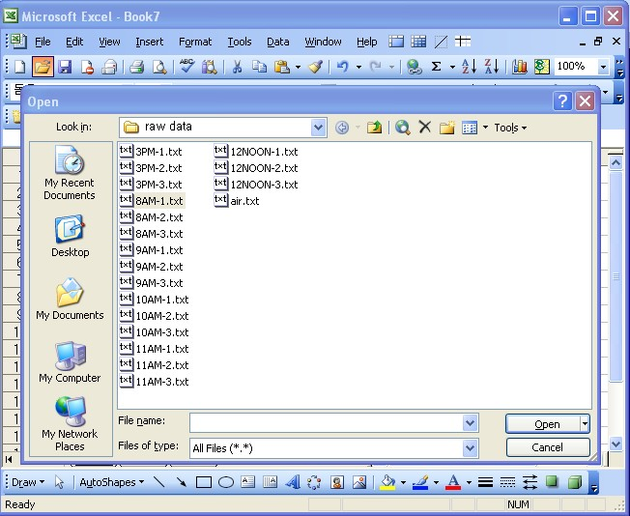

Slide 62
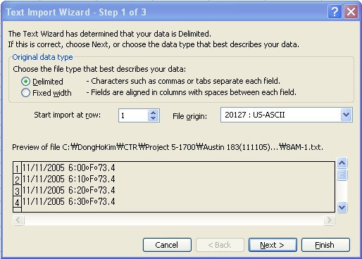

Slide 63
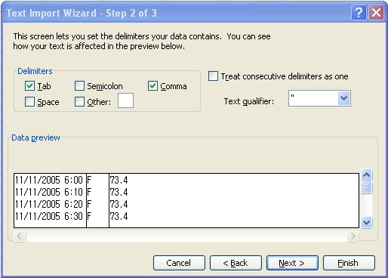

Slide 64
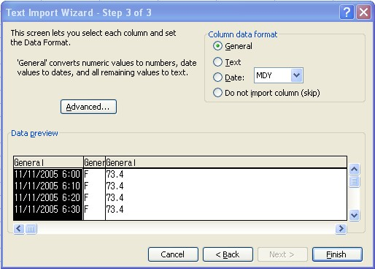

Slide 65
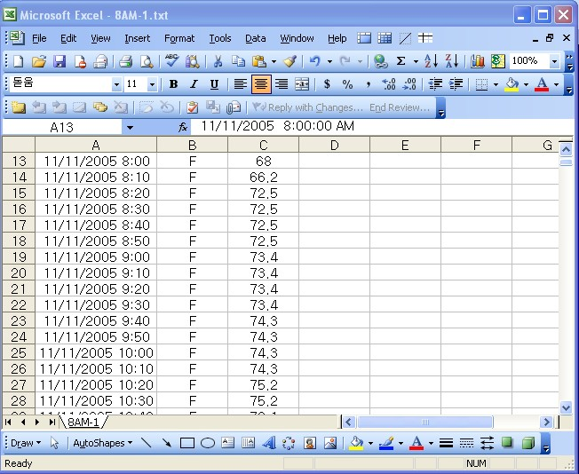

Slide 66
Graphic Presentation of Processed Downloaded Data from US 183 Test Section in Austin

Slide 67
Actual Temperature at the Top

Slide 68
Actual Temperature at the Middle

Slide 69
Actual Temperature at the Bottom

Slide 70
Compliance with Shadow Specifications Requirements
Inspect the maximum concrete temperature within 24 hours of concrete placement.
Inspect the maximum concrete temperature differential within 48 hours of concrete placement.

Slide 71
Future Developments
Pay factors or disincentives for non-compliance
Further enhancement of temperature prediction models
Continued efforts to quantify the effects of concrete temperature on long-term CRCP performance

